Slide 1
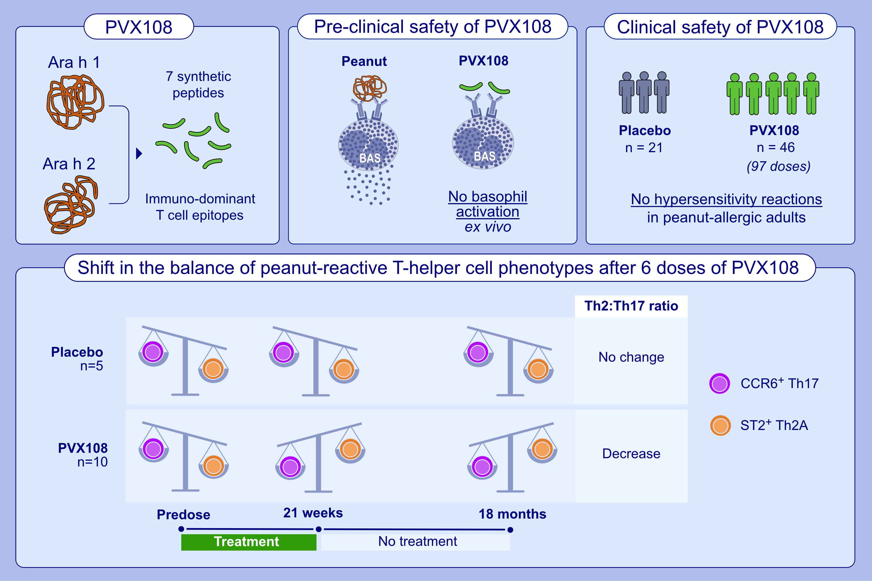
Phase 1 trial supports safety and mechanism of action of peptide immunotherapy for peanut allergy
Astrid L. Voskamp, Sugandhika Khosa, Tracy Phan, Hannah A. DeBerg, et al.
Allergy. 2024; pages: 485-498
https://doi.org/10.1111/all.15966
© 2024 EAACI and John Wiley and Sons A/S. Published by John Wiley and Sons Ltd.
Notes:
HIGHLIGHTS

