Slide 1
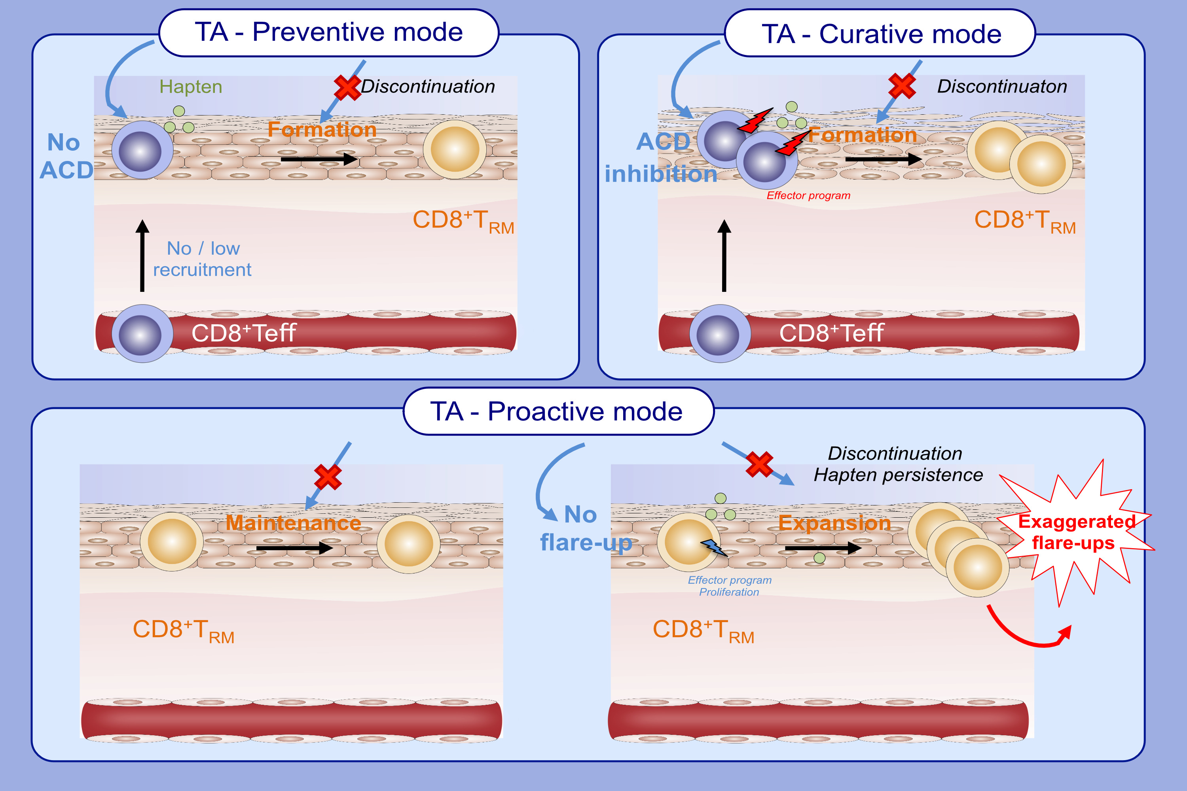
Topical corticosteroids inhibit allergic skin inflammation but are ineffective
in impeding the formation and expansion of resident memory T cells
Emi Ono, Vanina Lenief, Marine-Alexia Lefevre, Roxane Cuzin, Aurélie Guironnet-Paquet, et al.
Allergy. 2024; pages: 52-64
https://doi.org/10.1111/all.15819
© 2019 EAACI and John Wiley and Sons A/S. Published by John Wiley and Sons Ltd.
Notes:
HIGHLIGHTS
In preventive mode, Triamcinolone acetonide (TA) transiently inhibits the infiltration of effector T cells and the accumulation of T_{RM} upon hapten challenge.
In curative mode, TA blocks skin inflammation but it fails to prevent the formation of T_{RM}.
In a proactive mode, TA has no effect on the maintenance of skin T_{RM}, but transiently inhibits their reactivation program upon allergen re-exposure. Specific T_{RM} progressively regain proliferative functions upon TA discontinuation and the persistence of hapten moieties, and expand in the tissue. This leads to exaggerated iterative flare-up reactions.
Abbreviations: ACD, allergic contact dermatitis; CD8⁺Teff: Effector CD8⁺ T cells; CD8⁺T_{RM}, tissue resident memory CD8⁺ T cells

