Slide 1
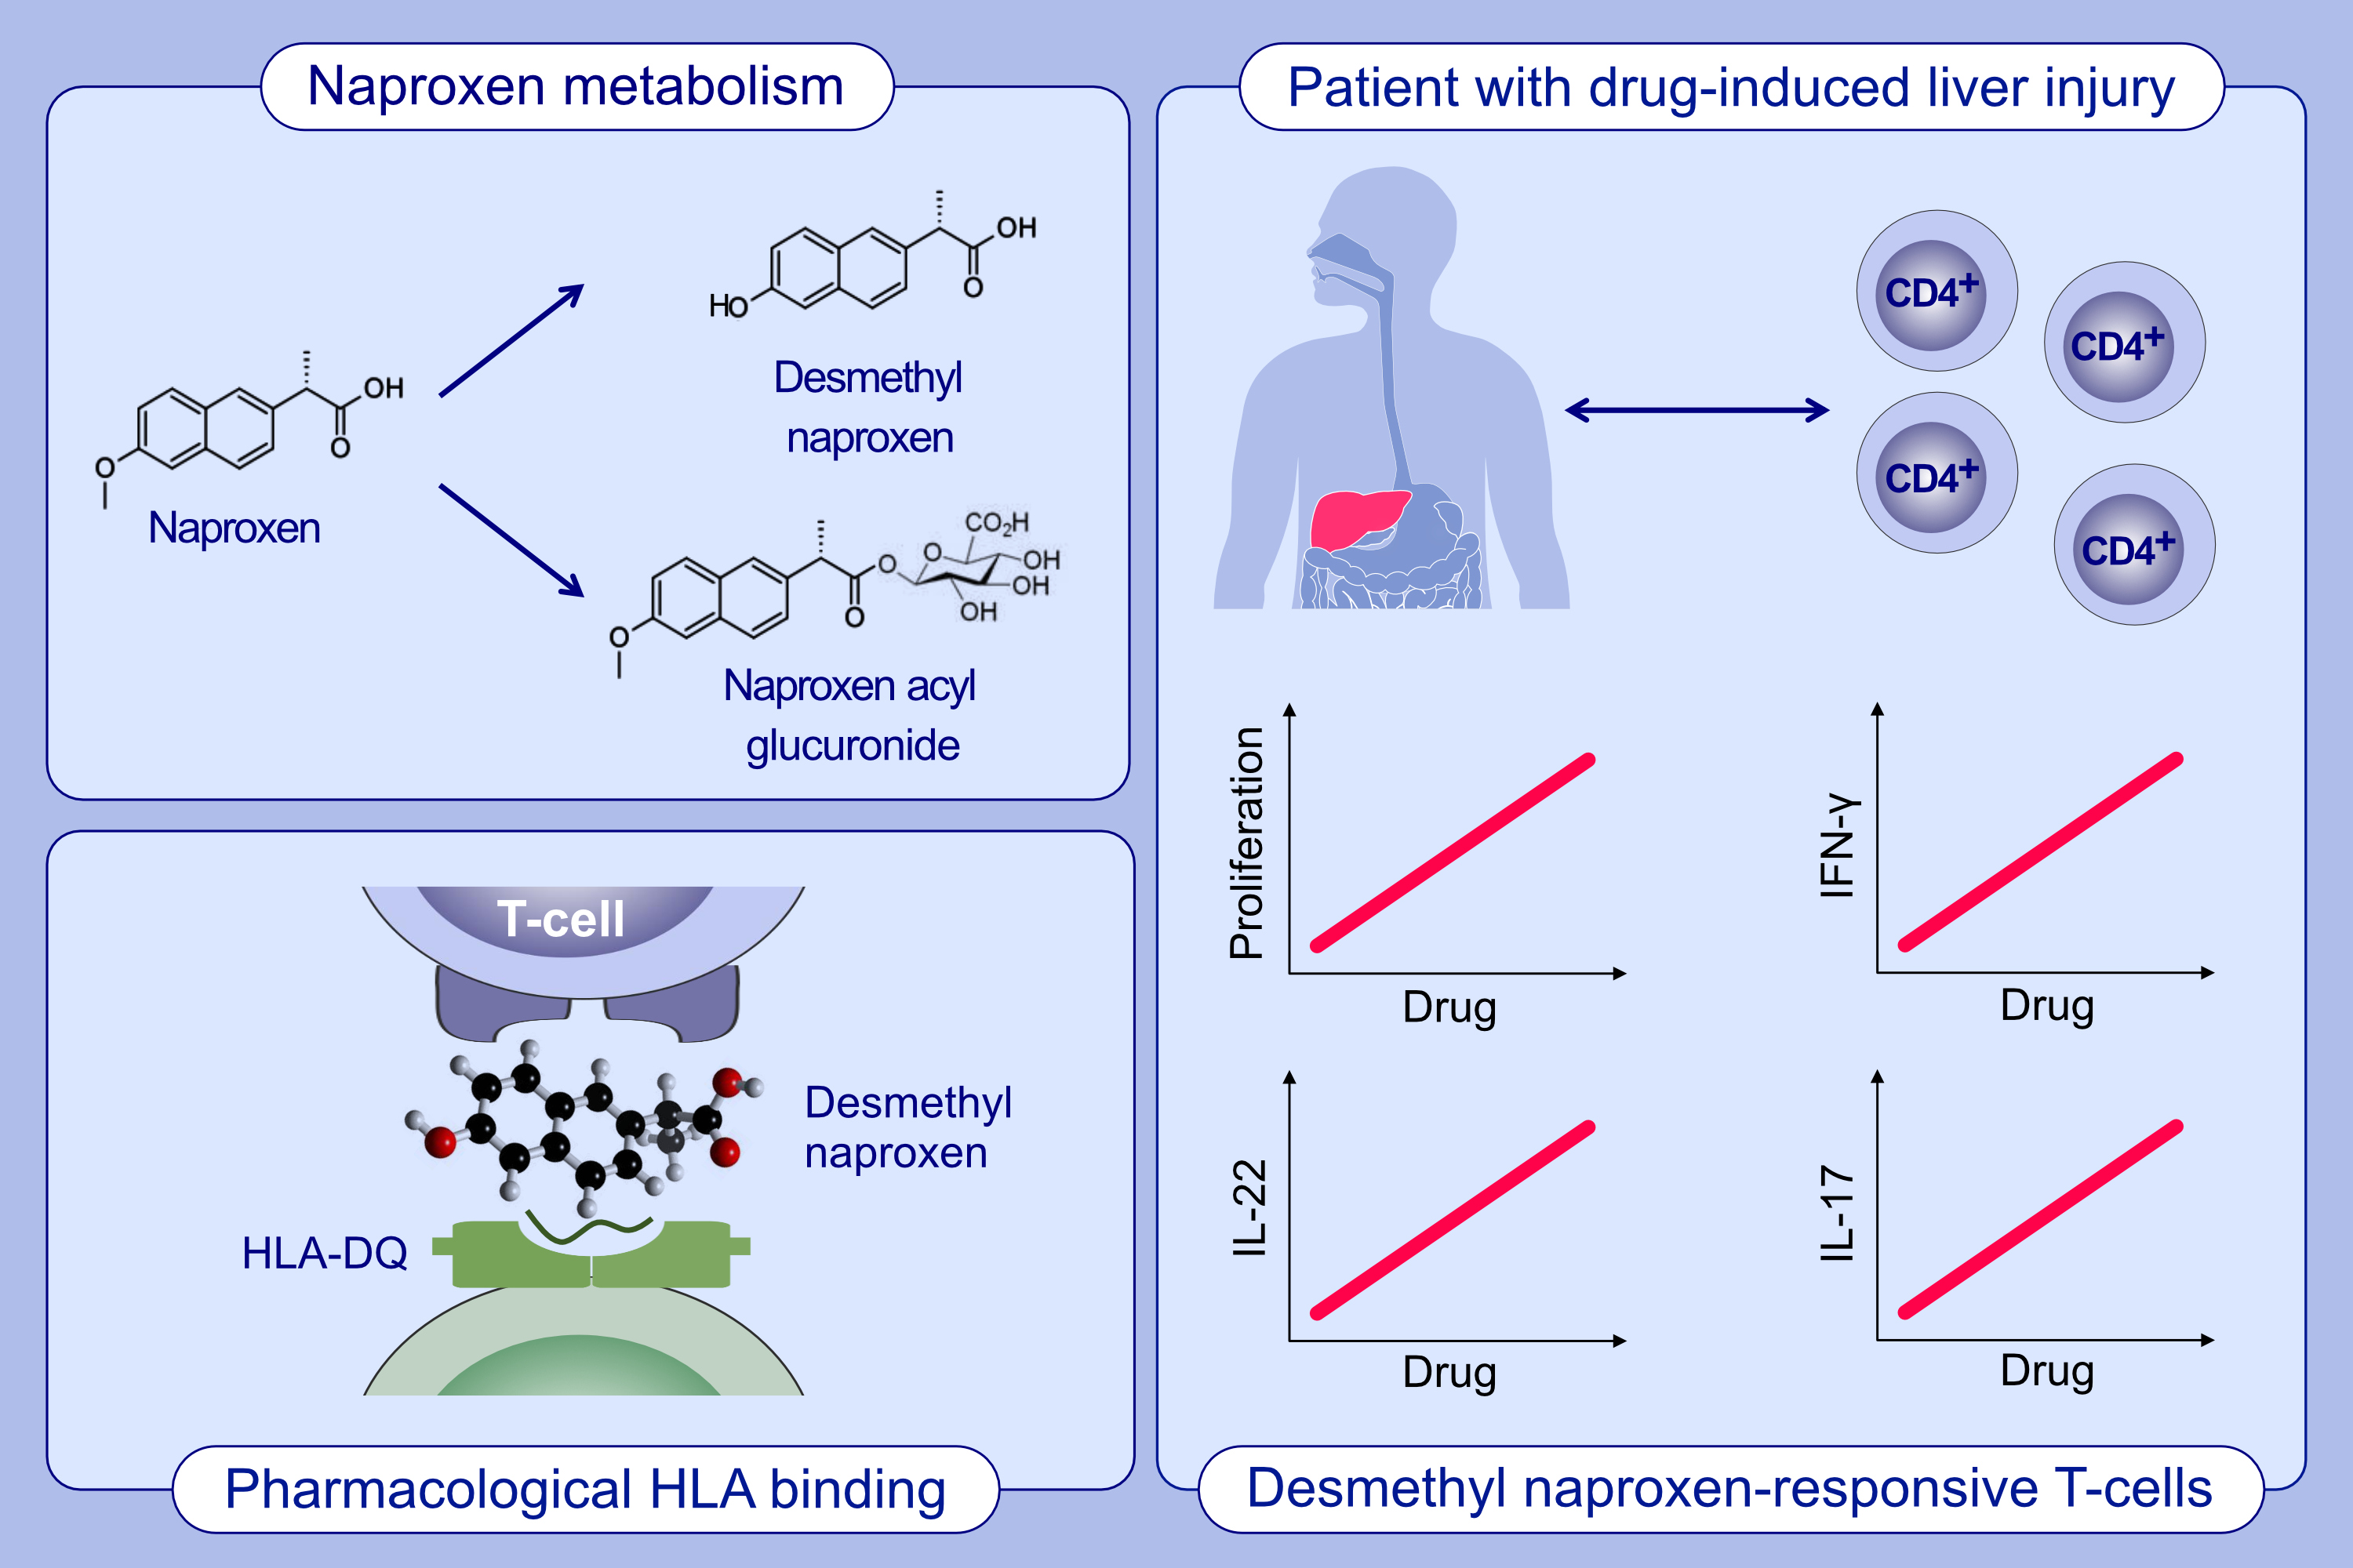
Patients with Naproxen-Induced Liver Injury Display T-cell Memory Responses Towards an Oxidative (S) O-Desmethyl Naproxen Metabolite but not the Acyl Glucuronide
Paul Thomson, Nik Fragkas, Laila M. Kafu, Guruprasad P. Aithal, M. Isabel Lucena, , et al.
Allergy. 2024; pages: 200-214
https://doi.org/10.1111/all.15830
© 2019 EAACI and John Wiley and Sons A/S. Published by John Wiley and Sons Ltd.
Notes:
HIGHLIGHTS
CD4+ and CD8+ T-cell hepatic infiltration is detected in a biopsy from a patient with NSAID-induced liver injury.
The naproxen metabolite, desmethyl naproxen, activates T-cells from patients with naproxen-induced liver injury.
Whilst bioactivation at the carboxylate group is widely hypothesised to be pathogenic for NSAID induced liver injury, we found no evidence of this with naproxen.
Abbreviations: HLA, human leukocyte antigen; IFN, interferon; IL, interleukin; NSAID, non-steroidal anti-inflammatory drug.

