Slide 1
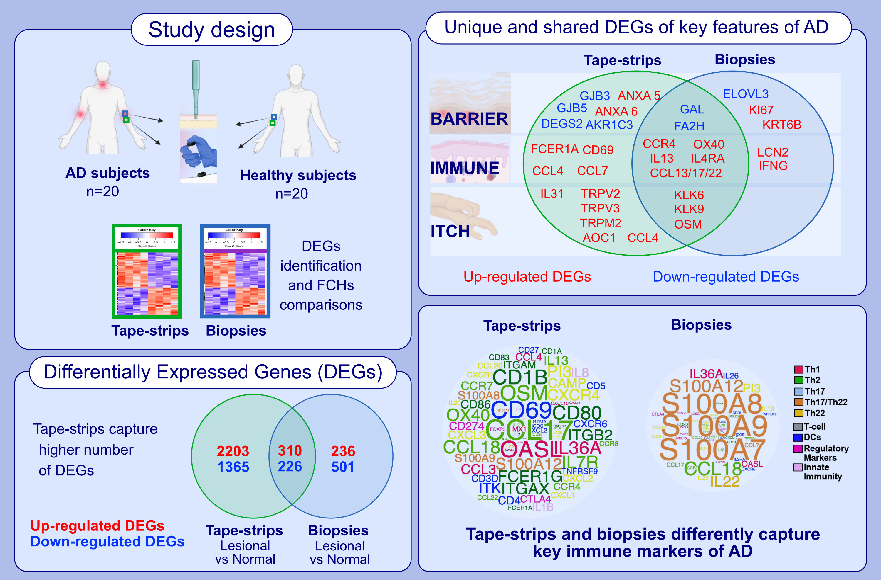
Intra-patient comparison of atopic dermatitis skin transcriptome shows differences between tape-strips and biopsies
Ester Del Duca, Helen He, Ying Liu, Angel D. Pagan, Eden David, et al.
Allergy. 2024; pages: 80-92
https://doi.org/10.1111/all.15845
© 2019 EAACI and John Wiley and Sons A/S. Published by John Wiley and Sons Ltd.
Notes:
HIGHLIGHTS
This study presents a global RNA-seq intra-patient profiling of tape-strips and whole-skin biopsies in moderate-to-severe AD as compared to healthy subjects.
Although both techniques captured dysregulation of key immune genes, tape-strips showed higher FCHs for innate immunity, dendritic cell, Th2, and Th17 products, while biopsies showed higher up-regulation of Th22 associated genes and dermal cytokines.
Itch-related genes were preferentially captured by tape-strips.
Abbreviations: AD, atopic dermatitis; AKR1C3, aldo-keto reductase family 1 member C3; ANXA, annexin; AOC1, amine oxidase copper containing 1; CAMP, cathelicidin antimicrobial peptide; CCL, C-C motif chemokine ligand; CD, cluster of differentiation; CXCR, C-X-C motif chemokine receptor; CTLA4, cytotoxic T-lymphocyte associated protein; DC, dendritic cell; DEGS2, delta 4-desaturase, sphingolipid 2; ELOVL3, ELOVL fatty acid elongase 3; FA2H, fatty acid 2-hydroxylase; FCER1A, Fc epsilon receptor 1A; FCH, fold chanage; FOXP3, forkhead box P3; GAL, galanin; GJPB, gap junction protein beta; GZMA, granzyme A; IL, interleukin; IL4RA, interleukin-4 receptor alpha chain; IFNG, interferon gamma; ITG, integrin; ITK, IL-2 inducible T cell kinase; KI67, marker of proliferation Ki-67; KLK, kallikrein related peptidase; KRT6B, keratin 6B; LCN2, lipocalin 2; MX1, MX dynamin like GTPase 1; OASL, 2'-5'-oligoadenylate synthetase like; OSM, oncostatin M; PI3, peptidase inhibitor 3; OX40, TNF receptor superfamily member 4; S100A, S100 calcium binding protein A­; TRPM/V, transient receptor potential cation channel subfamily M/V member; XCL2, X-C motif chemokine ligand 2

