Slide 1
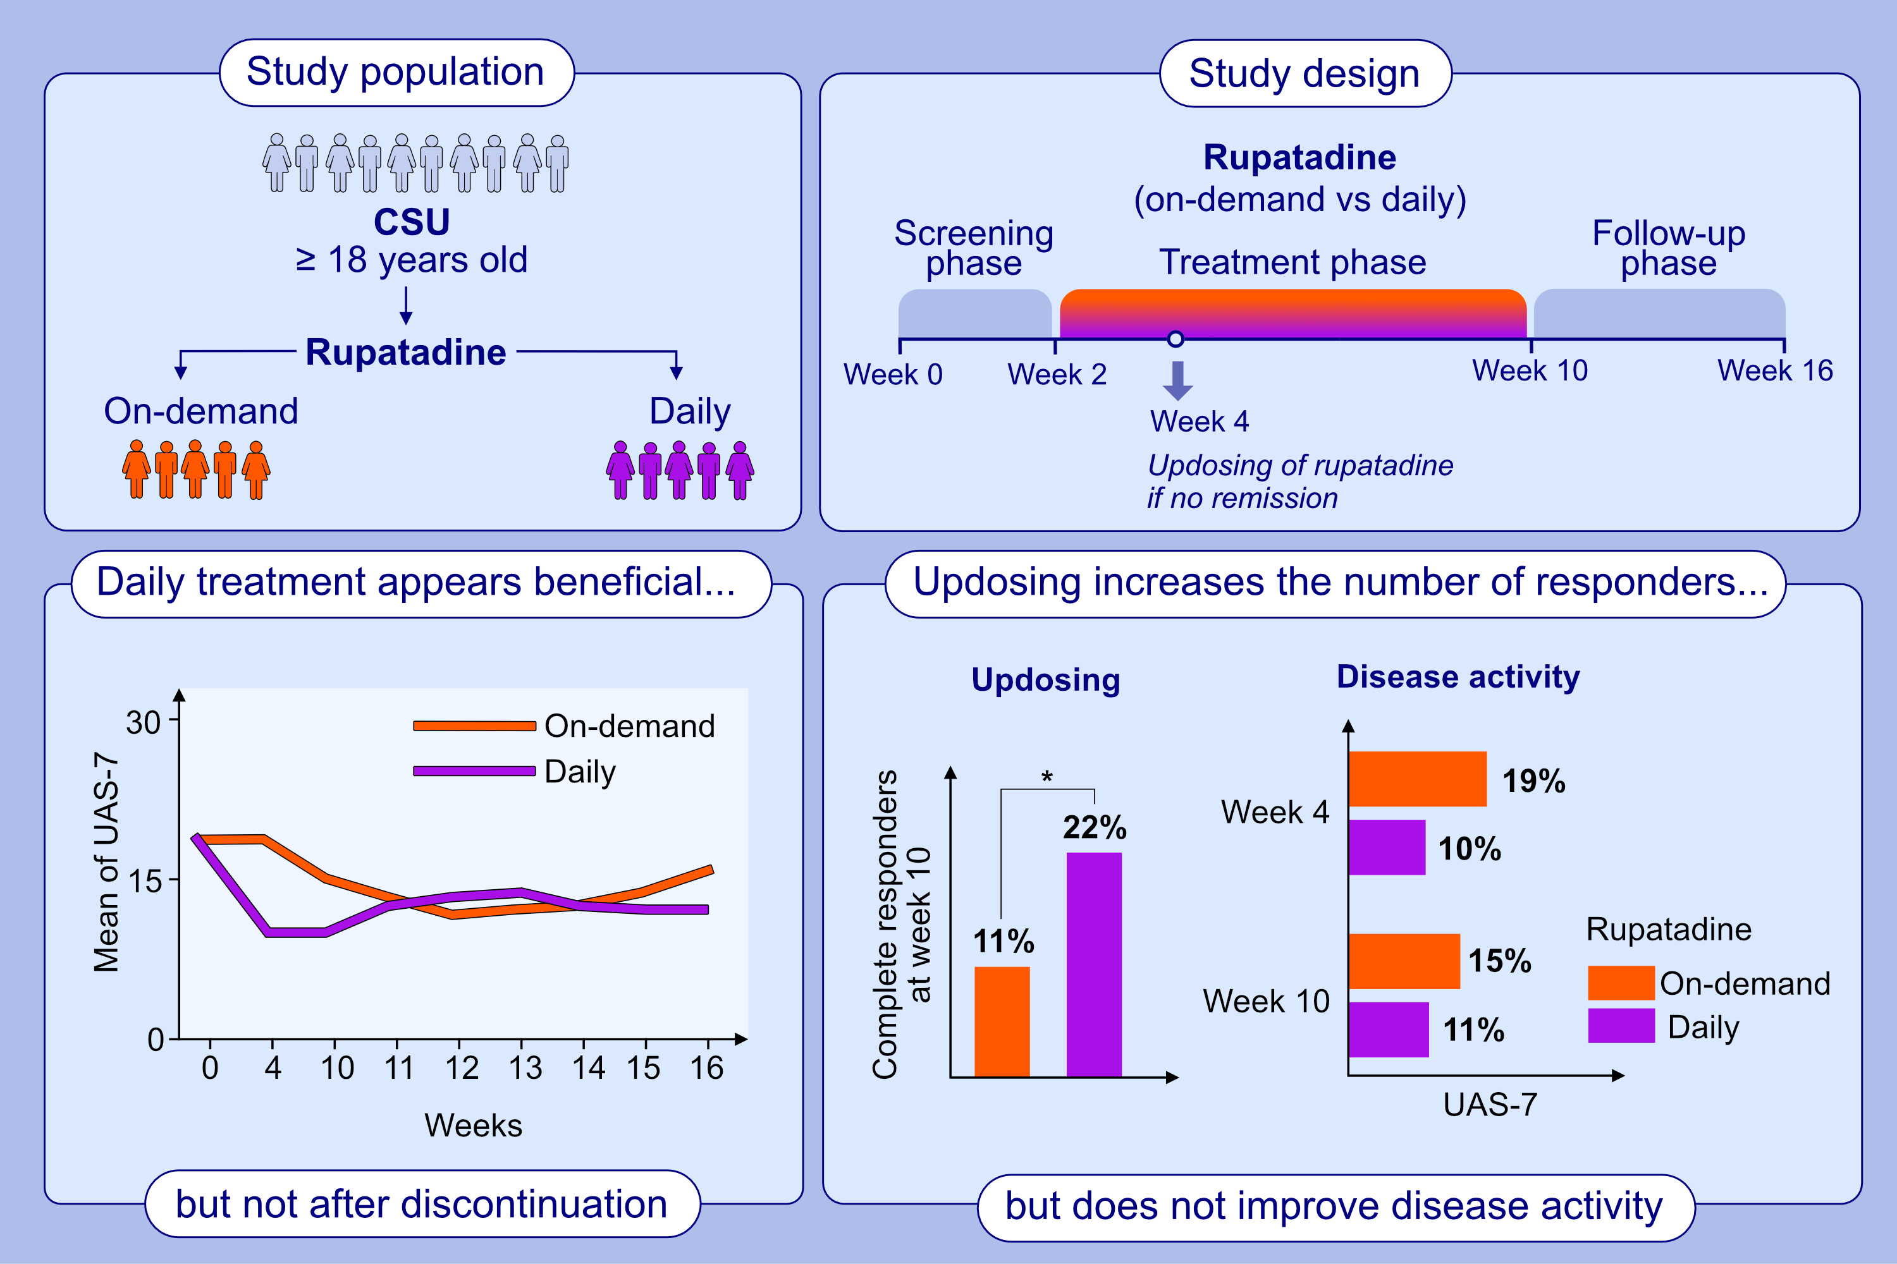
Efficacy and safety of on-demand versus daily rupatadine in chronic spontaneous urticaria: a randomized trial
Karsten Weller, Ana Maria Gimenez-Arnau, Jens Baron, Randolf Brehler, Marta Ferrer ,et al.
Allergy. 2024; pages: 93-103
https://doi.org/10.1111/all.15854
© 2019 EAACI and John Wiley and Sons A/S. Published by John Wiley and Sons Ltd.
Notes:
HIGHLIGHTS
This study assessed the longer-term potential disease-modifying effects of rupatadine, evaluated the effects of updosing, and compared daily vs. OD treatment in patients with CSU.
Daily rupatadine treatment significantly improved CSU disease activity and QoL during treatment vs. OD treatment but not after discontinuation of rupatadine.
Updosing rupatadine from 10 mg to 20 mg increased the number of complete responders but did not improve the overall disease activity.
Abbreviations: CSU, chronic spontaneous urticaria; OD, on-demand; QoL, quality of life; vs., versus.

