Slide 1
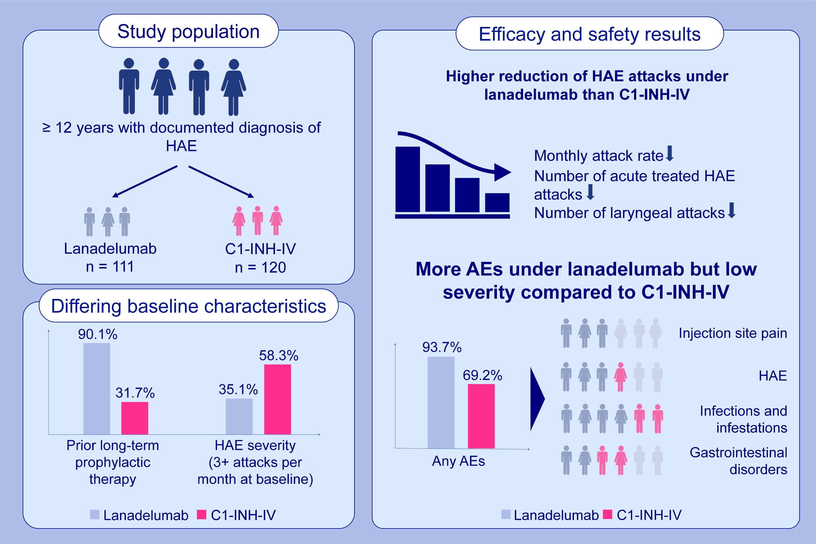
Patient-level indirect treatment comparison of lanadelumab vs. C1-INH-IV in hereditary angioedema patients: PATCH study
Markus Magerl, Guido Schiffhorst, Lena Fanter, Gerrit Müller, Christoph Hirche, et al.
Allergy. 2024; pages.215-224
https://doi.org/10.1111/all.15861
© 2019 EAACI and John Wiley and Sons A/S. Published by John Wiley and Sons Ltd.
Notes:
HIGHLIGHTS
Indirect treatment comparison of lanadelumab and C1-INH-IV according to IQWiG methodology was performed based on patient-level data from pivotal trials HELP and CHANGE.
Both drugs demonstrated a significant reduction of disease burden after adjusting for confounding variables, i.e. reduction of monthly HAE attacks.
Efficacy results suggest a more favorable efficacy of lanadelumab over C1-INH-IV in long-term prophylactic treatment of HAE.
Abbreviations: AE, adverse events; C1-INH-IV, intravenous C1-esterase inhibitor; HAE, hereditary angioedema; IQWIG, institute for Quality and Efficiency in Health Care (Institut für Qualität und Wirtschaftlichkeit im Gesundheitswesen)

