Slide 1
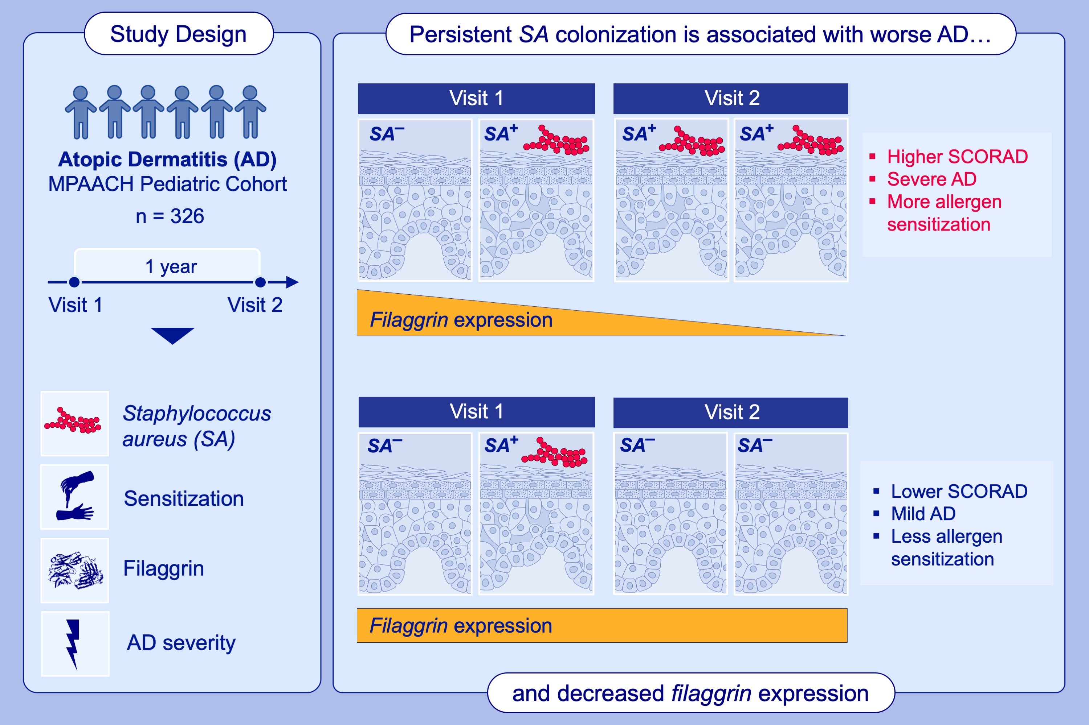
Temporal relationships between Staphylococcus aureus colonization, filaggrin expression, and pediatric atopic dermatitis
Arya Dahal, Wan Chi Chang, Cassandra Almasri, Elisabet Johansson, Makenna Hurd,,et al.
Allergy. 2024; pages:104-115
https://doi.org/10.1111/all.15871
© 2019 EAACI and John Wiley and Sons A/S. Published by John Wiley and Sons Ltd.
Notes:
HIGHLIGHTS
We assessed S. aureus skin colonization and AD outcomes across two annual visitsin the MPAACH cohort.
Persistent S. aureus colonization is characterized by increased severity, allergic sensitization, and decreasing never-lesional filaggrin expression.
Low never-lesional filaggrin expression positively mediates future S.aureus colonization. Maintaining filaggrin expression may be therapeutically important to halt colonization and worse AD outcomes.
Abbreviations: AD, atopic dermatitis; MPAACH, Mechanisms of Progression of Atopic Dermatitis to Asthma in Children; SA, Staphylococcus aureus; SCORAD, SCORing Atopic Dermatitis

