Slide 1
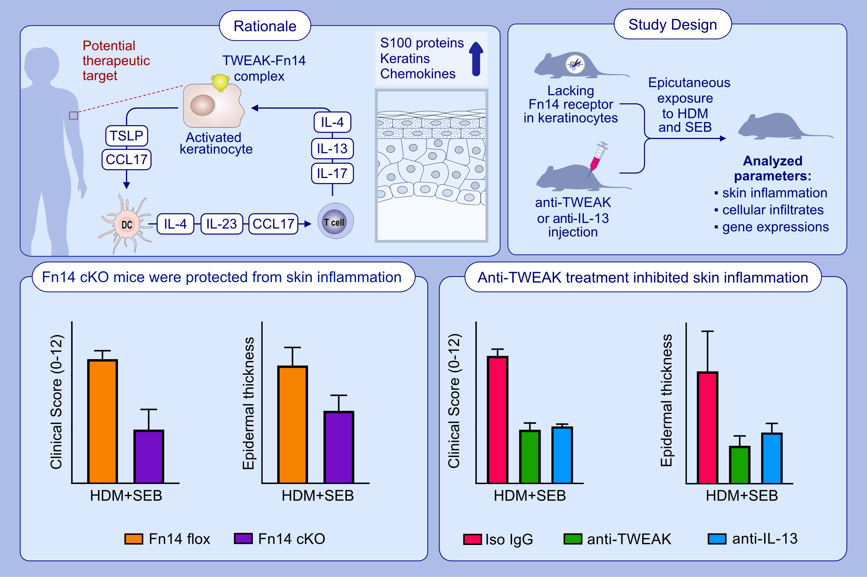
TWEAK inhibition is comparable to IL-13 blockade in ameliorating atopic dermatitis inflammation
Rinkesh K. Gupta, Jacqueline Miller, Michael Croft
Allergy. 2024; pages: 116-127
https://doi.org/10.1111/all.15879
© 2019 EAACI and John Wiley and Sons A/S. Published by John Wiley and Sons Ltd.
Notes:
HIGHLIGHTS
Mice that specifically lack Fn14, the receptor for TWEAK, in keratinocytes are protected from severe skin inflammation in a model of atopic dermatitis.
Keratinocytes are the primary target cells for the pathogenic activity of TWEAK.
Therapeutic antibody blocking of TWEAK is equally efficacious in reducing AD-like skin disease in mice as blockade of IL-13.
Abbreviations: AD, atopic dermatitis; cKO, conditional knock out mice; Fn14, fibroblast growth factor-inducible 14; HDM, house dust mite; Iso, isotype; SEB, staphylococcal enterotoxin B, TWEAK, TNF-like weak inducer of apoptosis.

