Slide 1
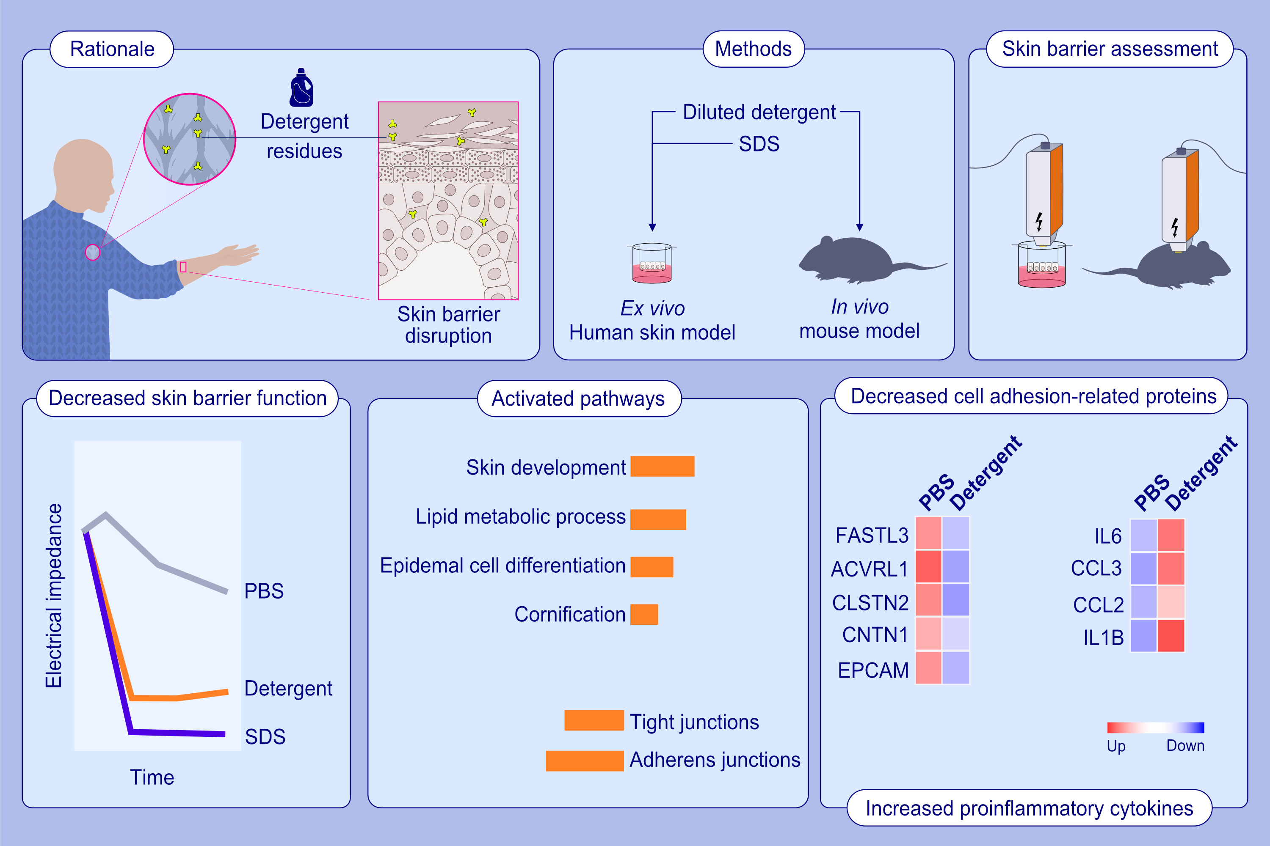
Household laundry detergents disrupt barrier integrity and induce inflammation in mouse and human skin
Arturo O. Rinaldi, Manru Li, Elena Barletta, Paolo D'Avino, Duygu Yazici, ,et al.
Allergy. 2024; pages:128-141
https://doi.org/10.1111/all.15891
© 2019 EAACI and John Wiley and Sons A/S. Published by John Wiley and Sons Ltd.
Notes:
HIGHLIGHTS
Household laundry detergents led to reduced electrical impedance, indicating impaired skin barrier.
RNA-seq and targeted multiplex protein analyses in skin biopsy demonstrated that laundry detergents disrupted several major pathways involved in the skin barrier and induced inflammation.
Laundry detergents and SDS caused barrier damage in ex-vivo human skin.
Abbreviations: ACVRL1, activin A receptor like type; CCL, C-C motif chemokine ligand; CLSTN2, calsyntenin-2; CNTN1, contactin-1; EPCAM, epithelial cell adhesion molecule; FASTL3, follistatin-related protein 3; IL1B, interleukin 1 beta; IL6, interleukin 6; PBS, phosphate-buffered saline; RNA-seq, RNA sequencing; SDS, sodium dodecyl sulfate.

