Slide 1
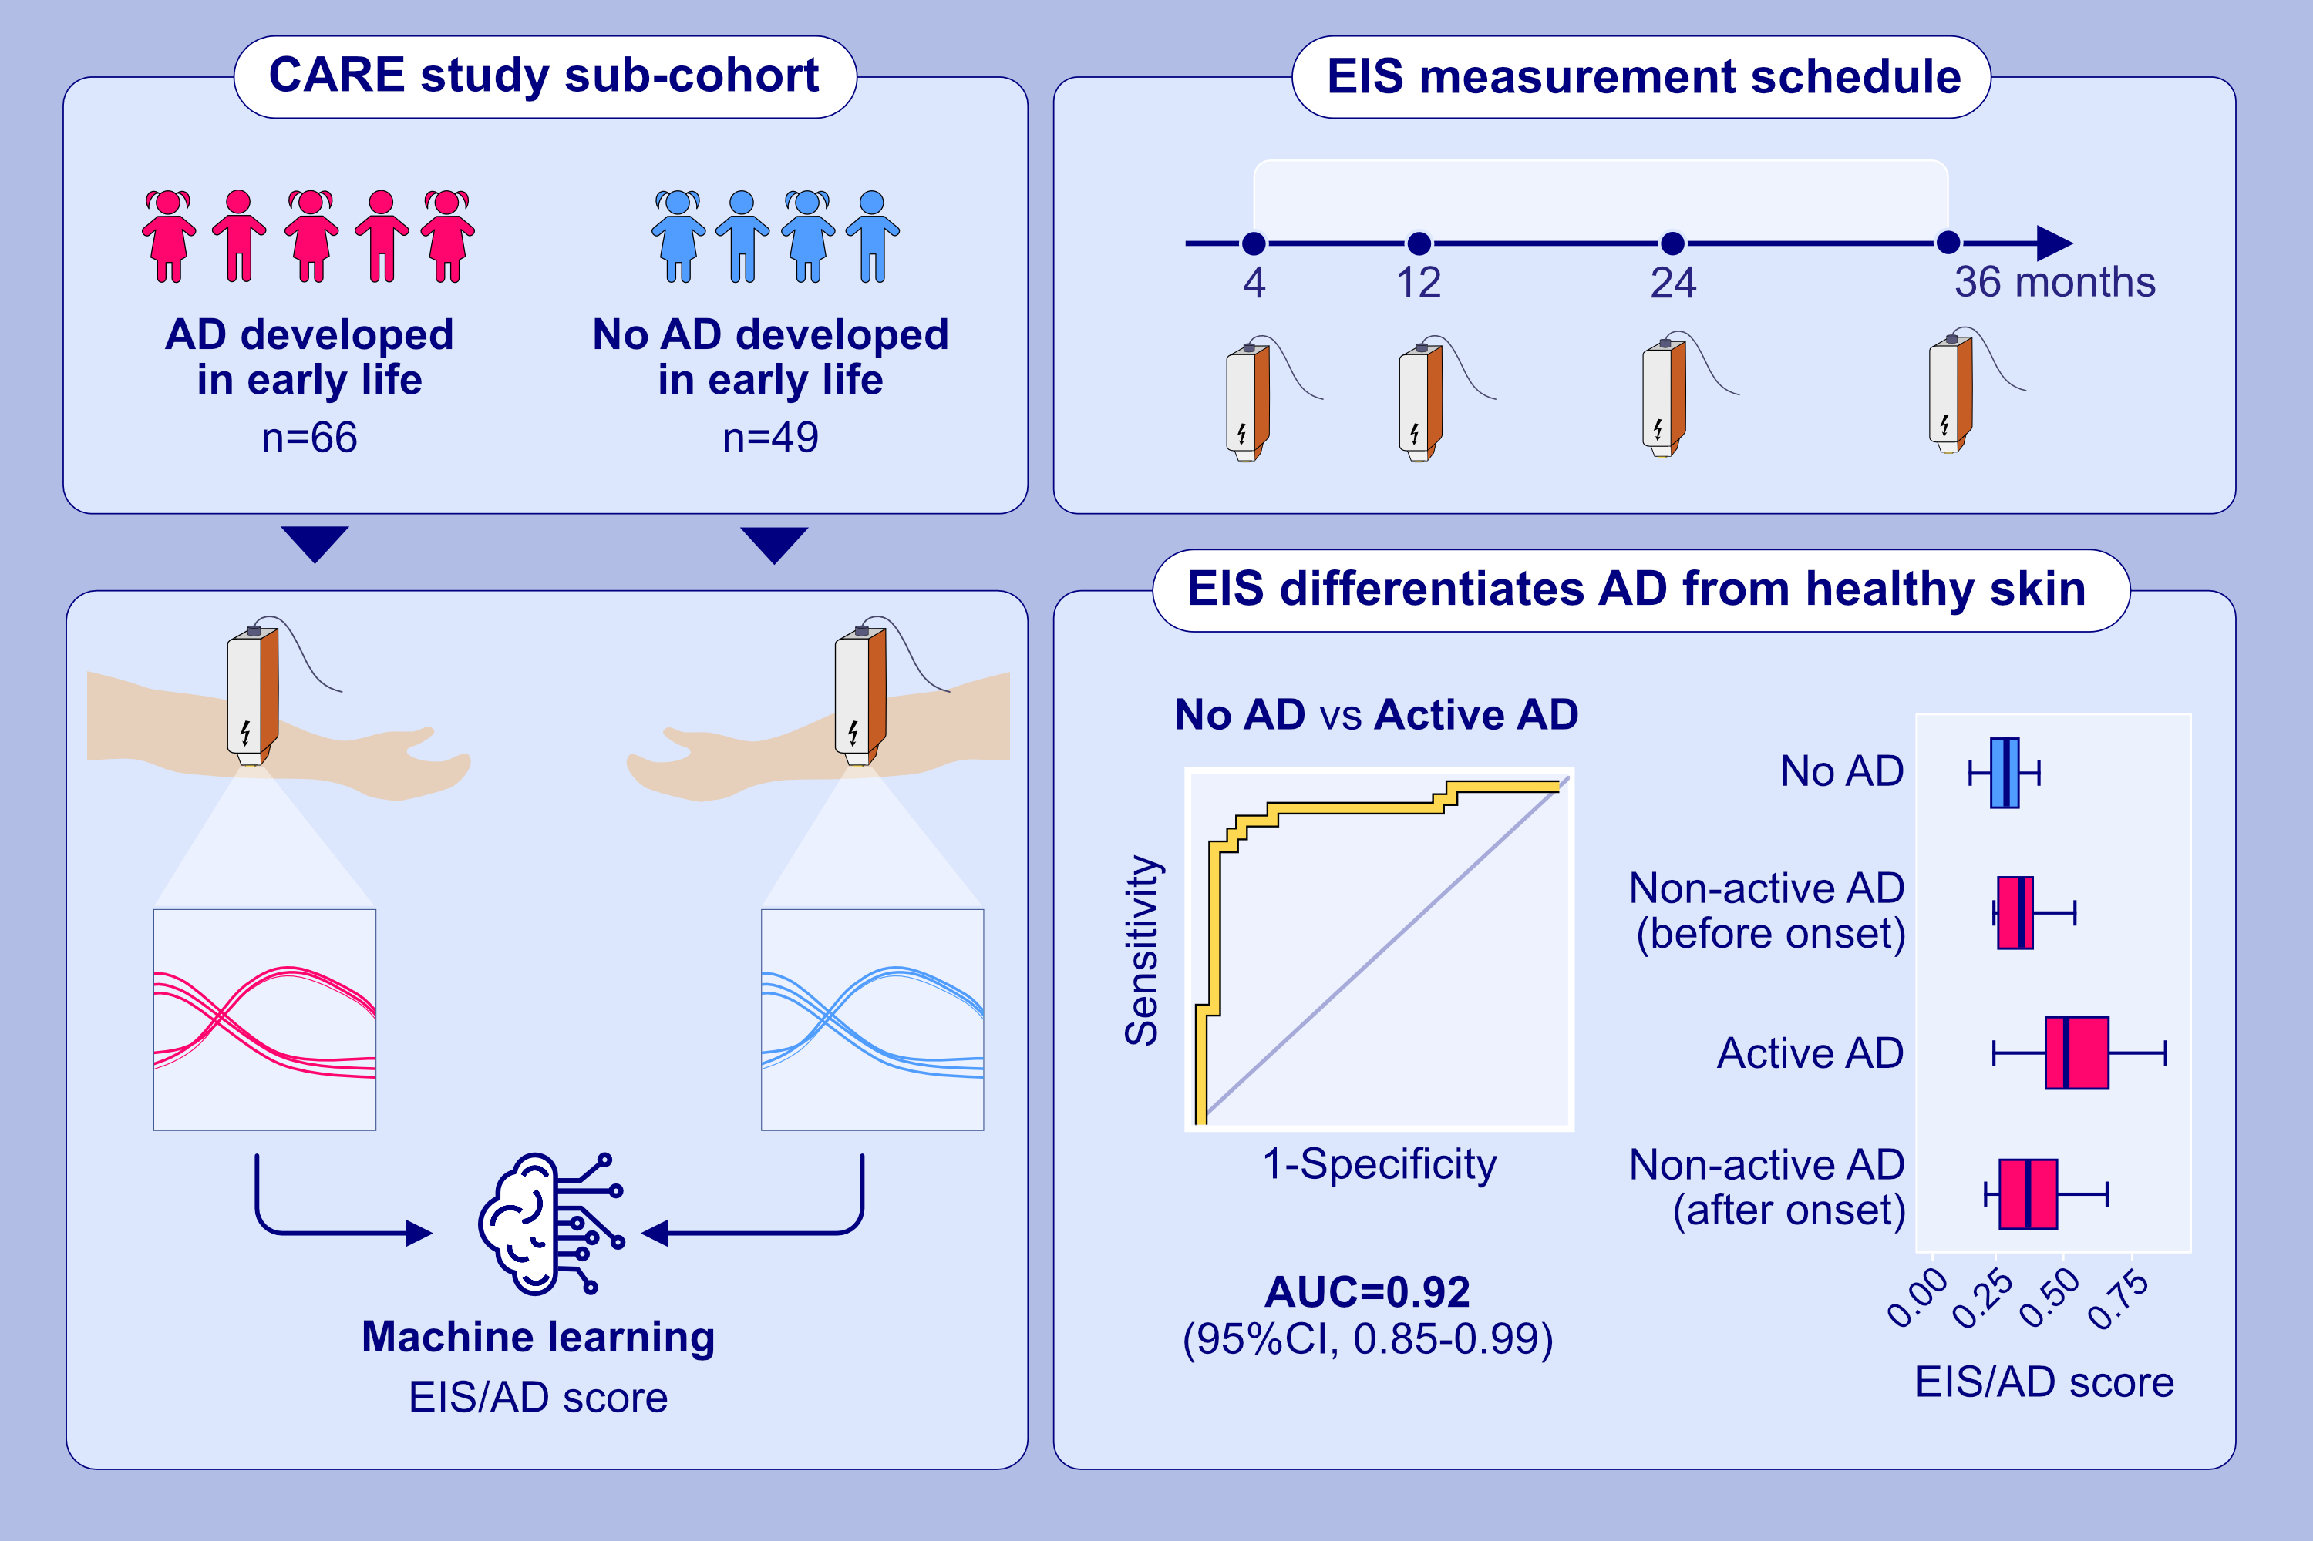
Electrical impedance spectroscopy detects skin barrier dysfunction in childhood atopic dermatitis
Mari Sasaki, Mathilda Sundberg, Remo Frei, Ruth Ferstl, Kristina N. Heye, ,et al.
Allergy. 2024; pages:142-152
https://doi.org/10.1111/all.15895
© 2019 EAACI and John Wiley and Sons A/S. Published by John Wiley and Sons Ltd.
Notes:
HIGHLIGHTS
This study investigates the use of electrical impedance spectroscopy to detect skin barrier dysfunction in children with AD of the CARE cohort.
Based on the EIS/AD score, EIS algorithm is able to clearly differentiate healthy skin and clinically unaffected skin of 4 months to 3-year-old children with active AD.
EIS/AD score is also different between healthy skin, skin of children with non-active AD (before onset or after onset of AD but without active symptoms) and active AD.
Abbreviations: AD, atopic dermatitis; AUC, area under the curve; CARE, Childhood AlleRgy, nutrition and Environment; CI, confidence interval; EIS, electrical impedance spectroscopy; EIS/AD score, the score given by the machine learning algorithm that reflects the probability that a given EIS measurement is from a child with active AD.

