Slide 1
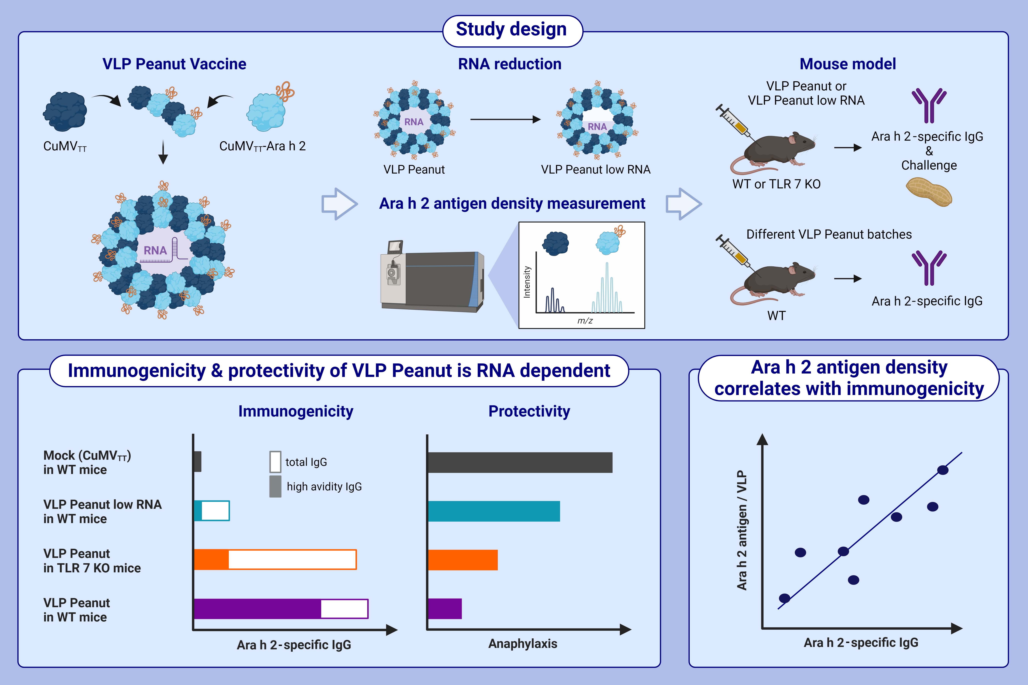
Influence of antigen density and TLR ligands on preclinical efficacy
of a VLP-based vaccine against peanut allergy
Pascal S. Krenger, Romano Josi, Jan Sobczak, Thalia L. C. Velazquez, Ina Balke, ,et al.
Allergy. 2024; pages:184-199
https://doi.org/10.1111/all.15897
© 2019 EAACI and John Wiley and Sons A/S. Published by John Wiley and Sons Ltd.
Notes:
HIGHLIGHTS
VLP Peanut is a novel immunotherapeutic vaccine candidate for the treatment of peanut allergy.
Encapsulated prokaryotic RNA is a key contributor to the immunogenicity and protective capacity of the VLP Peanut vaccine.
Antigen density of Ara h 2 on the particle surface positively correlates with the immunogenicity of the VLP Peanut vaccine.
Abbreviaitons: CuMV, cucumber mosaic virus; IgG, immunoglobulin G; KO, knock out; RNA, ribonucleic acid; TLR, toll-like receptor; TT, tetanus toxin epitope; VLP, virus-like particle; WT, wild type.

