Slide 1
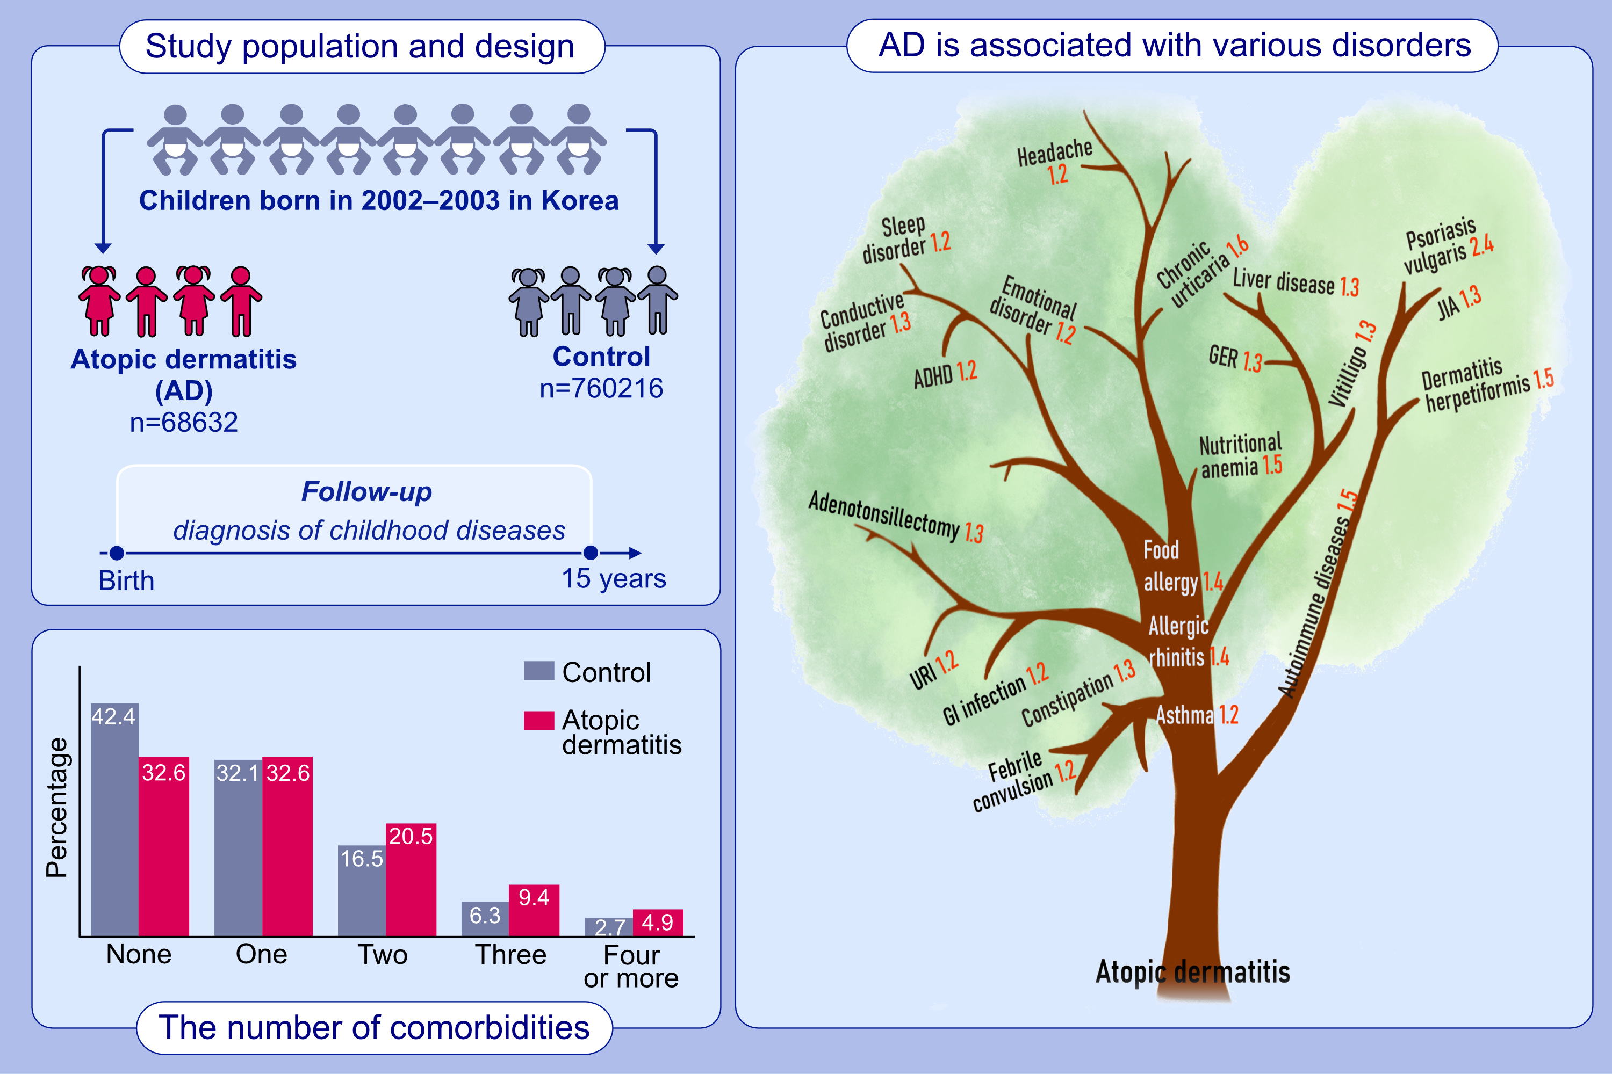
Cascade of Atopic Dermatitis Comorbidities in Children after Birth for 15 Years
Ju Hee Kim, Eun Lee, Eun Kyo Ha, Jeewon Shin, Gi Chun Lee, ,et al.
Allergy. 2024; pages:153-163
https://doi.org/10.1111/all.15917
© 2019 EAACI and John Wiley and Sons A/S. Published by John Wiley and Sons Ltd.
Notes:
HIGHLIGHTS
This administrative observational study investigated the development of comorbidities in children with atopic dermatitis over time.
Tracking individuals born between 2002 and 2003 over a period of 15 years, we found that atopic dermatitis is associated with various medical conditions, including neurological, gastrointestinal, and infectious diseases, in addition to well-known allergies and mental disorders.
Previous comorbidities often influence the subsequent development of concurrent conditions.
Abbreviations: AD, atopic dermatitis; ADHD, attention deficit hyperactivity disorder; GER, gastroesophageal reflux; GI, gastrointestinal; JIA, juvenile idiopathic arthritis; n, number; URI upper respiratory tract infection.

