Slide 1
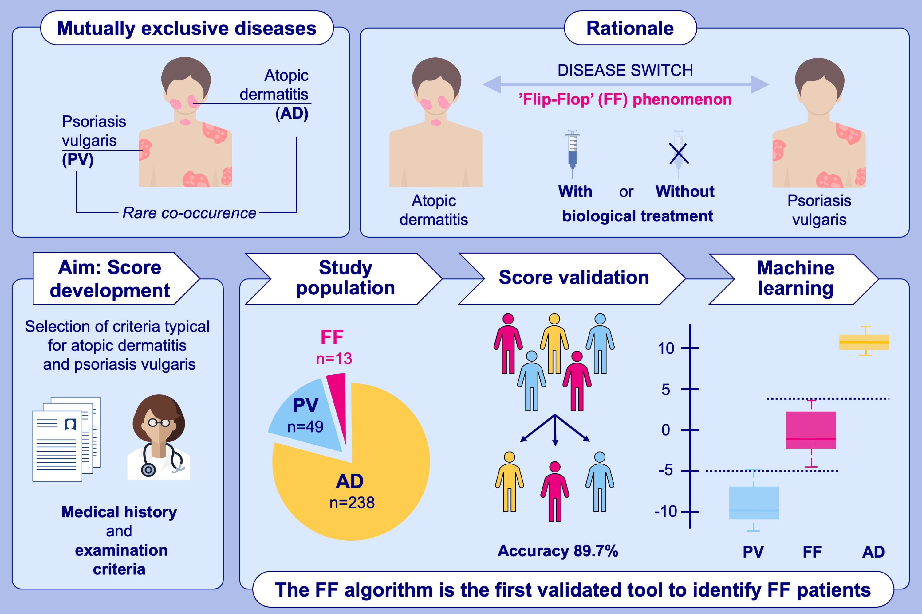
Development of a clinical algorithm to predict phenotypic switches between atopic dermatitis and psoriasis (the “Flip-Flop” phenomenon)
Svenja Müller, Thomas Welchowski, Matthias Schmid, Laura Maintz, Nadine Herrmann, et al.
Allergy. 2024; pages:164-173
https://doi.org/10.1111/all.15921
© 2019 EAACI and John Wiley and Sons A/S. Published by John Wiley and Sons Ltd.
Notes:
HIGHLIGHTS
Phenotypic switches from AD to PV or vice versa can occur spontaneously or during biologic therapy (‘paradoxical reactions’) in predisposed patients (so-called ‘Flip-Flop’ (FF) patients).
We developed the first clinical algorithm to identify FF patients by the combination of medical history and examination criteria typical for AD and PV.
The validation study with 300 Caucasian patients with AD, PV and FF showed a good prediction accuracy (89.7%). The model was improved using machine learning.
Abbreviations: AD, atopic dermatitis; FF, Flip-Flop; PV, psoriasis vulgaris

