Slide 1
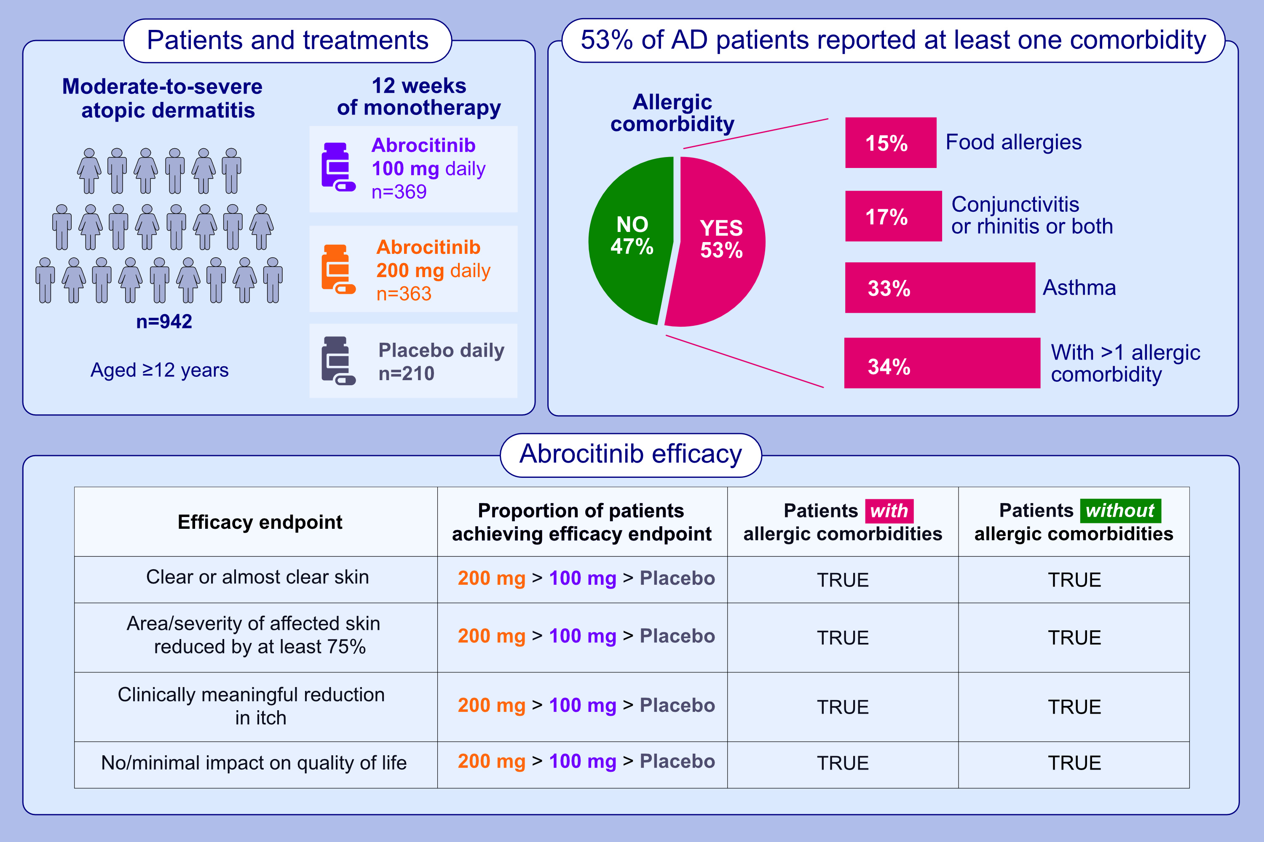
Efficacy and safety of abrocitinib in patients with moderate-to-severe atopic dermatitis and comorbid allergies
Peter Schmid-Grendelmeier, Melinda J. Gooderham, Karin Hartmann, George N. Konstantinou, Marc Fellmann, et al.
Allergy. 2024; pages:174-183
https://doi.org/10.1111/all.15952
© 2019 EAACI and John Wiley and Sons A/S. Published by John Wiley and Sons Ltd.
Notes:
HIGHLIGHTS
In this pool of patients with moderate-to-severe AD, 53% reported at least one allergic comorbidity (asthma, conjunctivitis, rhinitis or food allergies).
Abrocitinib 200 mg or 100 mg monotherapy improved clinical, patient-reported and HRQoL outcomes versus placebo, regardless of patients’ allergic comorbidities.
In patients with moderate-to-severe AD, abrocitinib is efficacious and well tolerated in those with or without allergic comorbidities.
Abbreviations: AD, atopic dermatitis; HRQoL, health-related quality of life.

