Slide 1
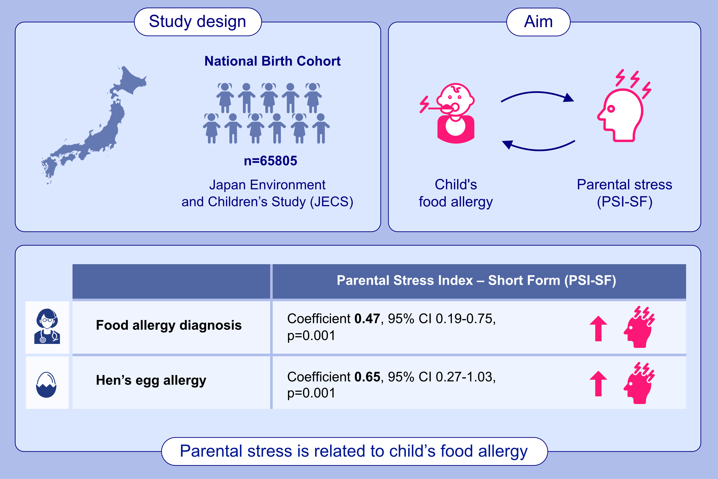
Parental stress and food allergy phenotypes in young children: A National Birth Cohort (JECS)
Kiwako Yamamoto-Hanada, Kyongsun Pak, Shintaro Iwamoto, Mizuho Konishi, Mayako Saito-Abe, et al.
Allergy. 2024; Pages:1881-1892
https://doi.org/10.1111/all.16035
© 2019 EAACI and John Wiley and Sons A/S. Published by John Wiley and Sons Ltd.
Notes:
HIGHLIGHTS
• This study explores the associations between food allergy phenotypes in children and parenting stress assessed by the PSI-SF from a national birth cohort.
• We found that parental stress is significantly related to a child’s food allergy.
• Furthermore, hen’s egg allergy increases parental stress.
• Healthcare providers need to be aware of parental stress in our daily clinic.
.

