Slide 1
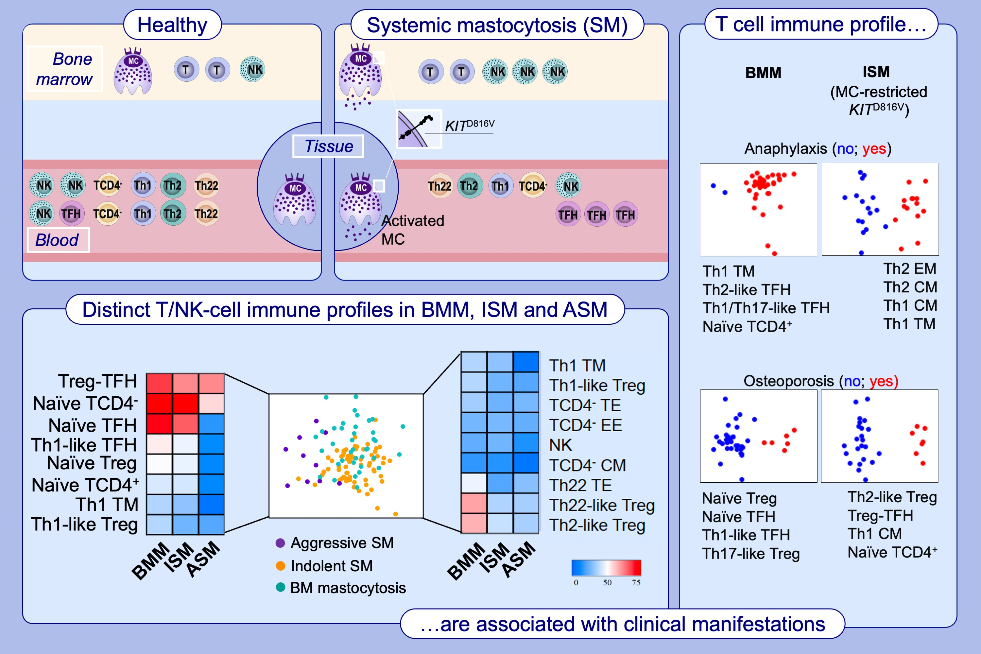
T-cell immune profile in blood of systemic mastocytosis: Association with disease features
Alba Pérez-Pons, Cristina Teodosio, María Jara-Acevedo, Ana Henriques, Paula Navarro-Navarro, et al.
Allergy. 2024; Pages: 1921-1937
https://doi.org/10.1111/all.16043
© 2019 EAACI and John Wiley and Sons A/S. Published by John Wiley and Sons Ltd.
Notes:
HIGHLIGHTS
• Constitutively activated tumor MC in SM patients are associated with a broad activation of the innate immune response and an altered distribution of other adaptive immune cells.
• The altered circulating T- and NK-cell immune profile in SM, varies depending on disease subtype, the pattern of involvement of hematopoiesis by KITD816V, the HαT genotype and specific clinical manifestations of the disease.
• These altered immune profiles contribute to a better understanding of the different patterns of clinical manifestations of the disease, independently of the MC burden.
•
.

