Slide 1
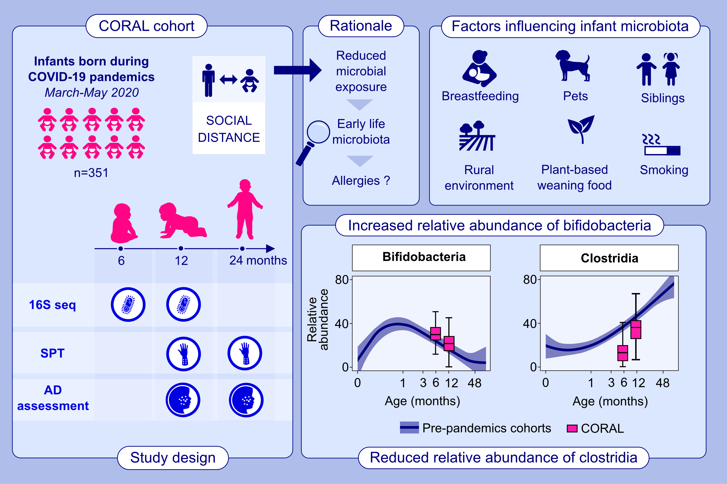
Association between gut microbiota development and allergy in infants born during pandemic-related social distancing restrictions
Katri Korpela, Sadhbh Hurley, Sinead Ahearn Ford, Ruth Franklin, Susan Byrne, et al.
Allergy. 2024;Pages: 1938-1951
https://doi.org/10.1111/all.16069
© 2019 EAACI and John Wiley and Sons A/S. Published by John Wiley and Sons Ltd.
Notes:
HIGHLIGHTS
• This study examines the environmental exposures and dietary factors that contribute to early life microbiota development, and their associations with allergic outcomes, in infants raised during COVID-19 associated social distancing measures (CORAL cohort).
• Bifidobacteria are higher and clostridia are lower compared to pre-pandemic cohorts.
• Breastfeeding, plant based weaning foods, siblings, rural environment, pets and smoking in the home associated with different microbiota patterns.
• Bifidobacteria and SCFA-producing microbes may be important to prevent allergies. .

