Slide 1
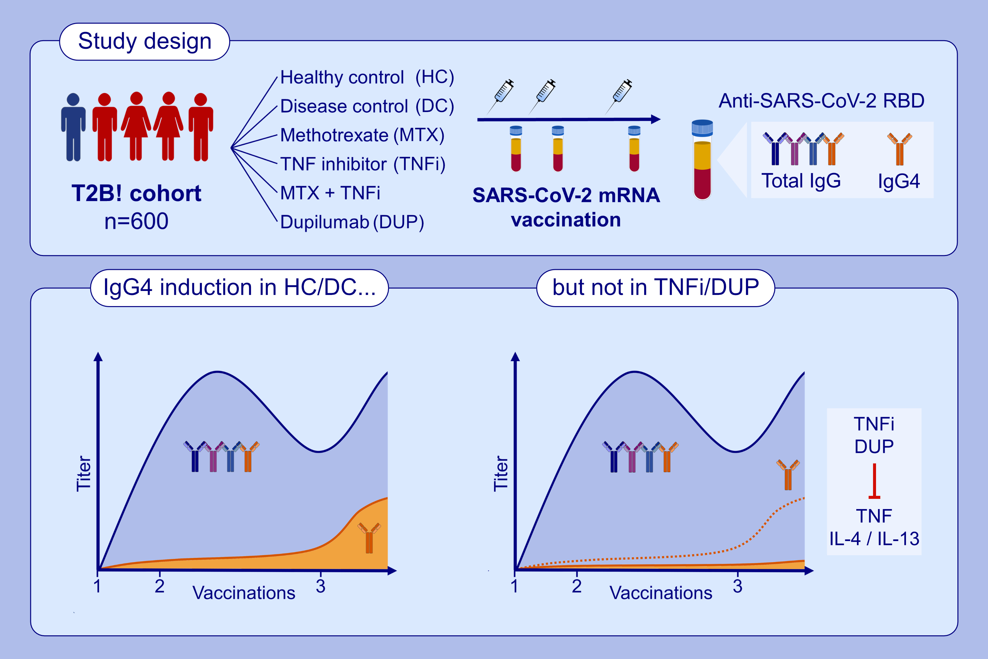
Suppressed IgG4 class switching in dupilumab- and TNF inhibitor-treated patients after mRNA vaccination
Anika M. Valk, Jim B. D. Keijser, Koos P. J. van Dam, Eileen W. Stalman, Luuk Wieske, et al.
Allergy. 2024; Pages: 1952-1961
https://doi.org/10.1111/all.16089
© 2019 EAACI and John Wiley and Sons A/S. Published by John Wiley and Sons Ltd.
Notes:
HIGHLIGHTS
• This study assessed total IgG and IgG4 anti-RBD responses after SARS-CoV-2 mRNA vaccination in a longitudinal cohort comprising health controls, disease controls, patients treated with methotrexate, TNF inhibitors, the combination thereof and dupilumab.
• We found significant IgG4 skewing in healthy and disease controls after repeated vaccination, and to a lesser extent in patients treated with methotrexate.
• IgG4 skewing was virtually absent in patients treated with dupilumab or TNF inhibitors, illustrating major roles for IL-4 / IL-13 and TNF in the overall process of class switching to IgG4. .

