Slide 1
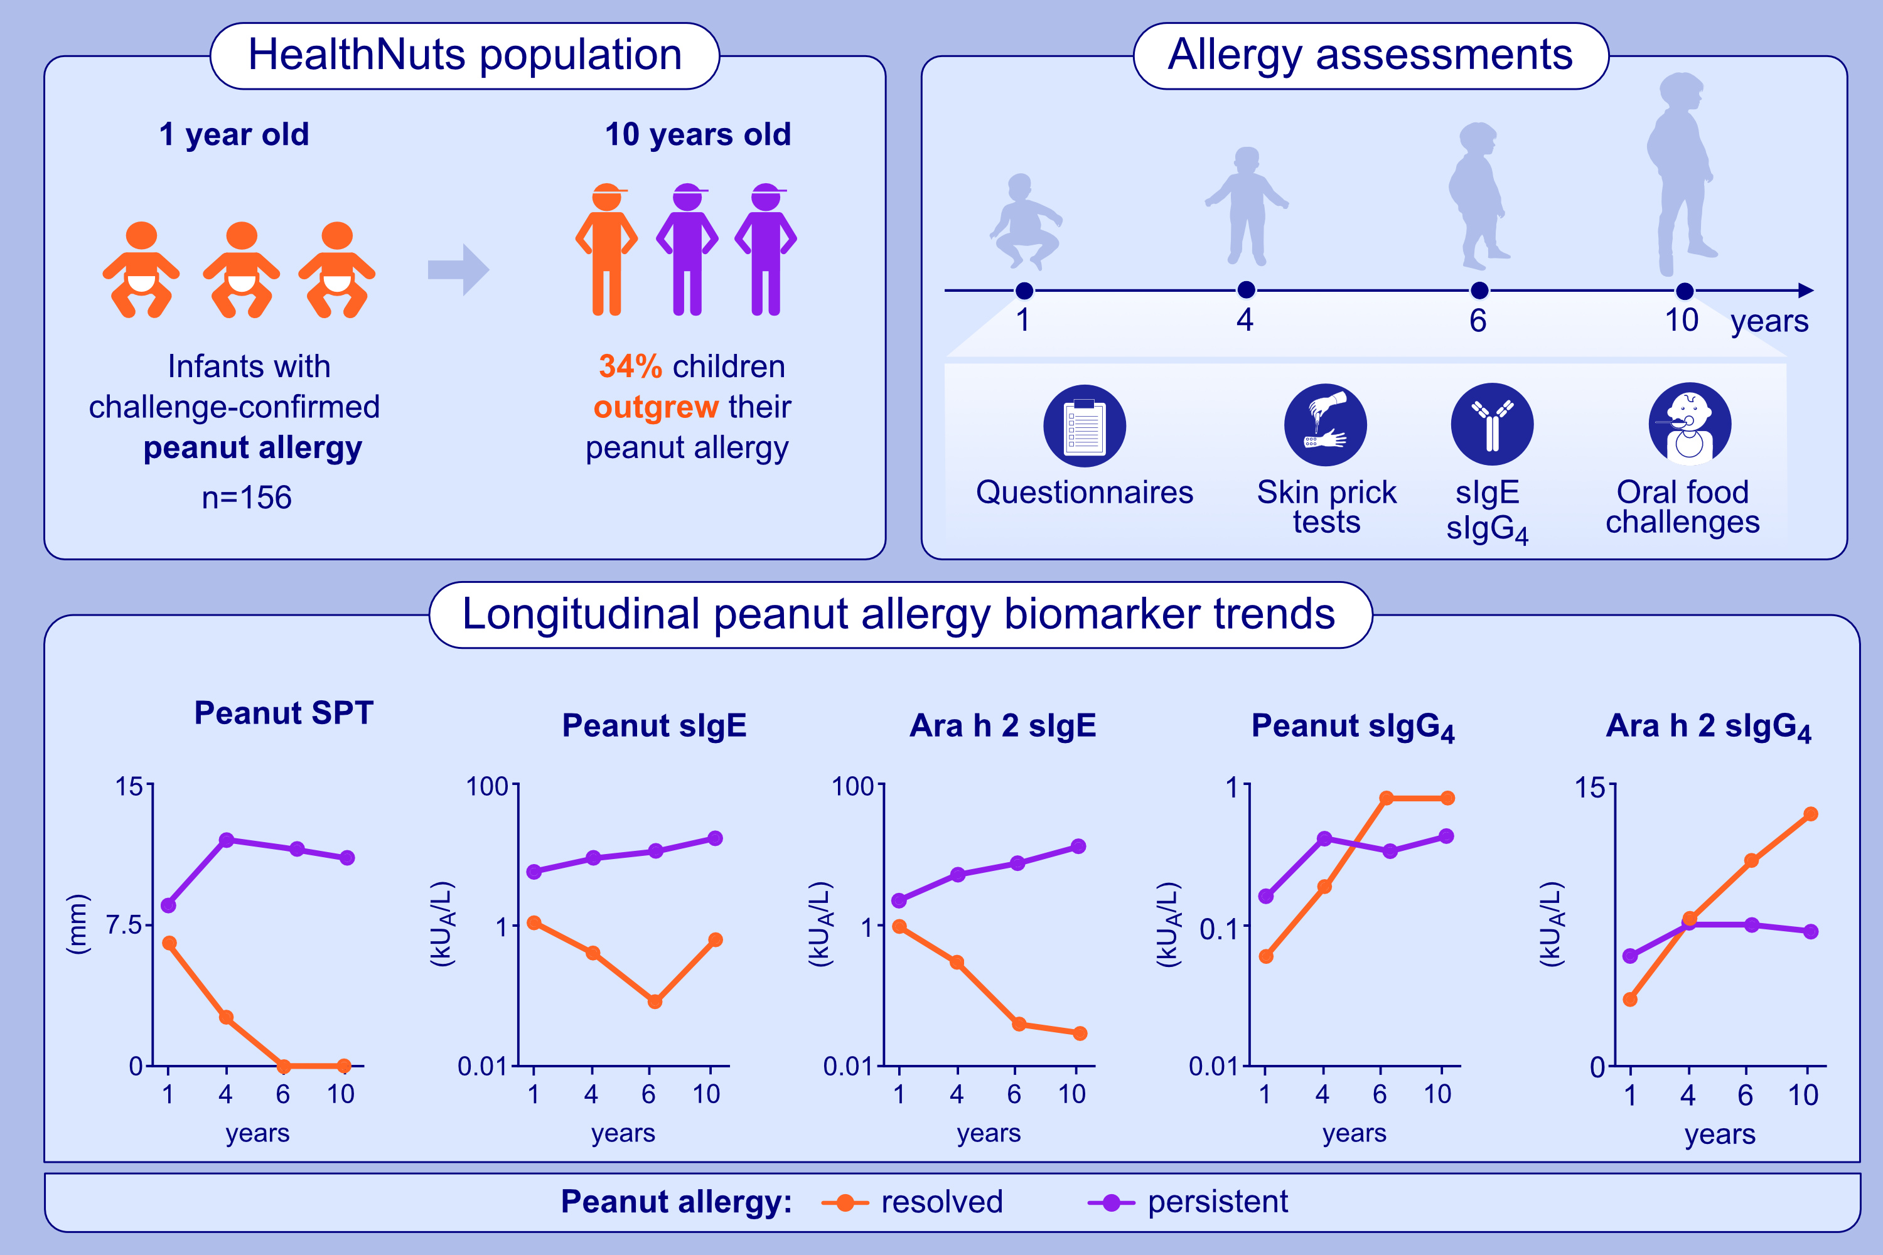
Longitudinal peanut and Ara h 2 specific-IgE, -IgG4, and -IgG4/-IgE ratios are associated with the natural resolution of peanut allergy in childhood
Kayla M. Parker, Thanh D. Dang, Rushani Wijesuriya, Victoria X. Soriano, Adrian J. Lowe, et al.
Allergy. 2024; Pages: 1868-1880
https://doi.org/10.1111/all.16111
© 2019 EAACI and John Wiley and Sons A/S. Published by John Wiley and Sons Ltd.
Notes:
HIGHLIGHTS
• 34% of infants with challenge-confirmed peanut allergy at age 1 year outgrew their peanut allergy.
• Resolution of peanut allergy between ages 6 and 10 years was rare.
• Peanut and Ara h 2 sIgE, sIgE/tIgE, sIgG4, and sIgG4/sIgE measured at age 1 year had poor to moderate value in determining whether infants with peanut allergy outgrow or have persistent disease by 10-years-of-age.
• Peanut allergy resolution was associated with decreasing Ara h 2 sIgE, increasing sIgG4 and increasing sIgG4/sIgE to both peanut and Ara h 2 from 1 to 10-years-of-age. .

