Slide 1
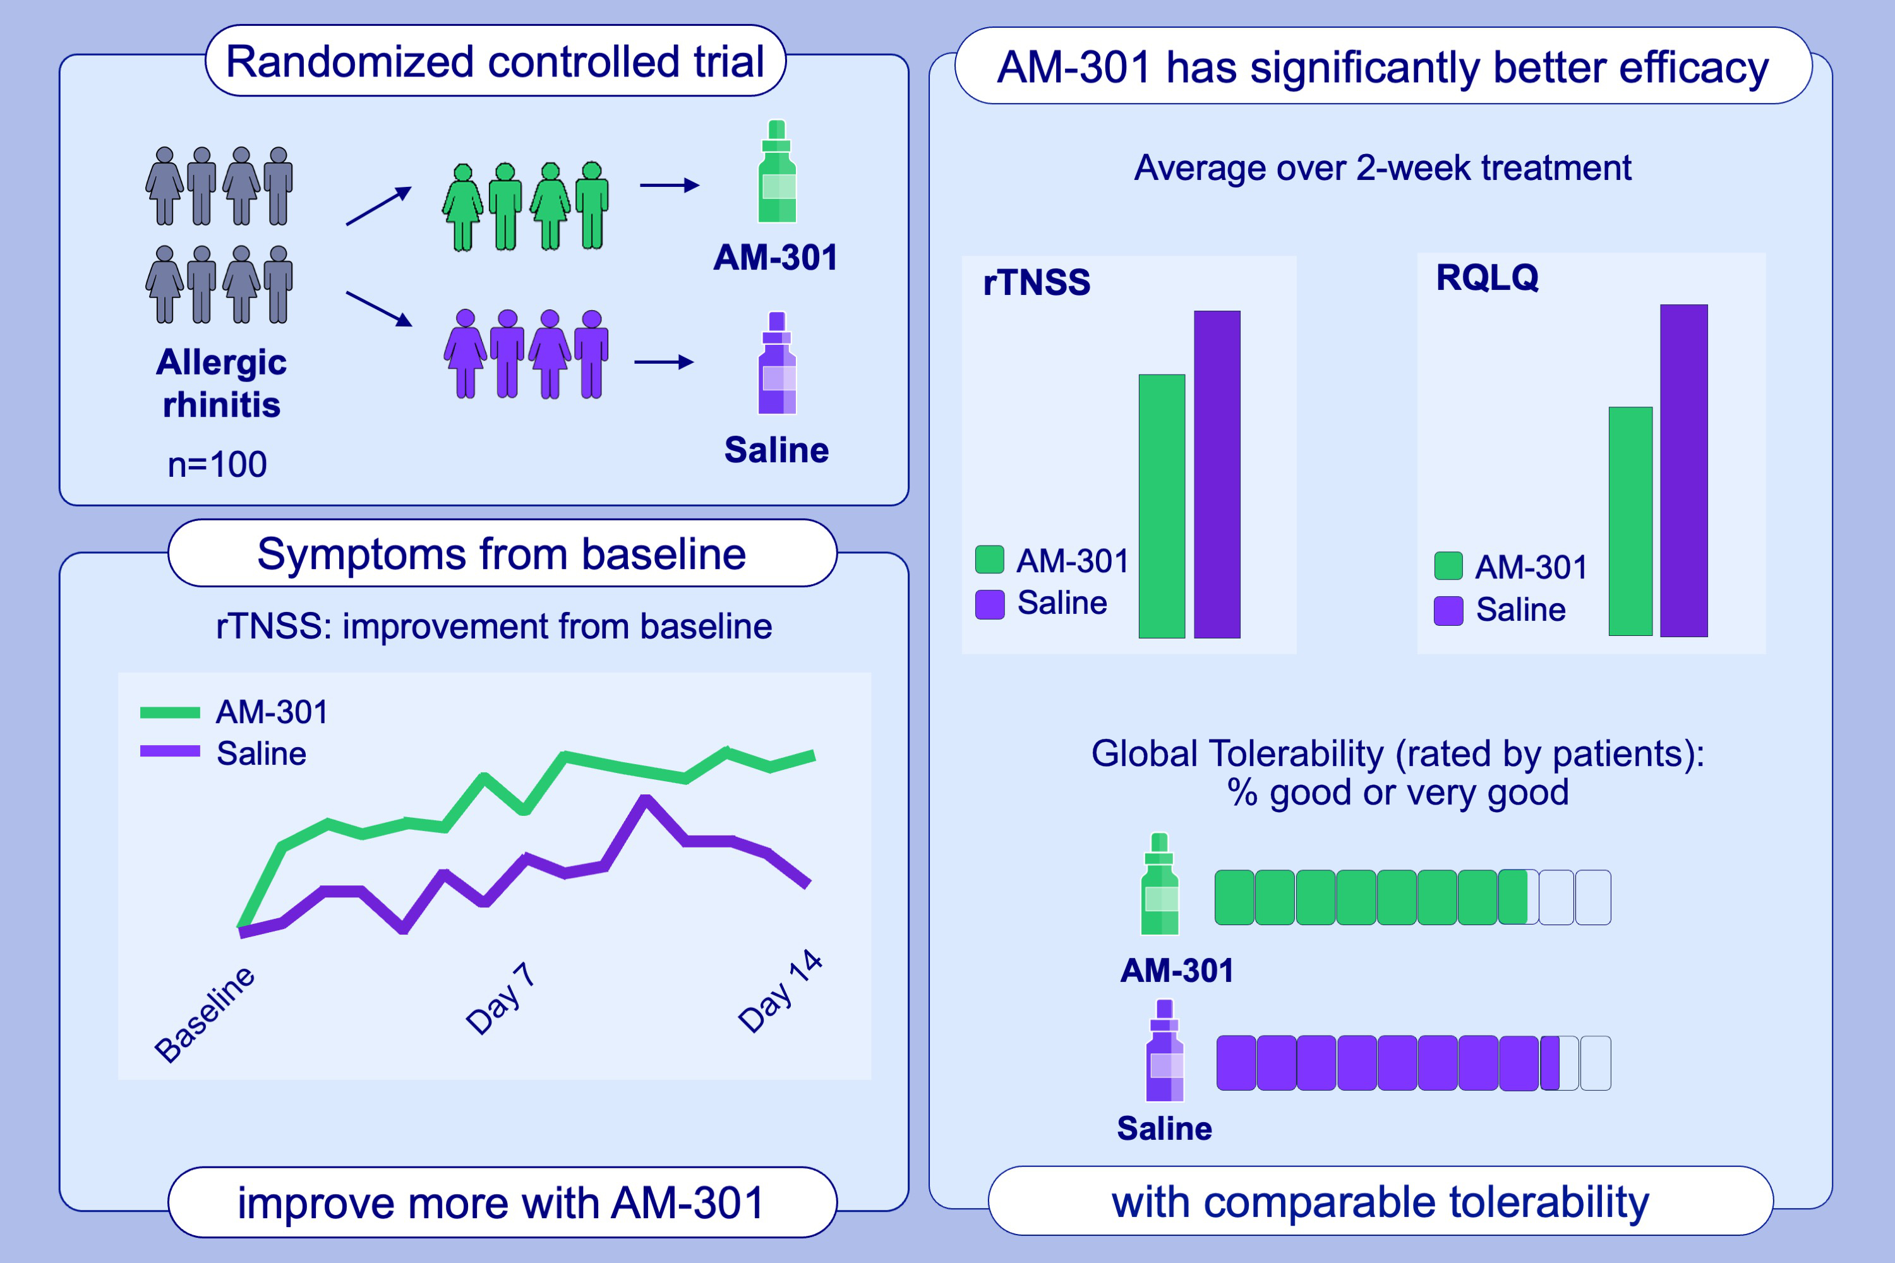
AM-301, a barrier-forming nasal spray, versus saline spray in seasonal allergic rhinitis: A randomized clinical trial
Sven Becker, Sachin Deshmukh, Ferdinandus De Looze, Veronica Francardo, Jessie Lee, et al.
Allergy. 2024;Pages: 1858-1867
https://doi.org/10.1111/all.16116
© 2019 EAACI and John Wiley and Sons A/S. Published by John Wiley and Sons Ltd.
Notes:
HIGHLIGHTS
• We compared the efficacy of two nonpharmacological nasal sprays (AM-301 and saline) in reducing symptoms of allergic rhinitis in a randomized, controlled clinical trial.
• A statistically significantly larger reduction in average rTNSS, iTNSS and RQLQ scores was observed in patients treated with AM-301 compared to saline-treated patients.
• Tolerability of AM-301 was comparable to the one of saline.
.

