Slide 1
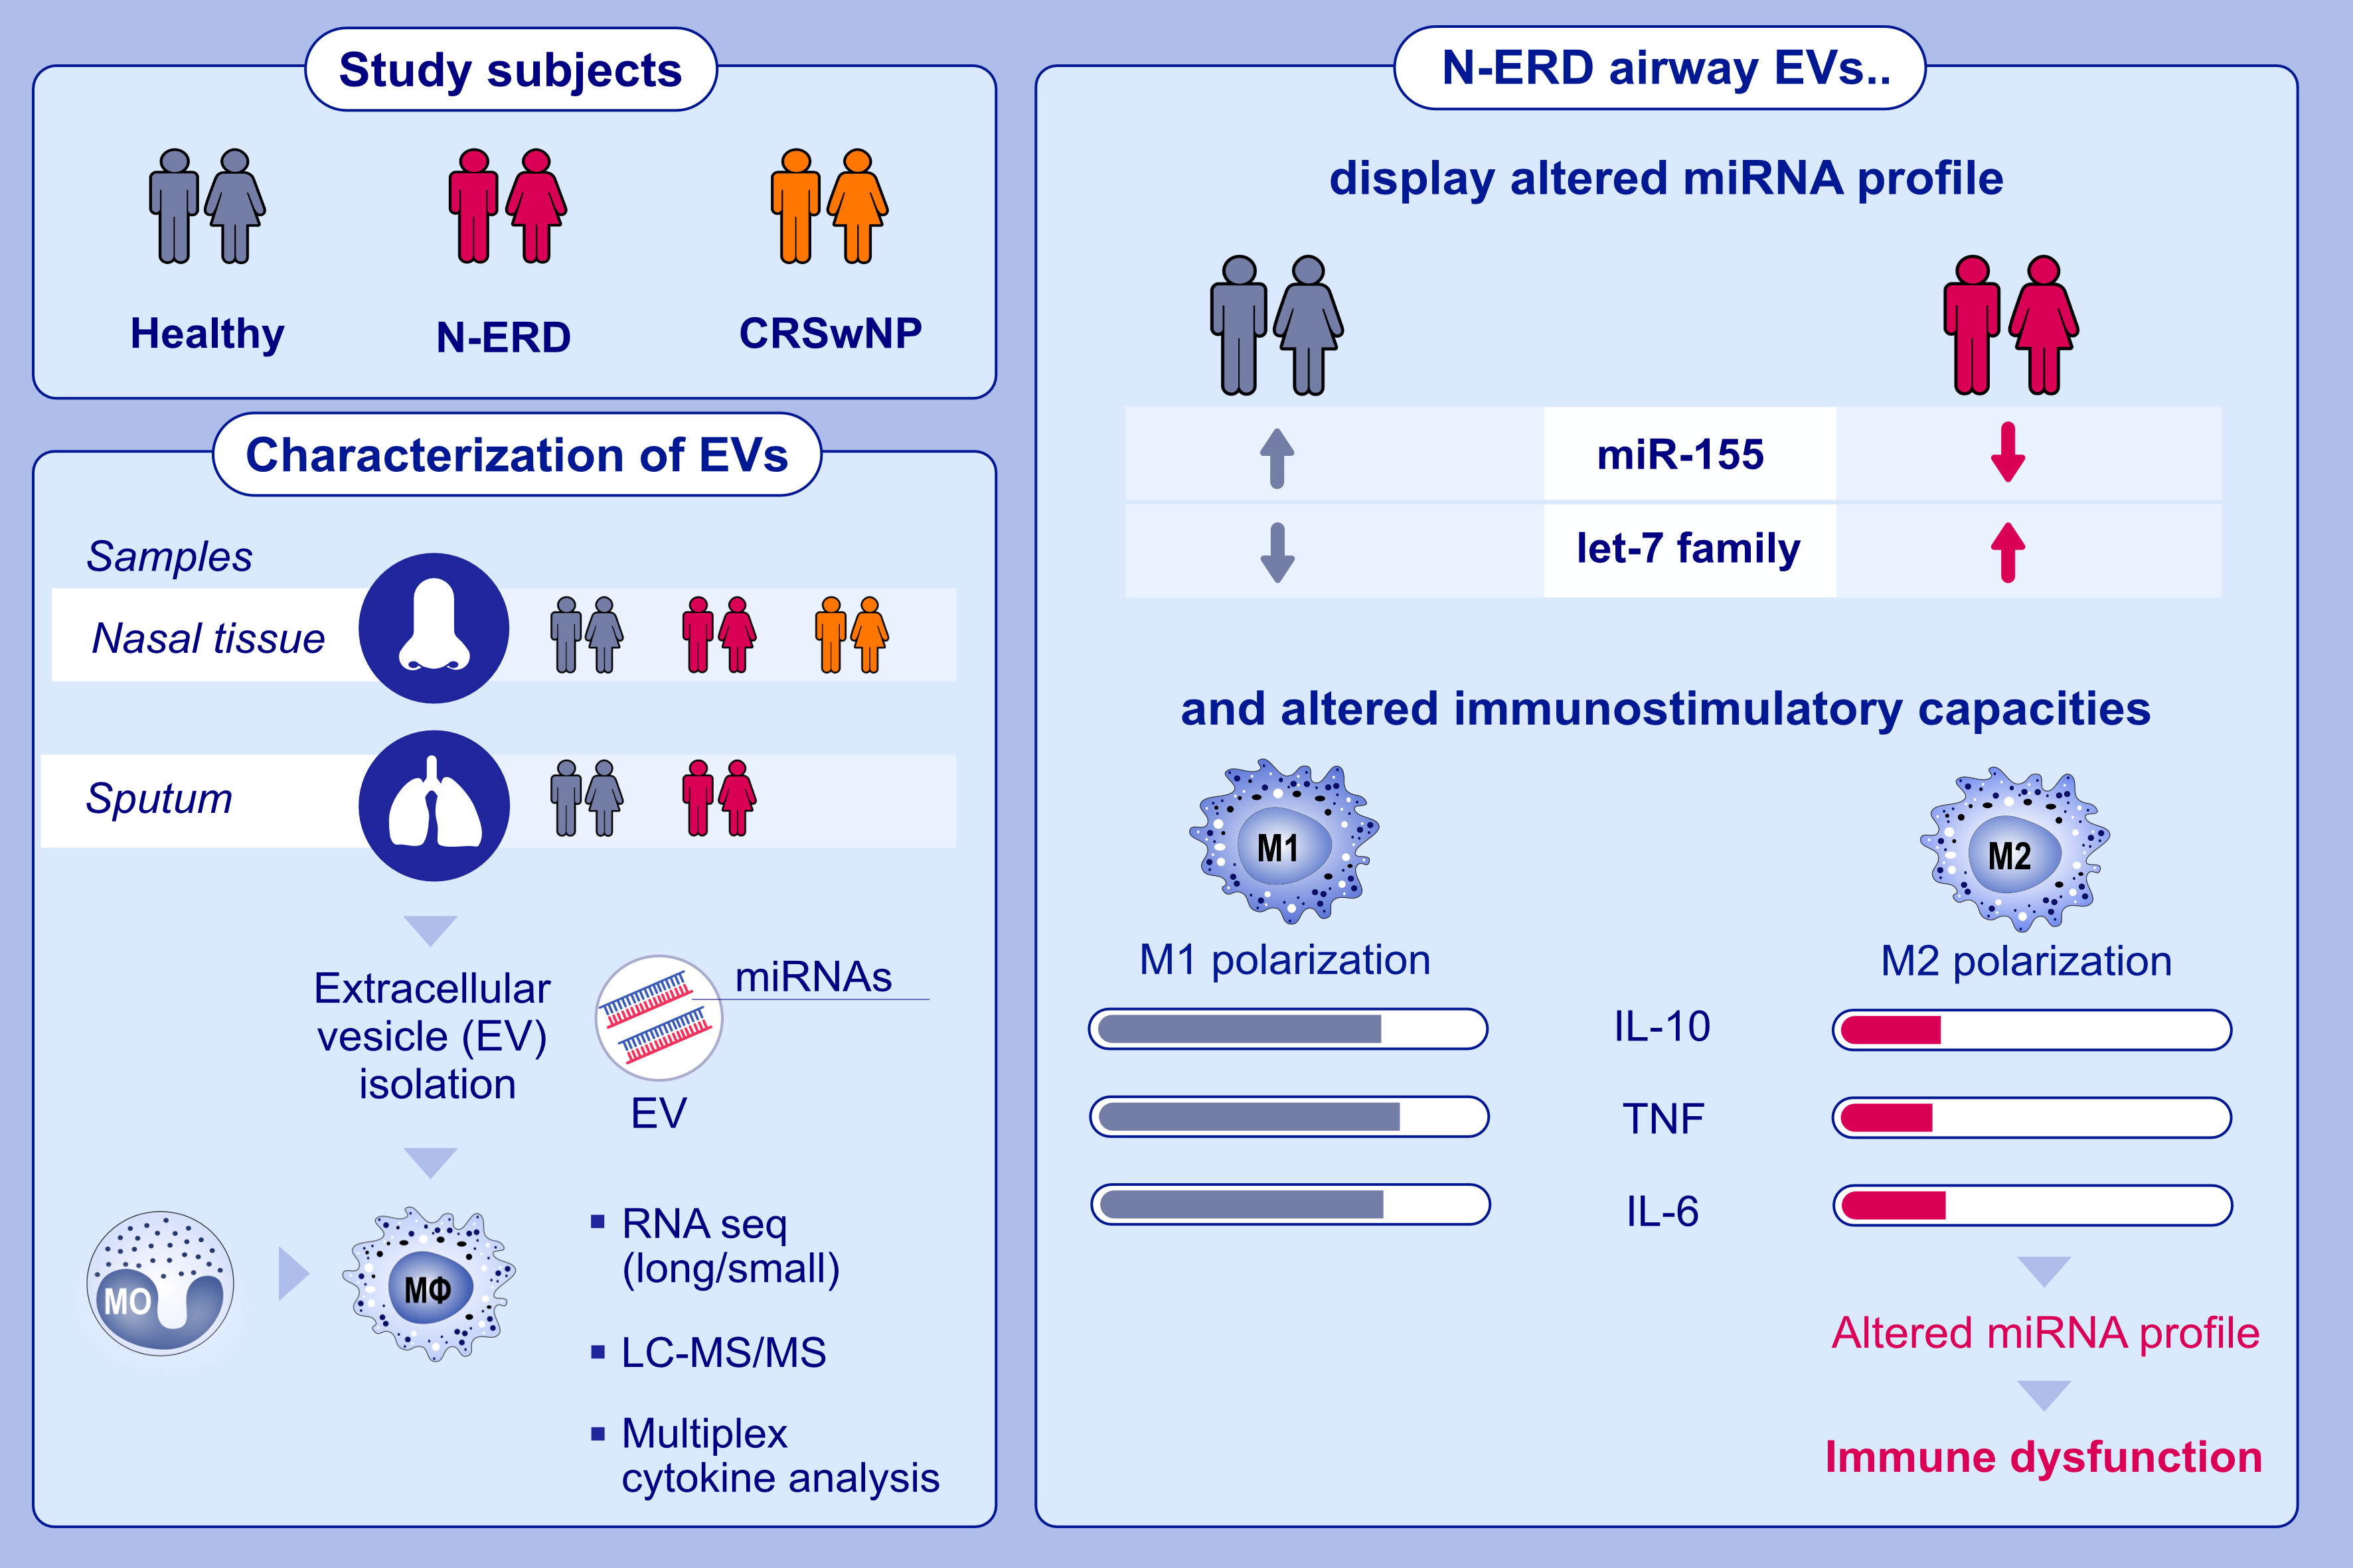
Extracellular vesicle miRNAs drive aberrant macrophage responses in NSAID-exacerbated respiratory disease
Franziska Hartung, Pascal Haimerl, Sonja Schindela, Veronika Mussack, Benedikt Kirchner, et al.
Allergy. 2024; Pages: 1893-1907
https://doi.org/10.1111/all.16117
© 2019 EAACI and John Wiley and Sons A/S. Published by John Wiley and Sons Ltd.
Notes:
HIGHLIGHTS
• EVs isolated from the upper and lower airways of N-ERD patients display altered miRNA profiles compared to healthy controls.
• Small RNA sequencing reveals upregulation of let-7 miRNAs and downregulation of miR-155 in N-ERD sputum EVs.
• Let-7 family miRNAs promote macrophage M2 activation, while limiting EV-triggered cytokine responses, thus implicating aberrant EV miRNA profiles in N-ERD pathogenesis
.

