Slide 1
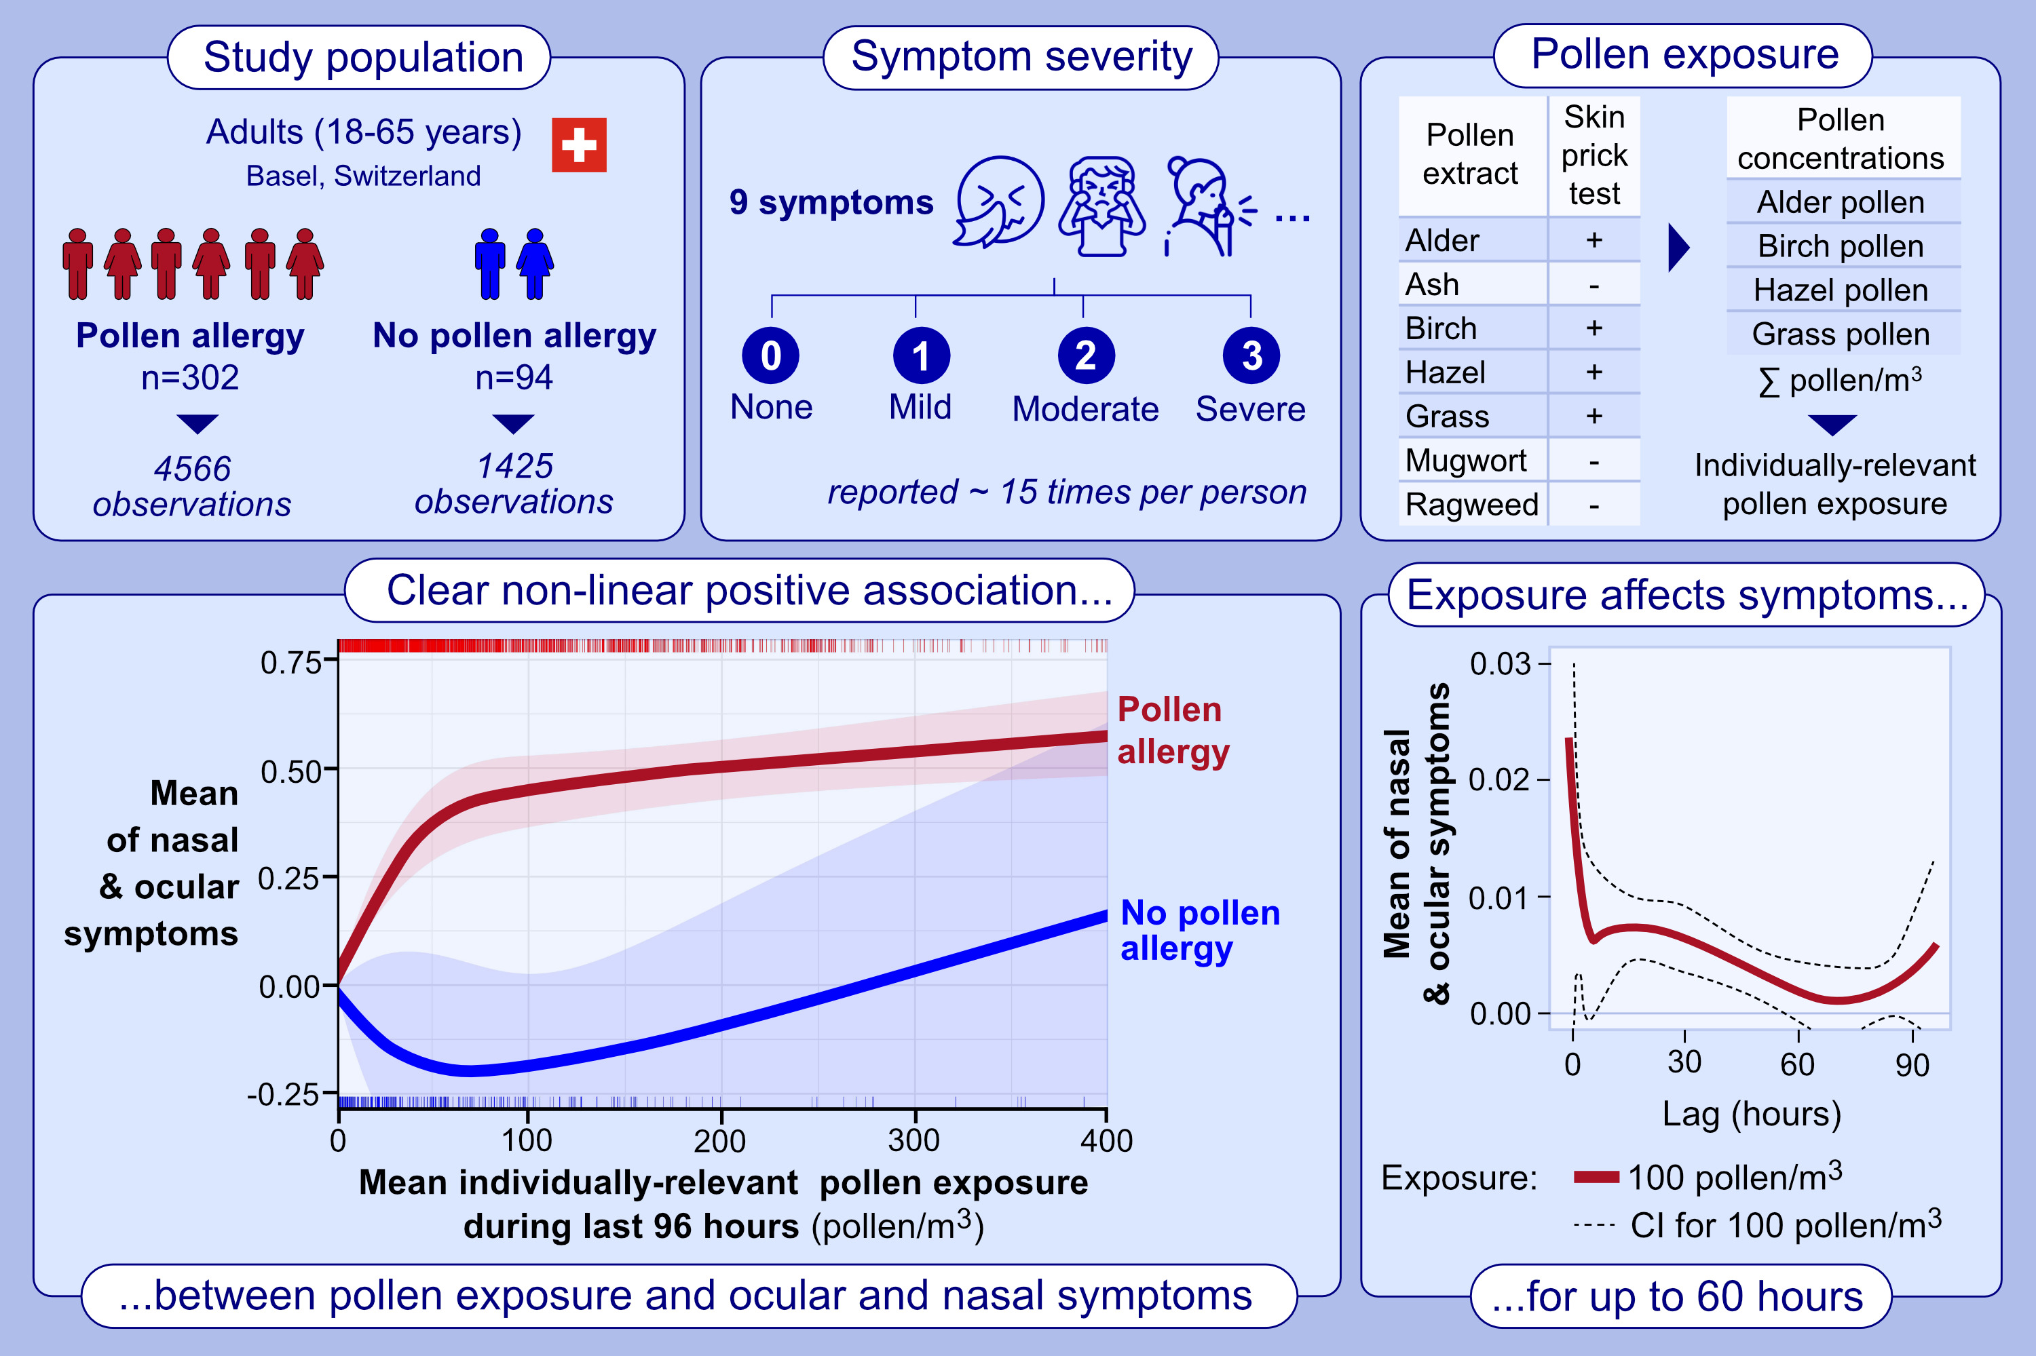
Ambient pollen exposure and pollen allergy symptom severity in the EPOCHAL study
Axel Luyten, Alexandra Bürgler, Sarah Glick, Marek Kwiatkowski, Regula Gehrig, et al.
Allergy. 2024; pages: 1908-1920
https://doi.org/10.1111/all.16130
© 2019 EAACI and John Wiley and Sons A/S. Published by John Wiley and Sons Ltd.
Notes:
HIGHLIGHTS
• The exposure-response relationship between ambient pollen exposure and symptom severity is non-linear: symptom severity increased steeply at low pollen levels and attenuates beyond ~80 pollen/m3.
• Pollen exposure influences symptoms for up to two and a half days after exposure.
• Pollen allergic participants aged 18-30 years experience the strongest symptoms.
• Symptoms are stronger in the grass pollen than in the tree pollen season. .

