Slide 1
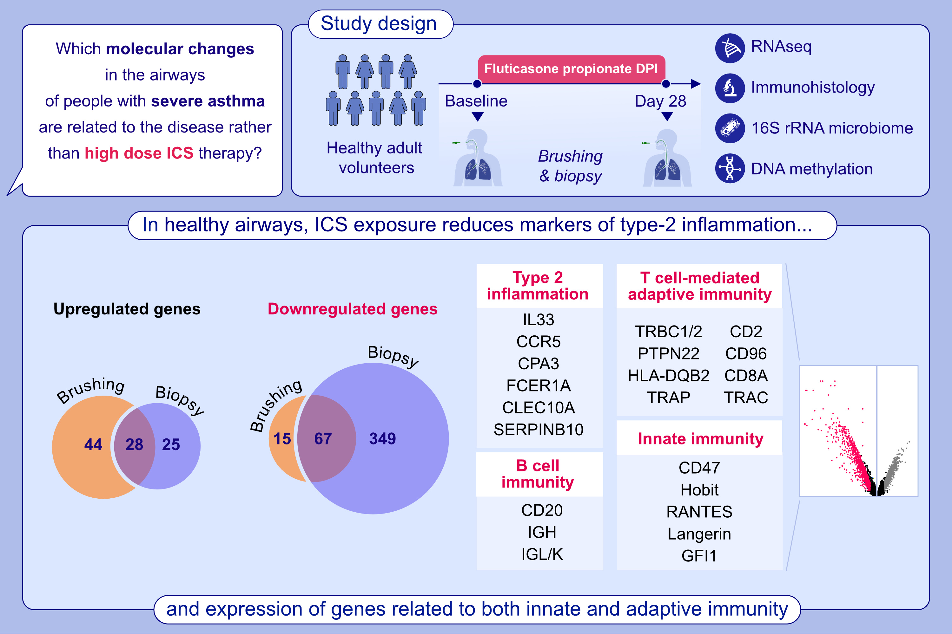
The effects of inhaled corticosteroids on healthy airways
Emanuele Marchi, Timothy S. C. Hinks, Matthew Richardson, Latifa Khalfaoui, Fiona A. Symon, et al.
Allergy. 2024; pages: 1831-1843
https://doi.org/10.1111/all.16146
© 2019 EAACI and John Wiley and Sons A/S. Published by John Wiley and Sons Ltd.
Notes:
HIGHLIGHTS
• 4-weeks ICS suppressed a broad spectrum of genes associated with adaptive T and B cell, and innate immunity, likely explaining the association between ICS use and pneumonia.
• Tonic T2 signalling in healthy airways was exquisitively sensitive to ICS, while an IL-17-dependent gene signature and CEACAM family members were not upregulated by 4-weeks ICS exposure, suggesting their increased expression in severe asthma is disease-related rather than treatment-related.
• 4-weeks ICS did not alter the airway microbiome, DNA methylation or airway cellularity.
.

