Slide 1
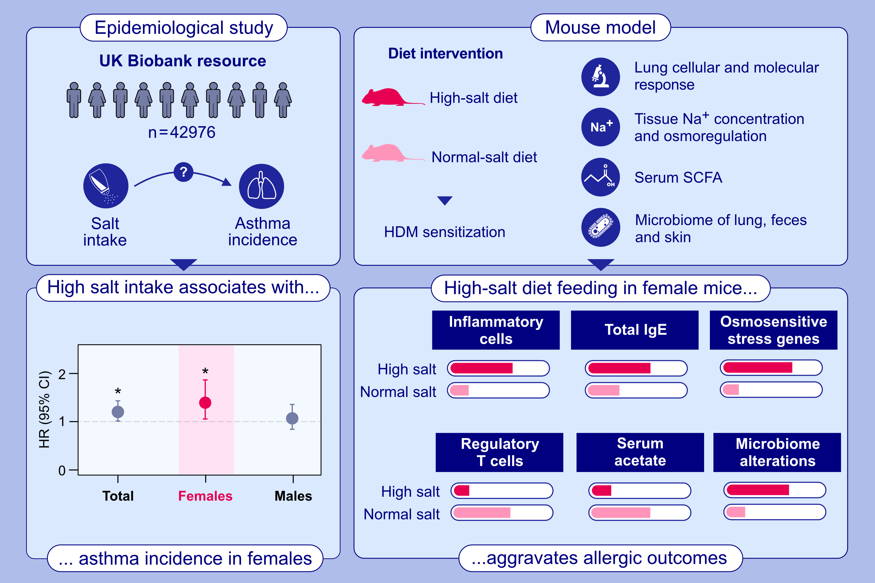
The impact of high-salt diet on asthma in humans and mice: Effect on specific T-cell signatures and microbiome
Stephanie Musiol, Carla P. Harris, Silvia Gschwendtner, Amy Burrell, Yacine Amar, et al.
Allergy. 2024; pages: 1844-1857
https://doi.org/10.1111/all.16148
© 2019 EAACI and John Wiley and Sons A/S. Published by John Wiley and Sons Ltd.
Notes:
HIGHLIGHTS
• Epidemiological study discovers novel associations between high intake of dietary salt and asthma incidence in females but not in males.High salt diet feeding in female mice aggravates allergic outcomes: serum IgE, lung inflammatory cell infiltration, TH2-TH17 profiles, reduced Tregs and increased expression of lung osmosensitive stress genes.High salt consumption induces alterations of SCFA in serum and of gut and lung microbiome. .

