Slide 1
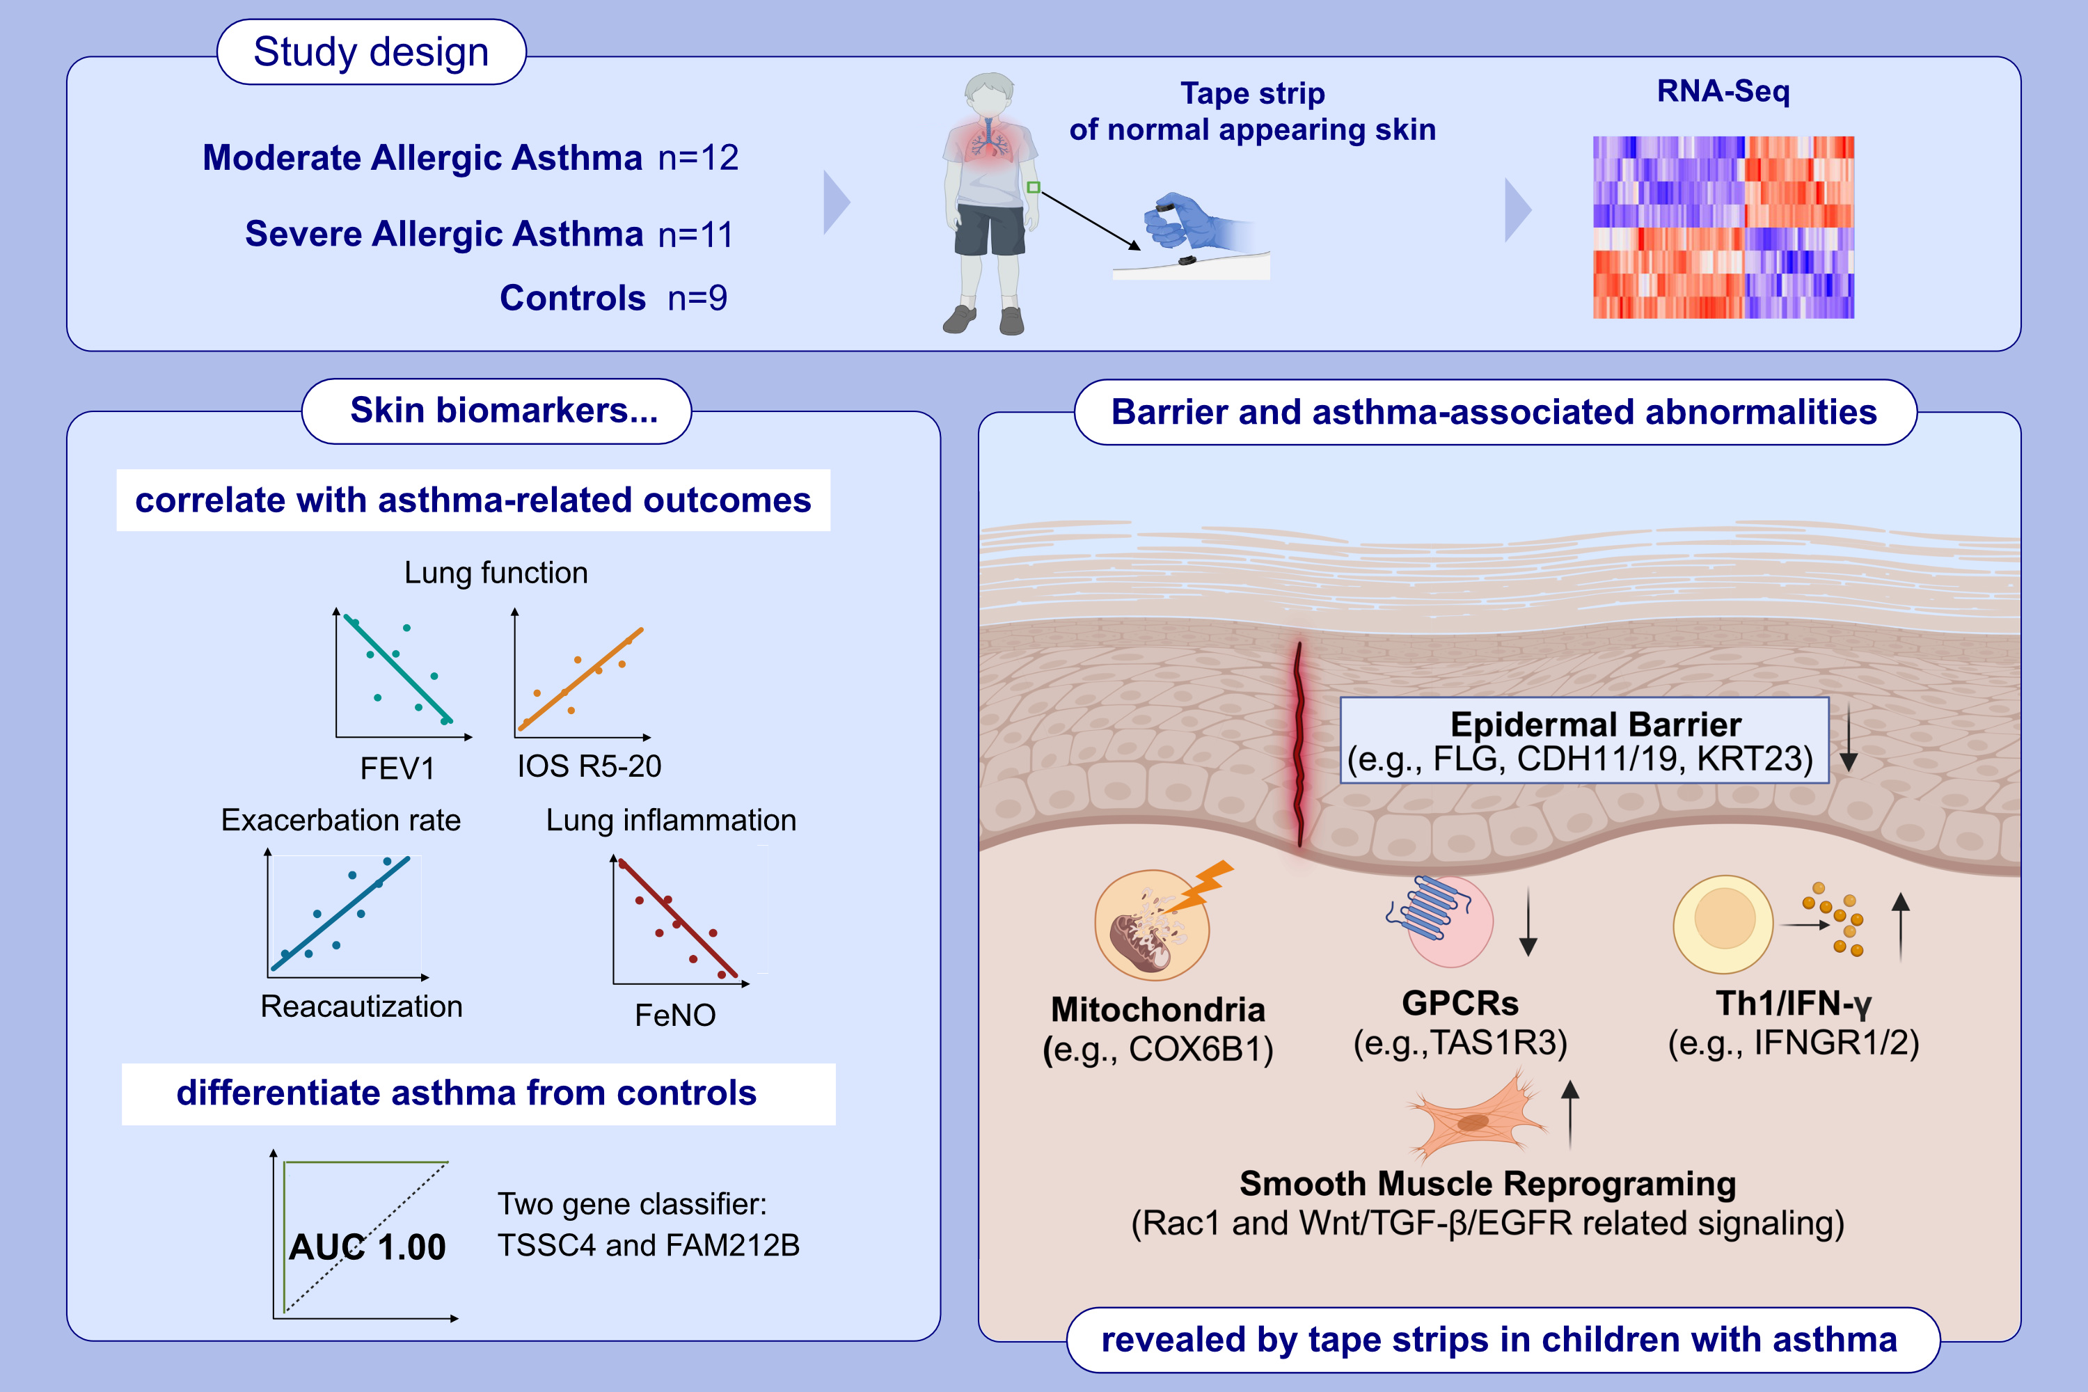
Transcriptomic evaluation of skin tape-strips in children with allergic asthma uncovers epidermal barrier dysfunction and asthma-associated biomarkers abnormalities
Ester Del Duca, Dante Dahabreh, Madeline Kim, Jonathan Bar, Joel Correa Da Rosa, et al.
Allergy. 2024; Pages: 1516-1530
https://doi.org/10.1111/all.16060
© 2019 EAACI and John Wiley and Sons A/S. Published by John Wiley and Sons Ltd.
Notes:
HIGHLIGHTS
• Using RNA-seq profiling, we characterized the normal-appearing skin of children with moderate allergic asthma and severe allergic asthma in comparison to healthy controls.Tape-strips of normal appearing skin from children with moderate allergic asthma and severe allergic asthma depict dysregulation of genes associated with epithelial barrier, lung extracellular milieu and correlate with asthma severity.
• A two-gene classifier, TSSC4 and FAM212B, differentiate asthmatic children from HCs with 100% accuracy. .

