Slide 1
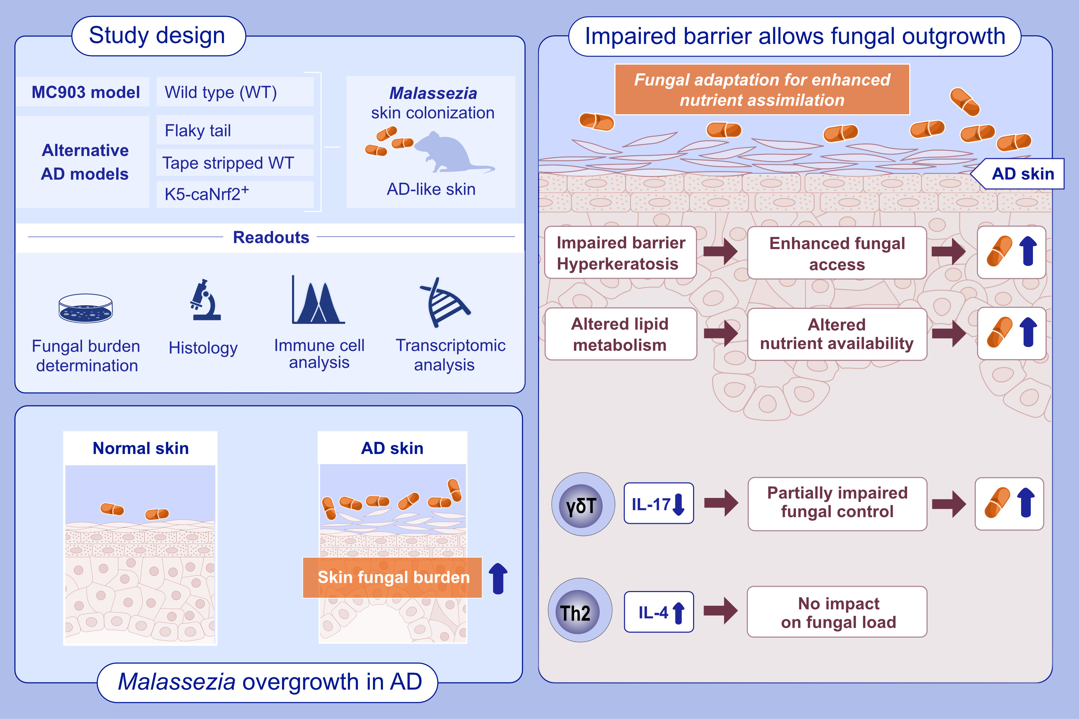
Epidermal barrier impairment predisposes for excessive growth of the allergy-associated yeast Malassezia on murine skin
Fiorella Ruchti, Pascale Zwicky, Burkhard Becher, Sandrine Dubrac, Salomé LeibundGut-Landmann et al.
Allergy. 2024; Pages: 1531-1547
https://doi.org/10.1111/all.16062
© 2019 EAACI and John Wiley and Sons A/S. Published by John Wiley and Sons Ltd.
Notes:
HIGHLIGHTS
• The abundant commensal yeast Malassezia overgrows in AD-like skin.
• Using four different experimental models of AD, we show that Malassezia acquires enhanced fitness in the barrier-impaired and metabolically dysregulated skin.
• The lipid-dependent yeast adapts to the AD-like skin for enhanced nutrient assimilation. .

