Slide 1
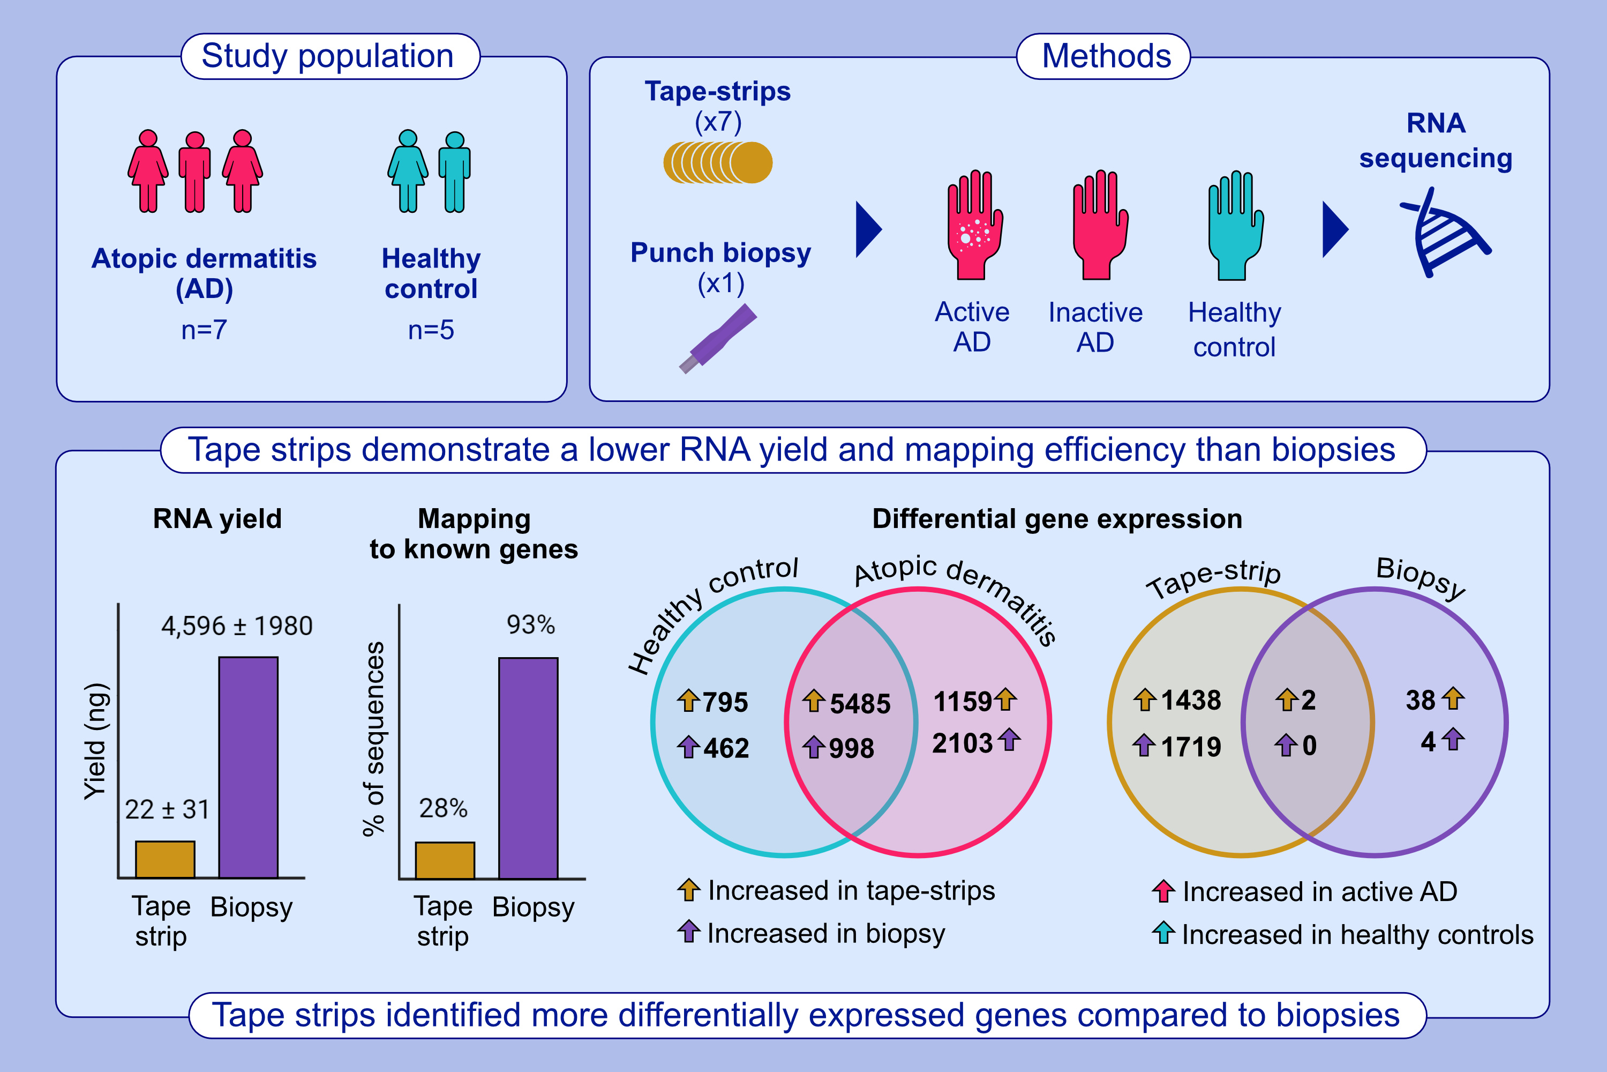
RNA-sequencing of paired tape-strips and skin biopsies in atopic dermatitis reveals key differences
Fritz B, Halling A-S, Cort I-P, et al.
Allergy. Pages: 1230-1241
https://doi.org/10.1111/all.16086
© 2019 EAACI and John Wiley and Sons A/S. Published by John Wiley and Sons Ltd.
Notes:
HIGHLIGHTS
Tape strips yielded a lower yield of RNA and fewer sequences mapping to known genes than biopsies.
Paired sampling from the same skin (AD or no AD) identified differential detection of thousands of genes between tape strips and biopsies.
Tape strips performed better than biopsies for identifying differentially expressed genes in AD.
Abbreviation: AD, atopic dermatitis

