Slide 1
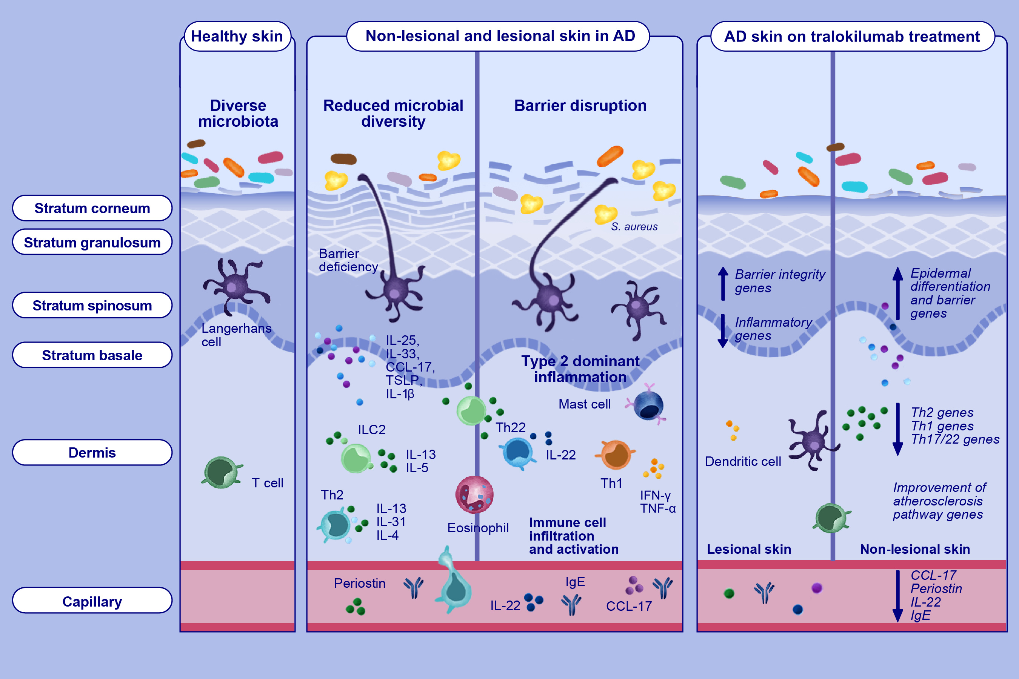
Targeting IL-13 with tralokinumab normalizes type 2 inflammation in atopic dermatitis both early and at 2 years
Emma Guttman-Yassky, Kenji Kabashima, Delphine Staumont-Salle, Walter K. Nahm, Sylvia Pauser, et al.
Allergy. 2024; Pages: 1560+1572
https://doi.org/10.1111/all.16108
© 2019 EAACI and John Wiley and Sons A/S. Published by John Wiley and Sons Ltd.
Notes:
HIGHLIGHTS
• This study evaluated early and 2-year impacts of IL-13 neutralization on skin and serum biomarkers following tralokinumab treatment in adults with moderate-to- severe AD.
• Specific targeting of IL-13 with tralokinumab improved epidermal pathology and normalized expression of key biomarkers in serum and lesional skin in patients with moderate-to-severe AD.
• These data further support the central role of IL-13 in driving AD pathology and highlight that inhibition of IL-13 alone is sufficient for normalizing the molecular phenotype of AD. .

