Slide 1
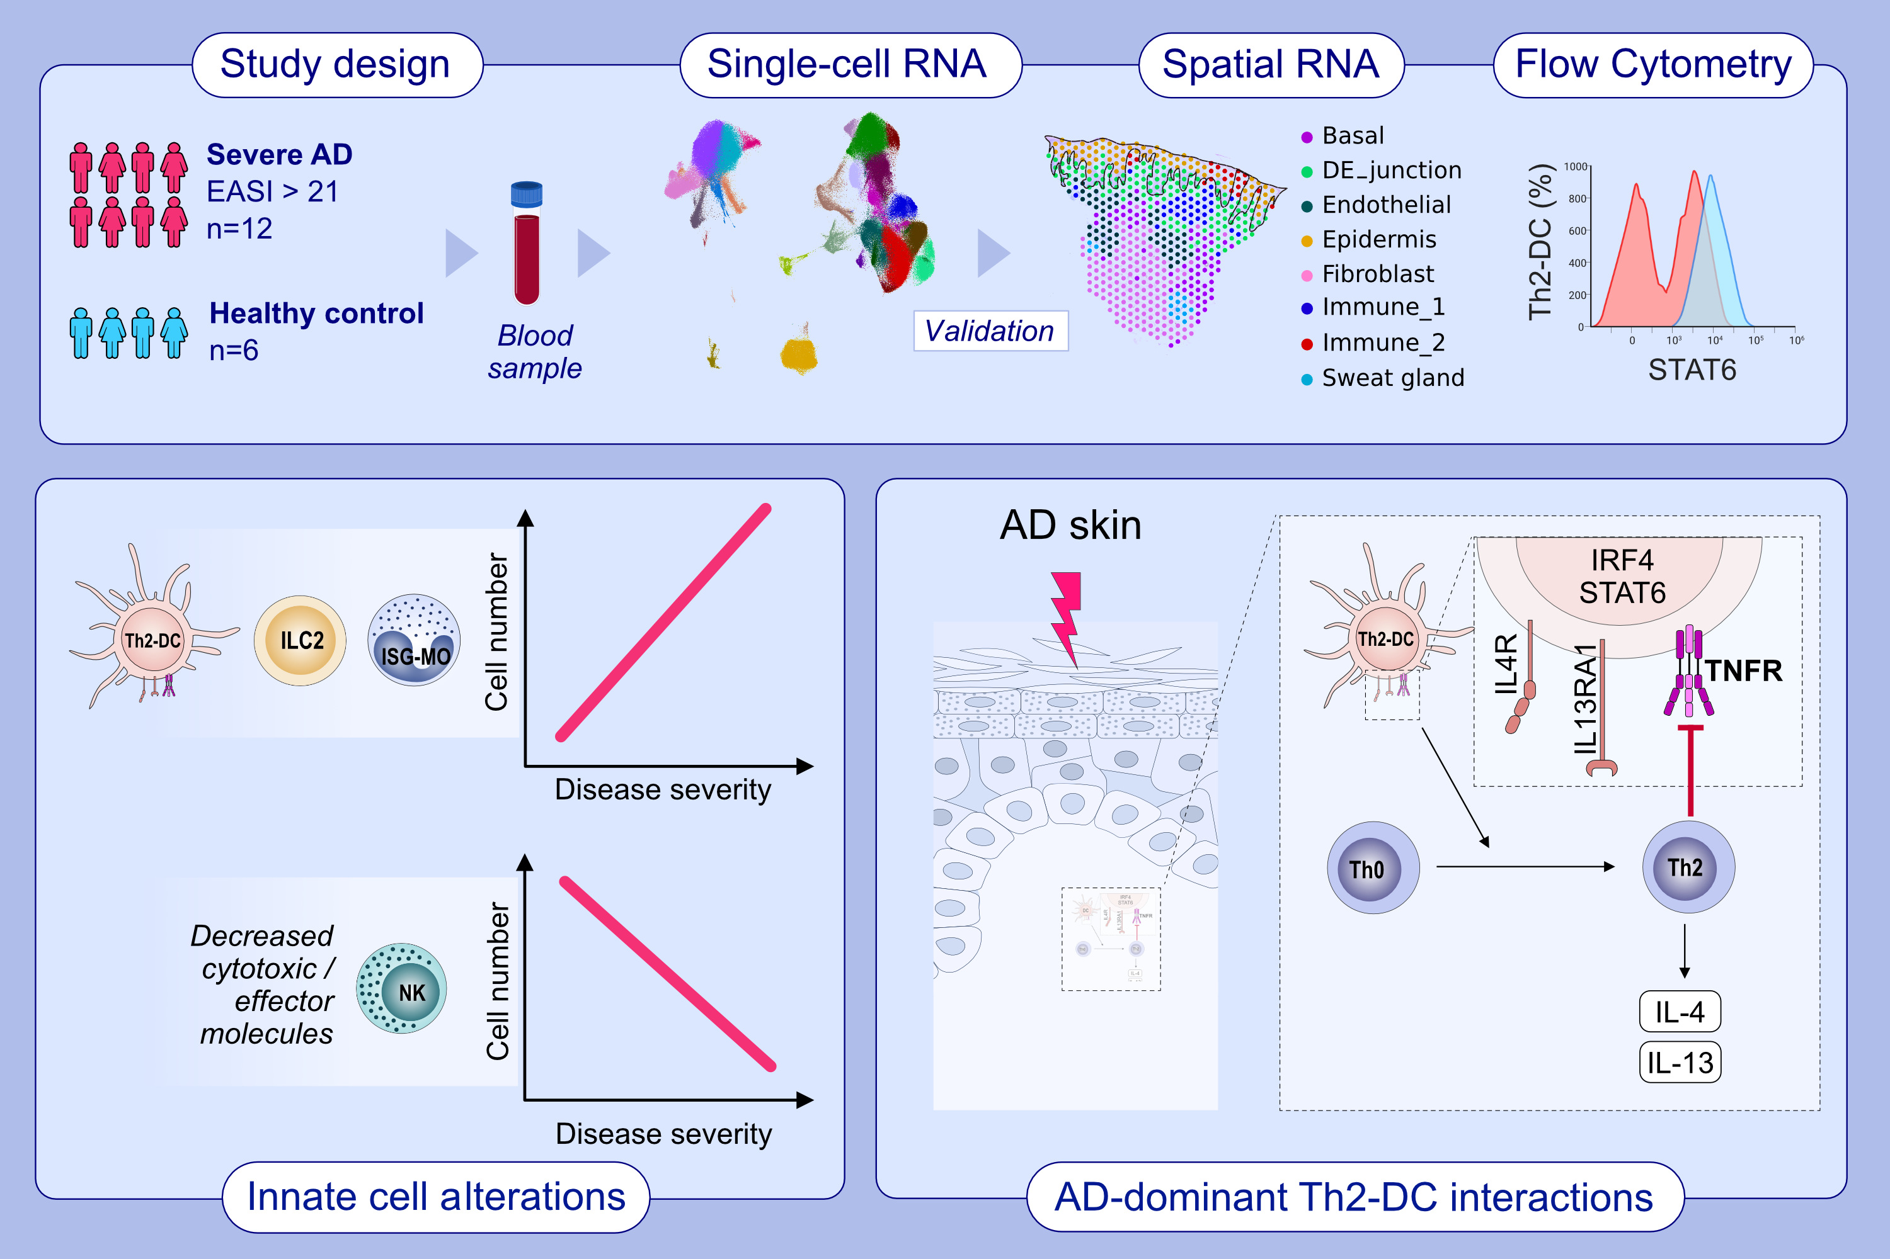
Mapping the immune cell landscape of severe atopic dermatitis by single-cell RNA-seq
Seon-Pil Jin, Kyungchun Lee, Yoon Ji Bang, Yun-Hui Jeon, Sunyoung Jung, et al.
Allergy. 2024; Pages: 1584-1597
https://doi.org/10.1111/all.16121
© 2019 EAACI and John Wiley and Sons A/S. Published by John Wiley and Sons Ltd.
Notes:
HIGHLIGHTS
• We analyzed blood samples from 12 patients with severe atopic dermatitis (EASI>21) using single-cell RNA sequencing.
• Additionally, we validated our findings with skin single-cell spatial sequencing and flow cytometry.
• Our findings revealed a strong correlation between disease severity and the expansion of ILC2s and ISG-Monocytes.
• Conversely, the number of NK cells was decreased in the patients, and the expression of cytotoxic/effector molecules in NK cells was negatively correlated with disease severity.

