Slide 1
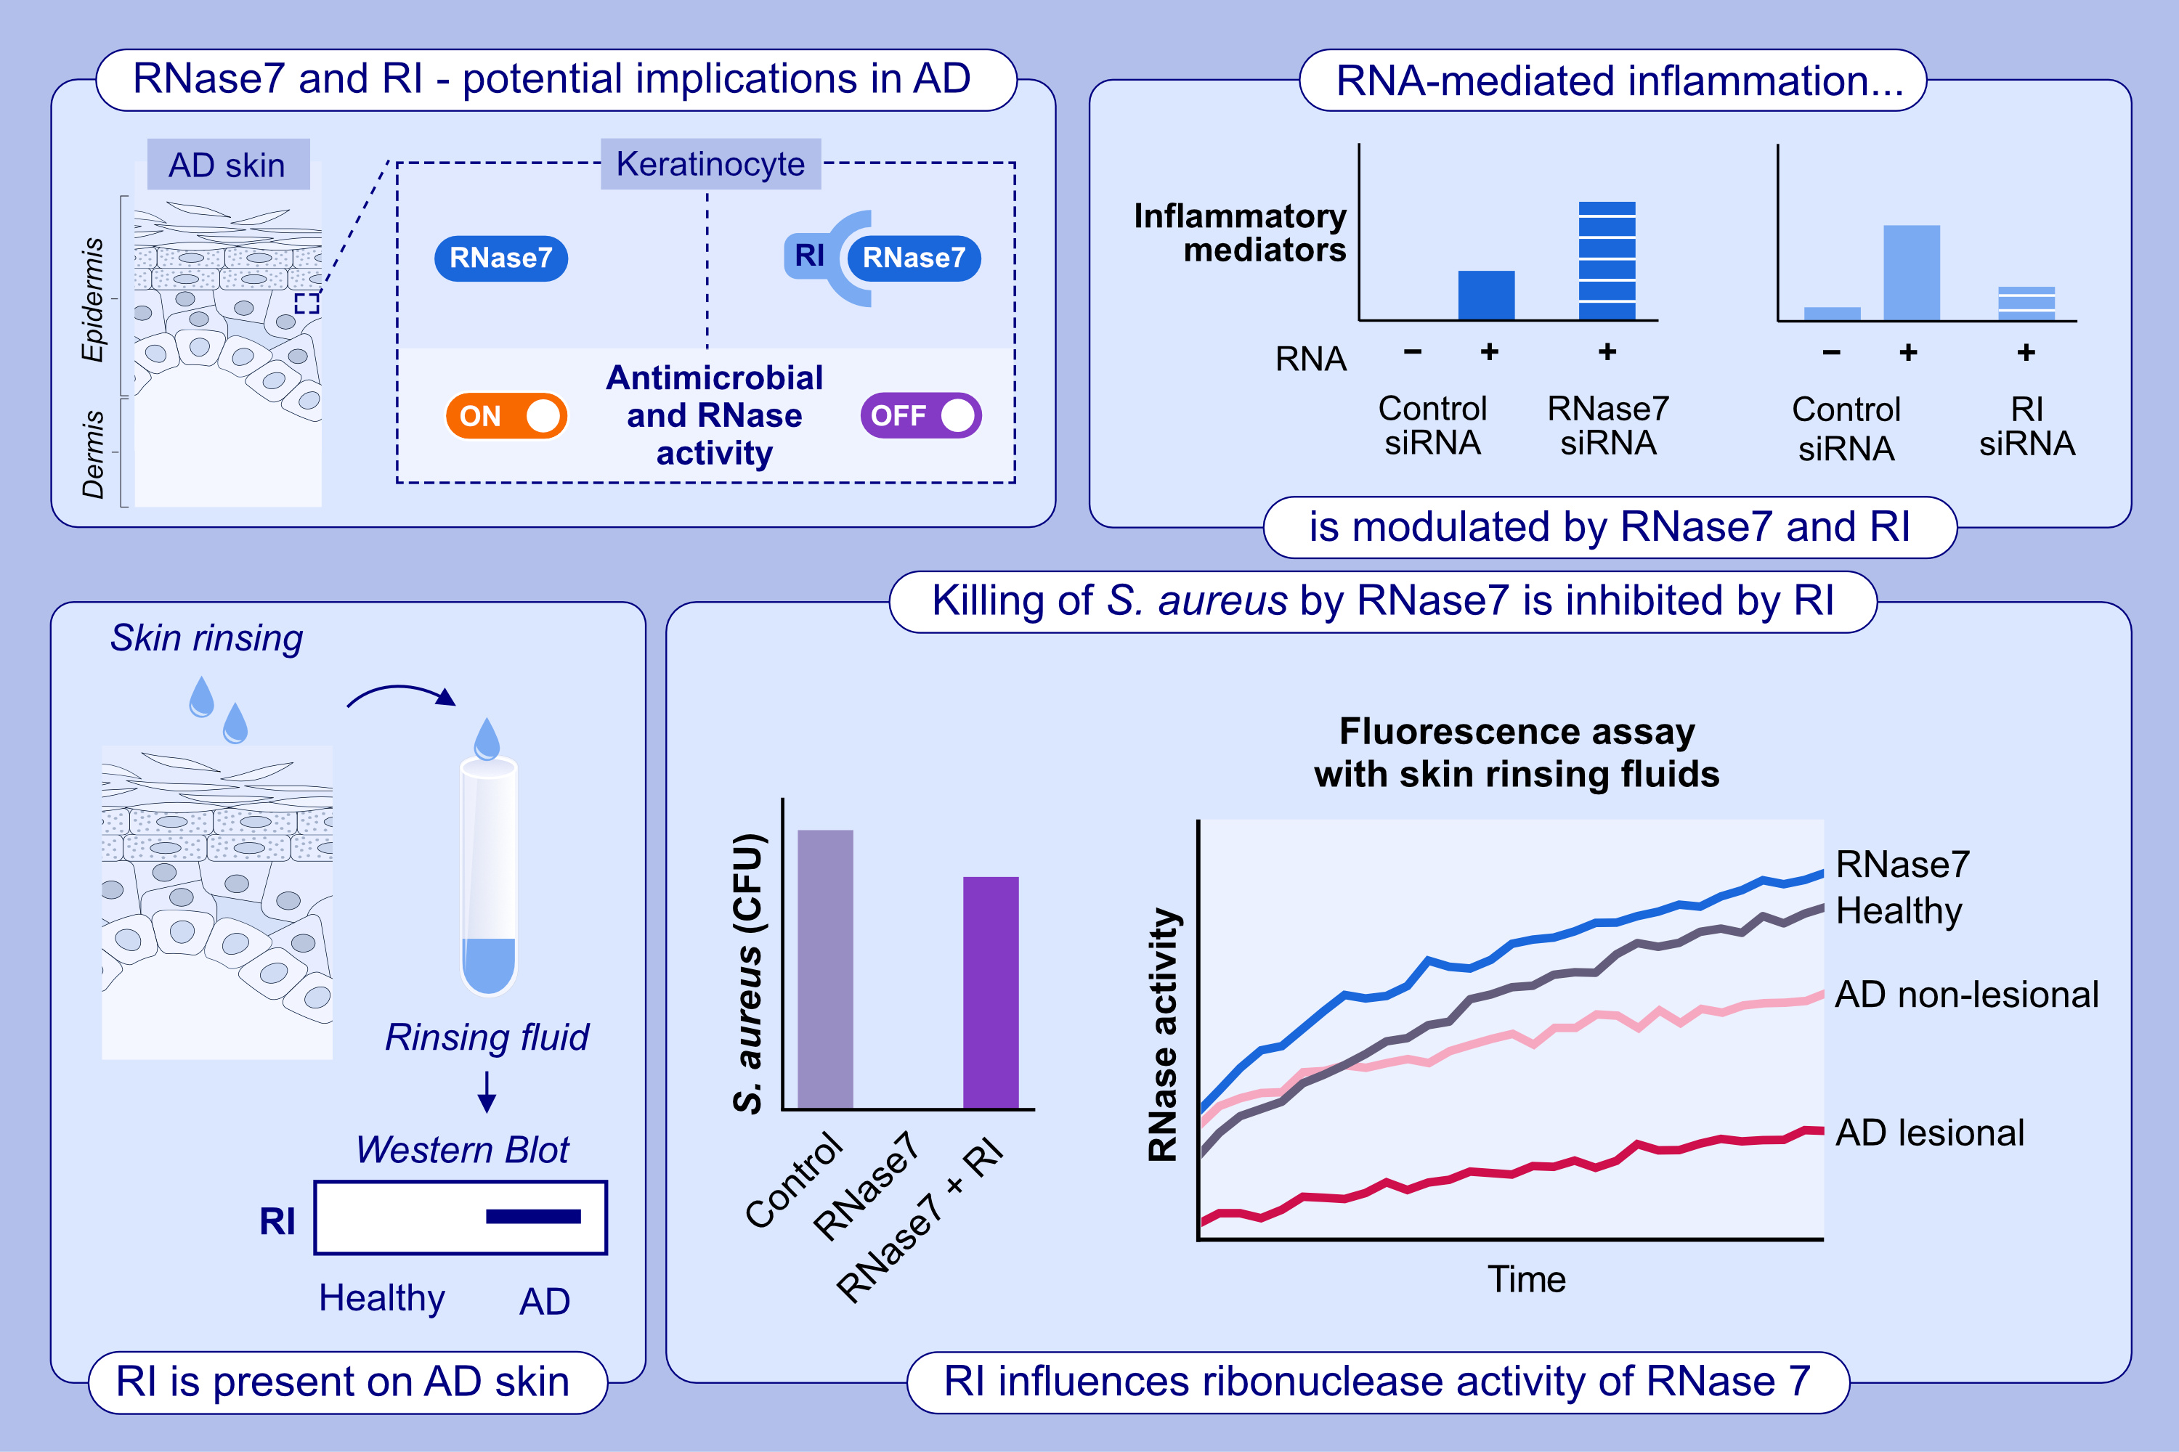
Inhibition of RNase 7 by RNase inhibitor promotes inflammation and Staphylococcus aureus growth: Implications for atopic dermatitis
Franziska Rademacher, Annika Scheel, Regine Gläser, Lena Schröder, Nina Heinemann, et al.
Allergy. 2024;Pages: 1573-1583
https://doi.org/10.1111/all.16125
© 2019 EAACI and John Wiley and Sons A/S. Published by John Wiley and Sons Ltd.
Notes:
HIGHLIGHTS
• The lesional skin of AD patients releases increased amounts of RNase inhibitor (RI).
• Host RI binds to RNase7 and blocks its ribonuclease and antimicrobial activity.
• This inactivation has an enhancing effect on the RNA-mediated pro-inflammatory response and S.
• aureus growth.

