Slide 1
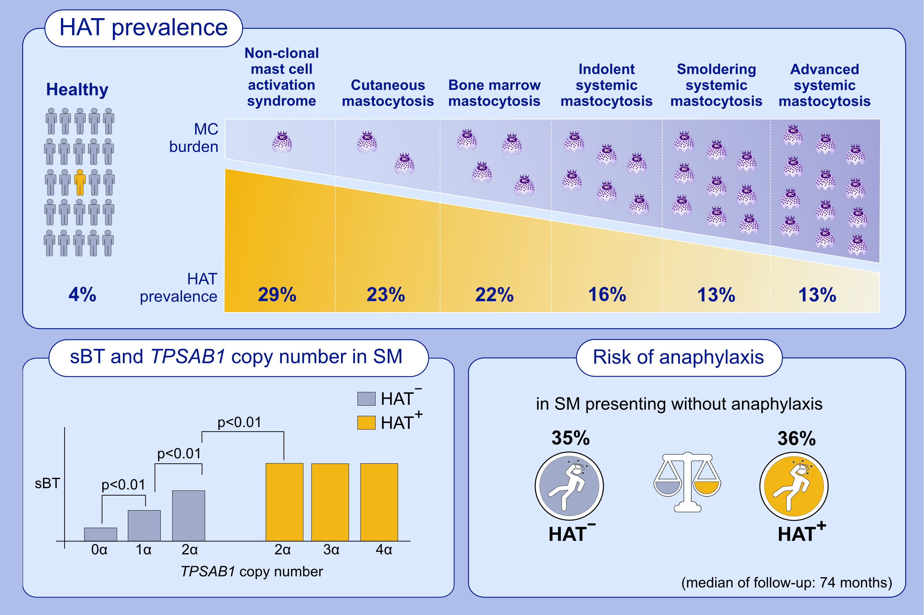
Clinical impact of the TPSAB1 genotype in mast cell diseases: A REMA study in a cohort of 959 individuals
David González-de-Olano, Paula Navarro-Navarro, Javier I. Muñoz-González, Laura Sánchez-Muñoz, Ana Henriques, et al.
Allergy. Hypersensitivity; 711-723
https://doi.org/10.1111/all.15911
© 2019 EAACI and John Wiley and Sons A/S. Published by John Wiley and Sons Ltd.
Notes:
HIGHLIGHTS
This study aimed to determine the prevalence of hereditary alpha-tryptasemia (HAT) in healthy controls and patients with different diagnostic subtypes of mast cell activation syndromes and mastocytosis.
HAT was detected in 4% healthy controls and in 29% of nc-MCAS. Among mastocytosis patients, HAT was detected in 23% CM, 22% BMM, 16 % ISM, 13% SSM and 13% AvdSM cases.
Median sBT was higher in cases presenting with HAT⁺ compared to HAT⁻ mastocytosis patients. However, among HAT⁺ patients, there is no correlation between the number of extra copies of the α-tryptase gene and sBT levels. Anaphylaxis was more frequently observed in HAT⁺ patients with mastocytosis. Those who did not refer anaphylaxis as the presenting symptom showed a similar prevalence of subsequent anaphylaxis (35% HAT⁻ and 36% HAT⁺ patients).
Abbreviations: HAT, hereditary alpha-tryptasemia; MC, mast cell; sBT, serum baseline tryptase; SM, systemic mastocytosis; TPSAB1, tryptase alpha/beta 1 gene.

