Slide 1
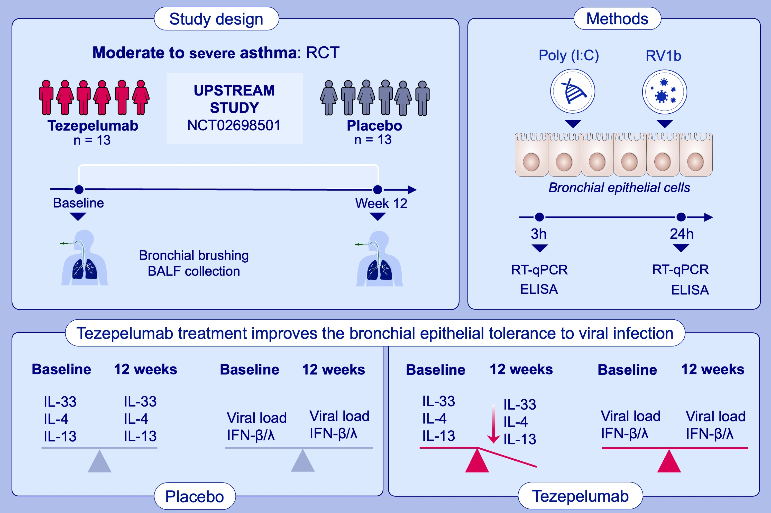
Tezepelumab decreases airway epithelial IL-33 and T2-inflammation in response to viral stimulation in patients with asthma
A. Sverrild, S. Cerps, J. J. Nieto-Fontarigo, S. Ramu, M. Hvidtfeldt, et al.
Allergy. Hypersensitivity; 656-666 https://doi.org/10.1111/all.15918
© 2019 EAACI and John Wiley and Sons A/S. Published by John Wiley and Sons Ltd.
Notes:
In a RCT study, patients with asthma were treated with placebo or tezepelumab for 12 weeks and bronchial epithelial brushes were obtained before and after treatment to investigate the bronchial epithelial immune responses to viral stimulation.
Bronchial epithelial cells obtained after tezepelumab treatment produced lower levels of viral-induced IL-33, IL-4, and IL-13 and sustained IFN-β production and viral load.
IL-33 levels in BALF were reduced after tezepelumab treatment.
Abbreviations: BALF, bronchoalveolarlavage fluid; ELISA, enzyme-linked immunosorbent assay; IFN, interferon; IL, interleukin; NCT; national clinical trial; poly (I:C), polyinosinic: polycytidylic acid; RTC, randomized controlled trial; RT-qPCR; reverse transcription quantitative polymerase chain reaction; RV, rhinovirus.

