Slide 1
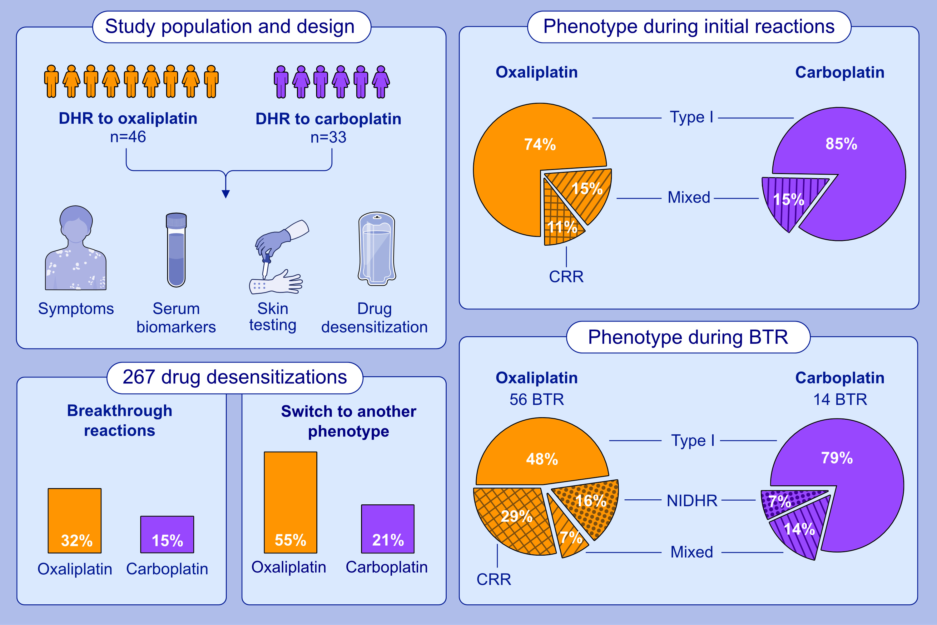
Differential presentation of hypersensitivity reactions to carboplatin and oxaliplatin: Phenotypes, endotypes, and management with desensitization
Teodorikez-Wilfox Jimenez-Rodriguez, Leticia de las Vecillas, Marina Labella, Donna-Marie Lynch, Kylie Marie Besz, et al.
Allergy. Hypersensitivity; 679-689
https://doi.org/10.1111/all.15940
© 2019 EAACI and John Wiley and Sons A/S. Published by John Wiley and Sons Ltd.
Notes:
HIGHLIGHTS
Carboplatin reactions are type I IgE-mediated with few mixed phenotype, while oxaliplatin reactions are type I IgE-mediated, CRR and mixed phenotypes.
Desensitization is safe and effective for both platins regardless of phenotypes.
Breakthrough reactions during desensitization are type I for carboplatin with tryptase elevations. Oxaliplatin reaction can undergo phenotype switching from type I to CRR and mixed with IL-6 elevations.
Abbreviations: BTR, breakthrough reaction; CRR, cytokine release reaction phenotype; IL-6, interleukin 6; NIDHR, non-immediate drug hypersensitivity reaction.

