Slide 1
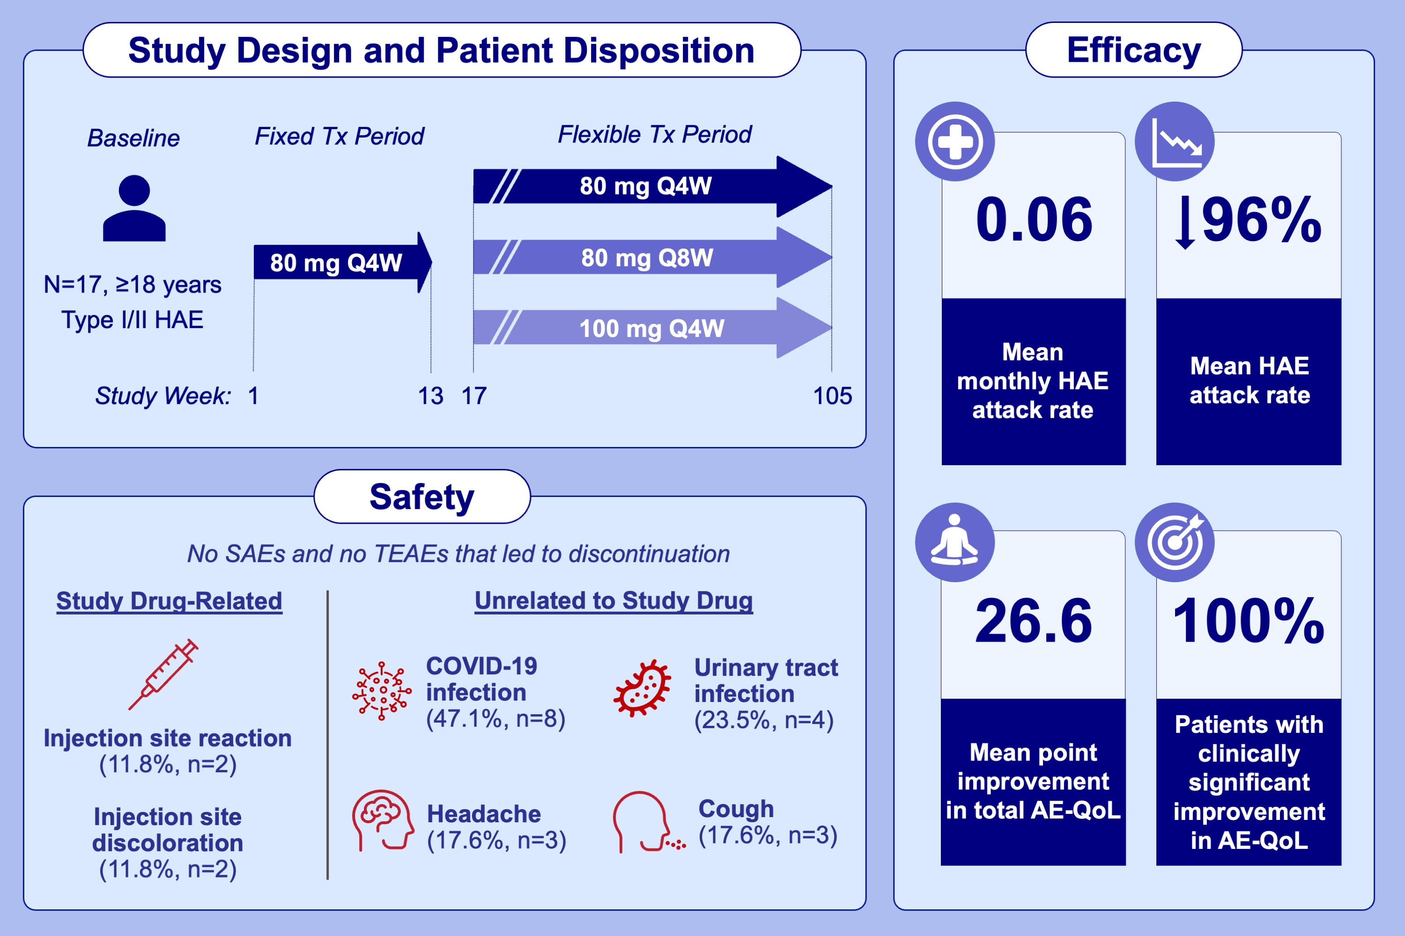
A phase 2 open-label extension study of prekallikrein inhibition with donidalorsen for hereditary angioedema
Remy S. Petersen, Laura Bordone, Marc A. Riedl, Raffi Tachdjian, Timothy J. Craig, et al.
Allergy. Hypersensitivity; 724-734
https://doi.org/10.1111/all.15948
© 2019 EAACI and John Wiley and Sons A/S. Published by John Wiley and Sons Ltd.
Notes:
HIGHLIGHTS
After 2 years of donidalorsen treatment, injection site discoloration and reaction were the only treatment-related adverse events reported in >1 patient.
Donidalorsen treatment resulted in a sustained mean 96.0% reduction from baseline in HAE attack rates, with a mean ≈1 attack/year (median 0.04).
100.0% of patients treated with donidalorsen had clinically significant improvements in quality of life at week 105.
Abbreviations: AE-QoL, angioedema quality of life; HAE, hereditary angioedema; TEAE, treatment-emergent adverse event; Q4W; every 4 weeks; Q8W, every 8 weeks;
SAE, serious adverse event; Tx, treatment.

