Slide 1
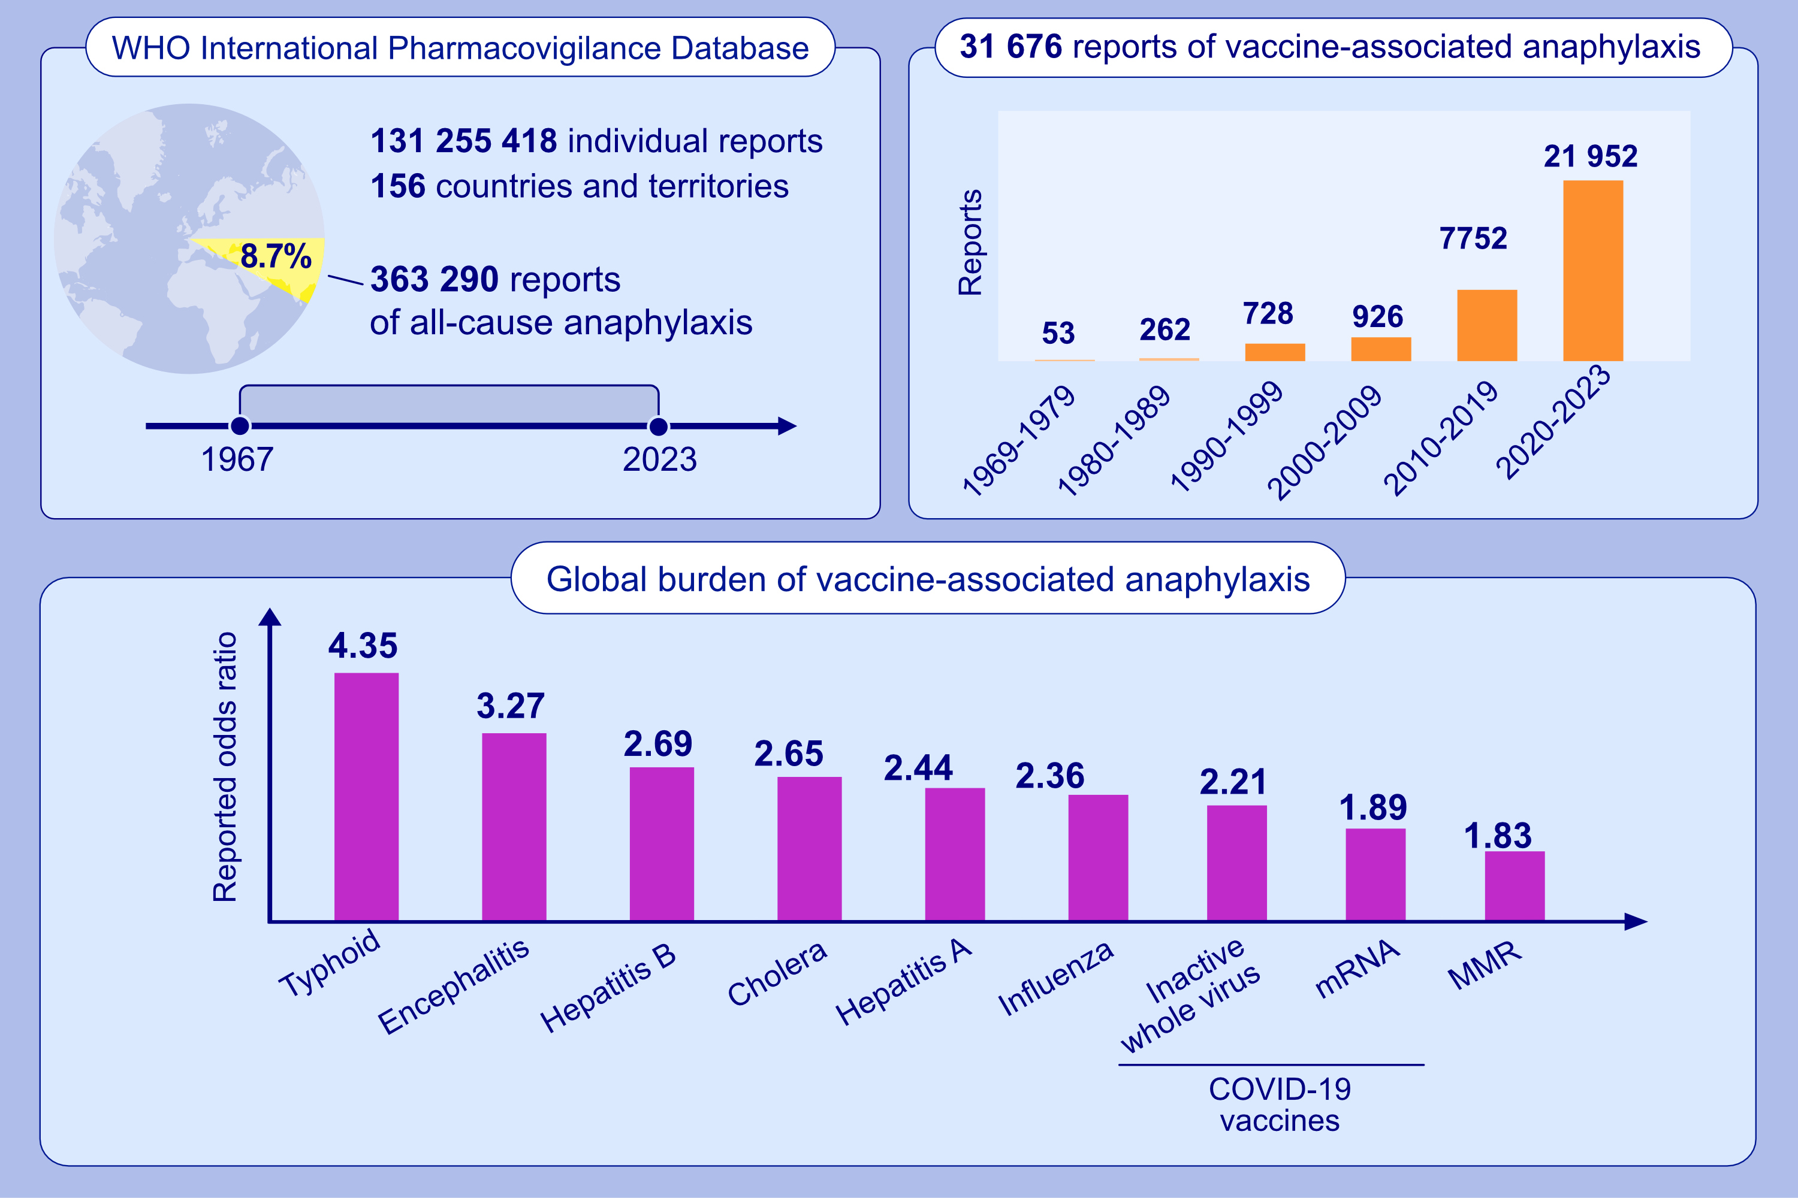
Global burden of vaccine-associated anaphylaxis and their related vaccines, 1967–2023: A comprehensive analysis of the international pharmacovigilance database
Kyeonghun Lee, Hayeon Lee, Rosie Kwon, Youn Ho Shin, Seung Geun Yeo, et al.
Allergy. Hypersensitivity; 690-701
https://doi.org/10.1111/all.15968
© 2019 EAACI and John Wiley and Sons A/S. Published by John Wiley and Sons Ltd.
Notes:
HIGHLIGHTS
We identified 31 676 reports of vaccine-associated anaphylaxis among 363 290 reports of all-cause anaphylaxis from the World Health Organization International Pharmacovigilance Database.
The cumulative number of reports on vaccine-associated anaphylaxis has gradually increased over time, with a dramatic increase after 2020, owing to COVID-19 mRNA vaccine-associated anaphylaxis.
The typhoid vaccines caused the most anaphylactic reports, followed by encephalitis, hepatitis B, cholera, hepatitis A, influenza, inactivated whole-virus COVID-19, and COVID-19 mRNA vaccines.
Abbreviations: COVID-19, coronavirus disease 2019; MMR, measles, mumps, and rubella;
WHO, World Health Organization.

