Slide 1
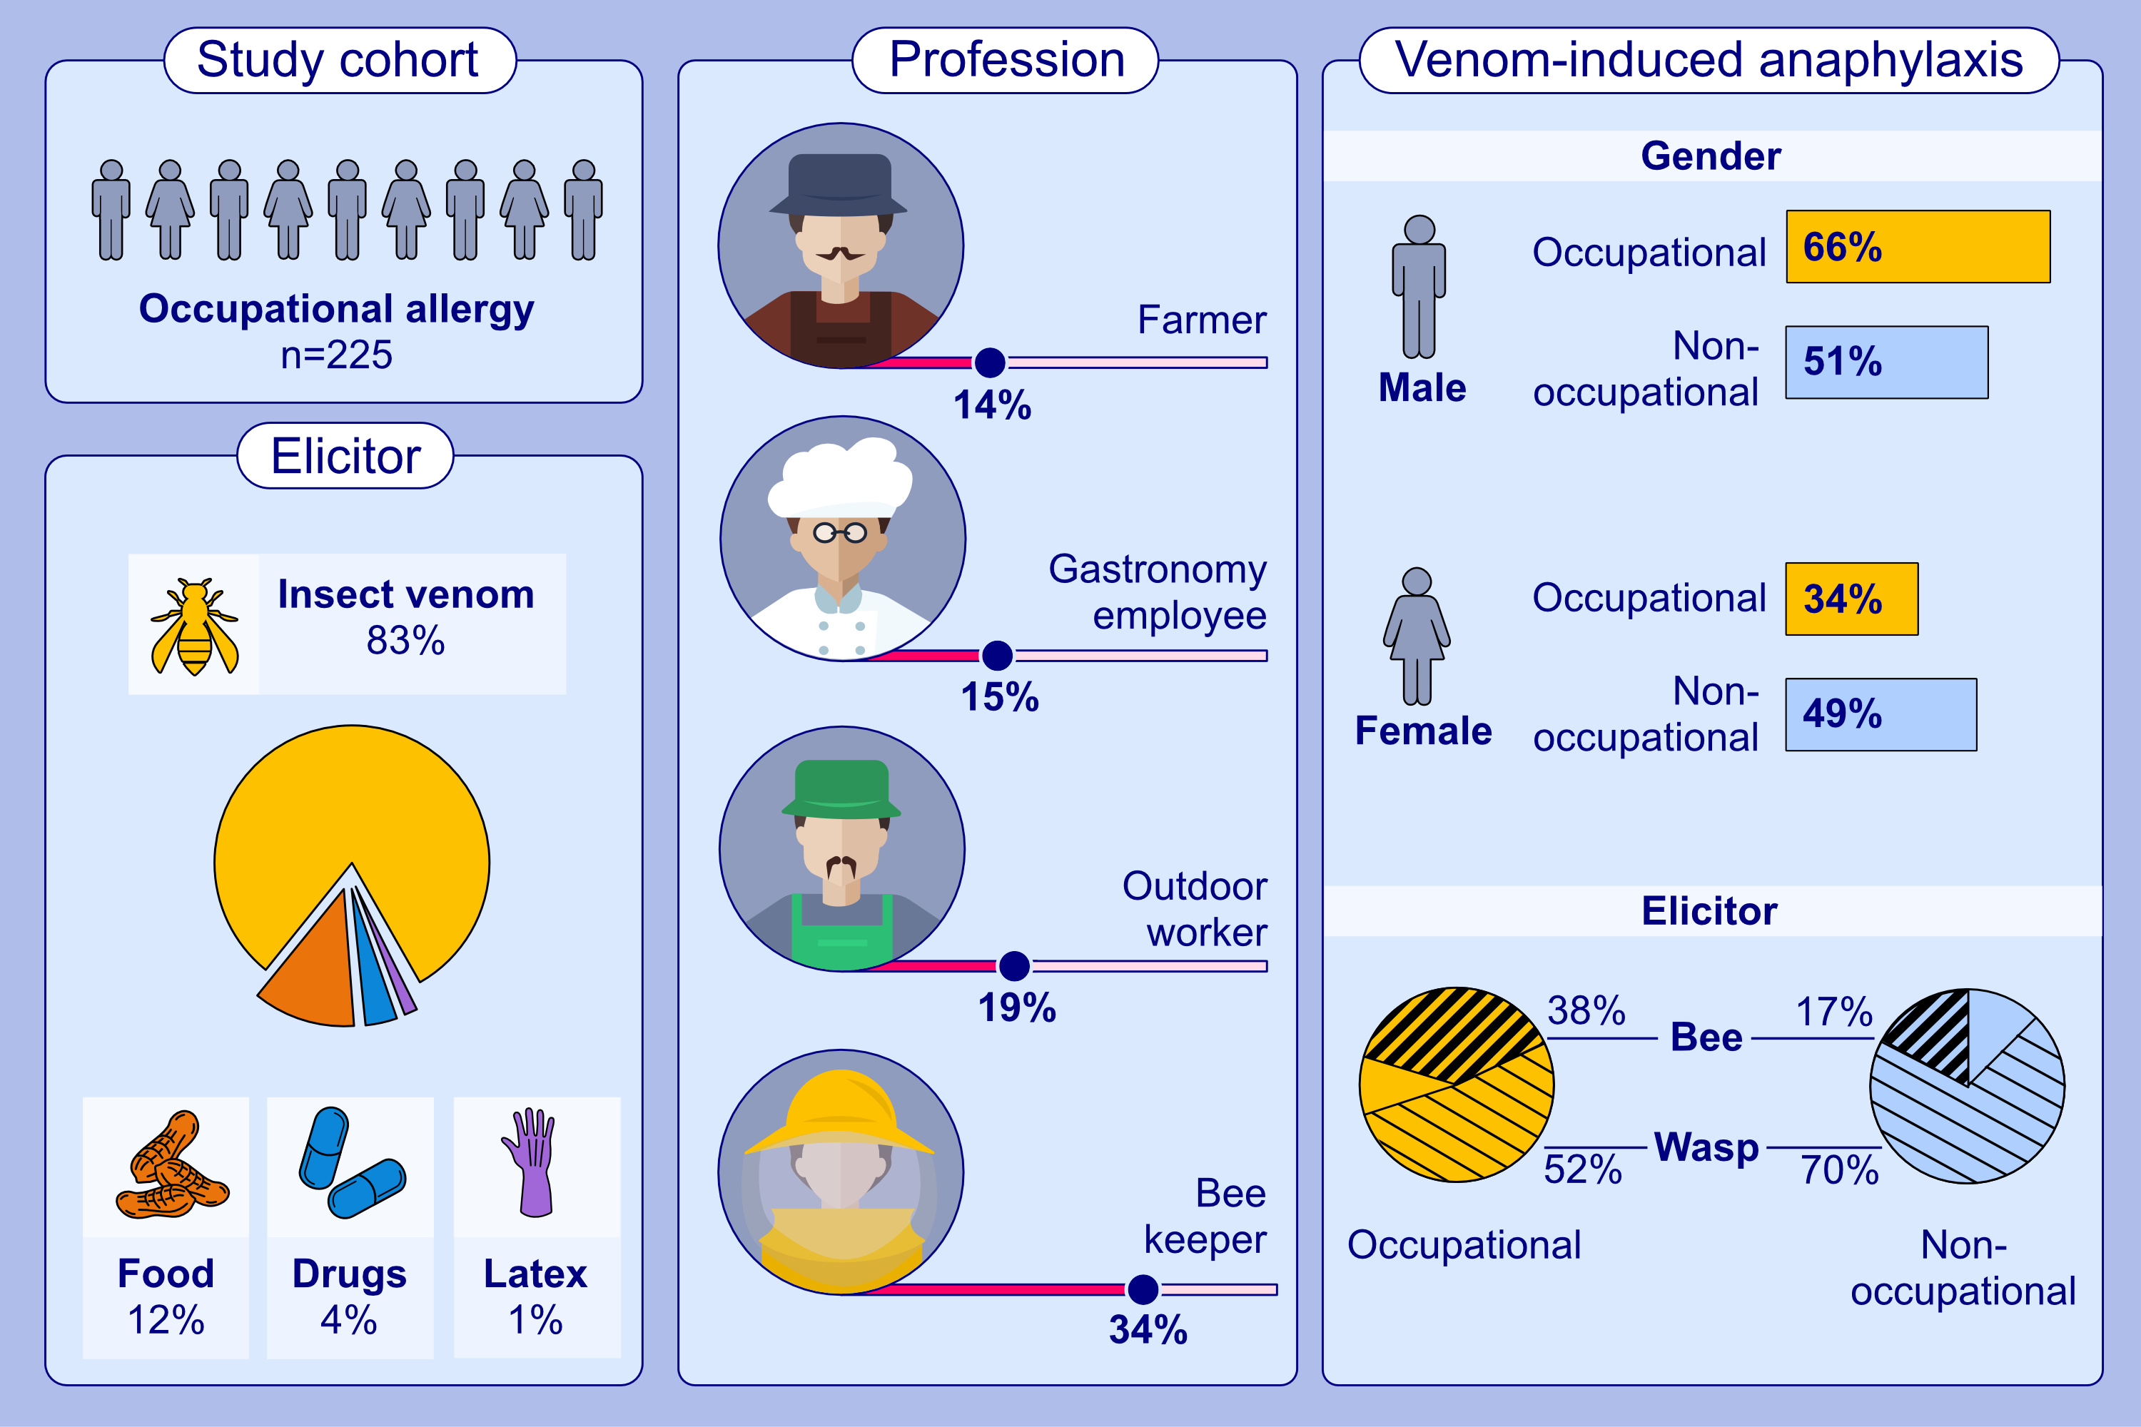
Occupational anaphylaxis—Data from the anaphylaxis registry
Margitta Worm, Veronika Höfer, Sabine Dölle-Bierke, Maria Beatrice Bilo, Karin Hartmann, et al.
Allergy. Hypersensitivity; 702-710
https://doi.org/10.1111/all.15974
© 2019 EAACI and John Wiley and Sons A/S. Published by John Wiley and Sons Ltd.
Notes:
HIGHLIGHTS
Insect venom, followed by food were the most frequent elicitors of occupational anaphylaxis. Anaphylaxis to bee venom was more frequent in occupational anaphylaxis than non-occupational anaphylaxis in adults.
Occupational anaphylaxis to drugs was rare and most frequently induced by antibiotics. Only two occupational cases were latex-induced.
Beekeepers, outdoor workers (e.g. gardeners) and farmers were the most frequently affected occupations.

