Slide 1
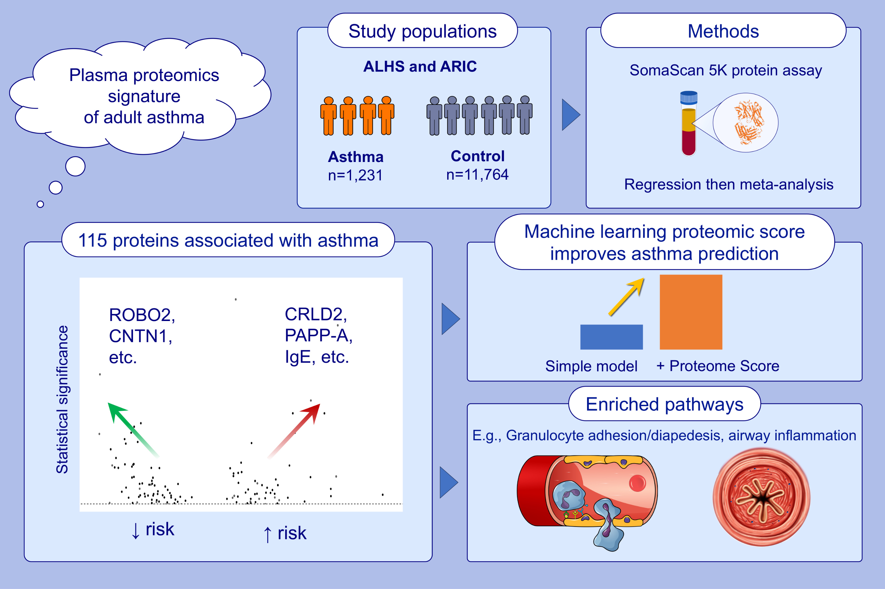
Plasma protein signatures of adult asthma
Gordon J. Smilnak, Yura Lee, Abhijnan Chattopadhyay, Annah B. Wyss, Julie D. White, et al.
Allergy. Hypersensitivity; 643-655 https://doi.org/10.1111/all.16000
© 2019 EAACI and John Wiley and Sons A/S. Published by John Wiley and Sons Ltd.
Notes:
HIGHLIGHTS
We identified 115 proteins significantly related to asthma. Using limited data from published studies, we validated some proteins. Many were novel.
Using a machine learning method, we constructed a proteomic score which provided additional predictive value for asthma.
Notably, a druggable target search revealed that 20 proteins we identified are targets of approved or investigational drugs.
Abbreviations: ALHS, Agricultural Lung Health Study; ARIC, Atherosclerosis Risk in Communities; CNTN1, contactin-1; CRLD2, Cysteine-rich secretory protein LCCL domain-containing 2; IgE, Immunoglobulin E; PAPP-A, Pappalysin-1; ROBO2, roundabout homolog 2.

