Slide 1
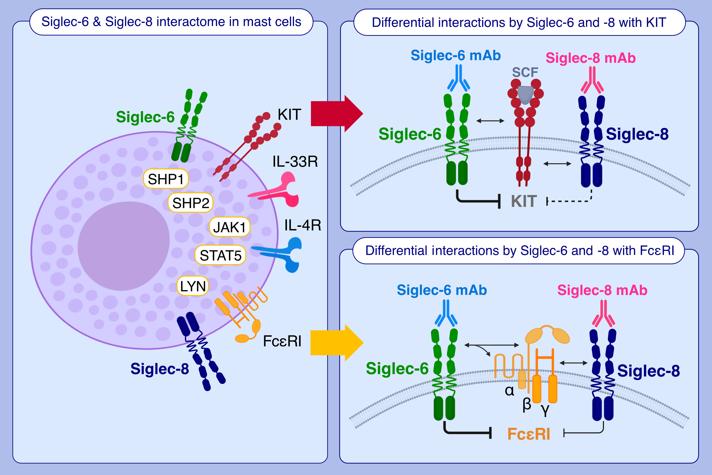
Regulation of mast cells by overlapping but distinct protein interactions of Siglec-6 and Siglec-8
Wouter Korver, Zachary Benet, Alan Wong, Gian Luca Negri, Katherine Chang, et al.
Allergy. Hypersensitivity; 629-642 https://doi.org/10.1111/all.16004
© 2019 EAACI and John Wiley and Sons A/S. Published by John Wiley and Sons Ltd.
Notes:
HIGHLIGHTS
Siglec family inhibitory receptors interact with multiple activating receptors and signaling molecules in mast cells.
Comparative analysis of Siglec-6 and Siglec-8 interactomes suggests distinct roles in mast cell regulation, with some functional overlap.
Siglec-6 engagement appears to elicit broader and more complete mast cell inhibition through ITAM and non-ITAM receptors than through Siglec-8.
Abbreviations: FcεRI, Fc epsilon receptor I, ITAM, immunoreceptor tyrosine-based activation motif; JAK1, Janus kinase 1; KIT, proto-oncogene, receptor tyrosine kinase; LYN, tyrosine-protein kinase; mAb, monoclonal antibody; SCF, stem cell factor; SHP, Src homology region 2 domain-containing phosphatase; Siglec, sialic acid-binding immunoglobulin-like lectin; STAT5, signal transducer and activator of transcription 5

