Slide 1
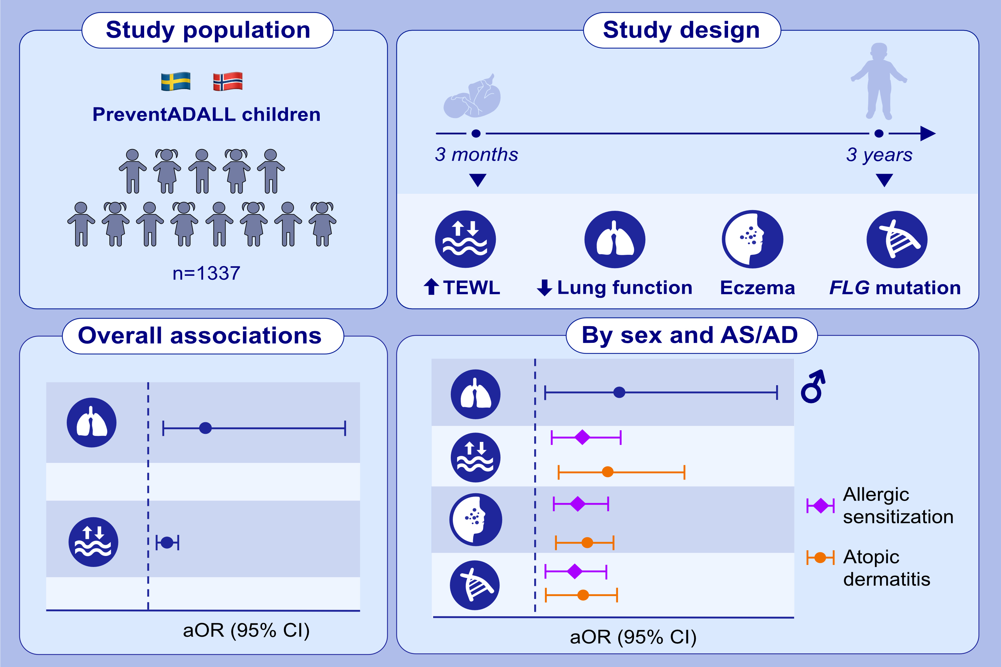
Infant lung function and early skin barrier impairment in the development of asthma at age 3 years
Martin Färdig, Angela Hoyer, Catarina Almqvist, Karen Eline S. Bains, Karin C. Lødrup Carlsen, et al.
Allergy. Hypersensitivity; 667-678 https://doi.org/10.1111/all.16024
© 2019 EAACI and John Wiley and Sons A/S. Published by John Wiley and Sons Ltd.
Notes:
HIGHLIGHTS
In a large pediatric population from the factorially designed randomized controlled intervention study PreventADALL, we investigated if lower lung function, impaired skin barrier function by TEWL, eczema at age 3 months and FLG mutations were associated with asthma at age 3 years.
Lower lung function and skin barrier impairment in infancy increased the risk of asthma in general.
Stratifying for sex, the risk of asthma was only increased in boys with lower lung function. Eczema and FLG mutations were associated with asthma in children with AD or AS only.
Abbreviations: AD, atopic dermatitis; AS, allergic sensitization; aOR, adjusted odds ratio; CI, confidence interval; FLG, filaggrin; PreventADALL, Preventing Atopic Dermatitis and ALLergies in children; TEWL, transepidermal water loss.

