Slide 1
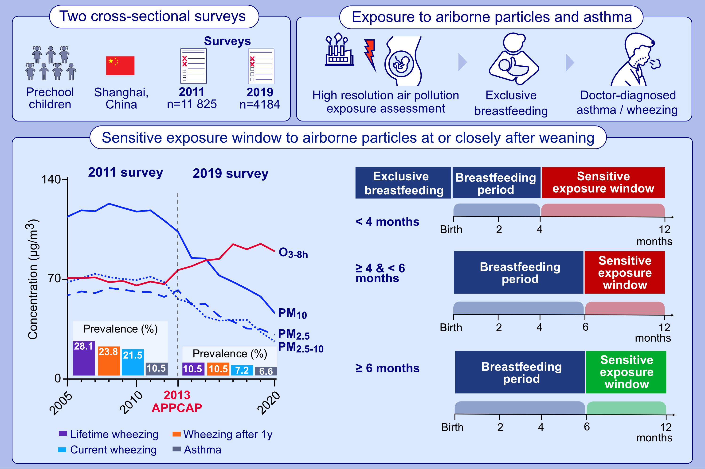
Improved ambient air quality is associated with decreased prevalence of childhood asthma and infancy shortly after weaning is a sensitive exposure window
Tianyi Chen, Su Shi, Xinyue Li, Lu Zhou, Yongfu Yu, et al.
Allergy. Pages: 1166-1179
https://doi.org/10.1111/all.15815
© 2019 EAACI and John Wiley and Sons A/S. Published by John Wiley and Sons Ltd.
Notes:
HIGHLIGHTS
• Compared to 2011, improved air quality benefited in decreasing preschool children’s asthma in 2019 in Shanghai.
• Exposure to airborne particles in infancy was associated with preschoolers' asthma and wheezing, independent of exposure in pregnancy.
• We firstly reported a sensitive exposure window for asthma in infancy at or closely after weaning in children with <6m of exclusive breastfeeding. .

