Slide 1
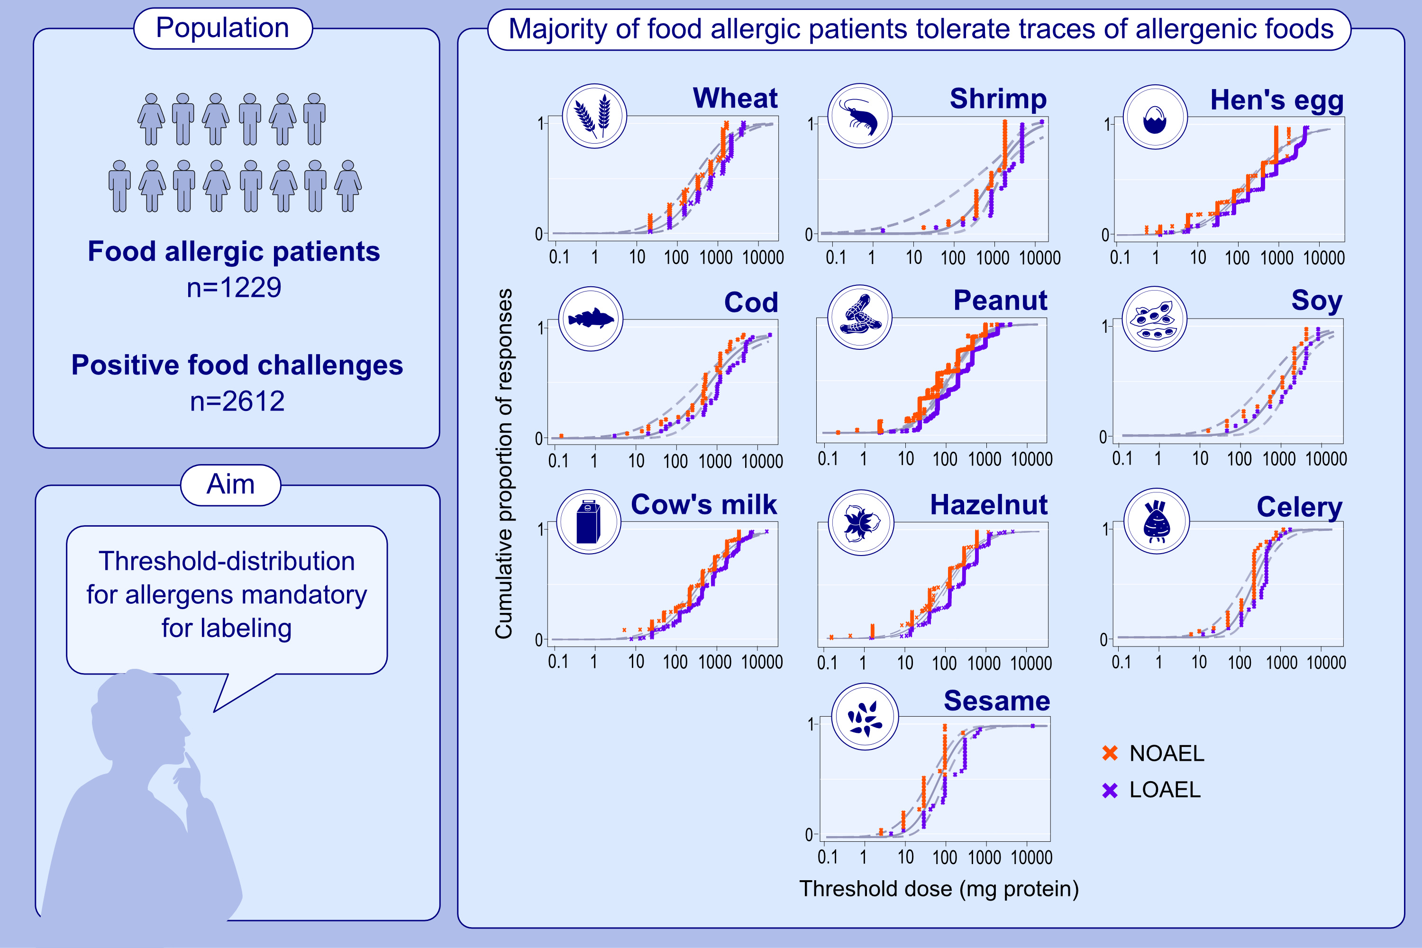
Challenge-verified thresholds for allergens mandatory for labeling: How little is too much for the most sensitive patient?
Charlotte G. Mortz, Esben Eller, Olav Sivertsen Garvik, Henrik Fomsgaard Kjaer, Torsten Zuberbier, et al.
Allergy. Pages: 1306-1316 https://doi.org/10.1111/all.15870
© 2019 EAACI and John Wiley and Sons A/S. Published by John Wiley and Sons Ltd.
Notes:
HIGHLIGHTS
• Using interval censored log-normal models only five groups (hens´ egg, fish, peanut, milk, tree-nuts) could elicit reactions after ingestion of 0.5 mg protein and in low frequencies of the population.
• Hen´s egg was the most potent allergen, with reactivity to <0.5 mg protein in 0.24%.
• The majority of the most sensitive patients reacted with a Sampson severity score of 2-3.
.

