Slide 1
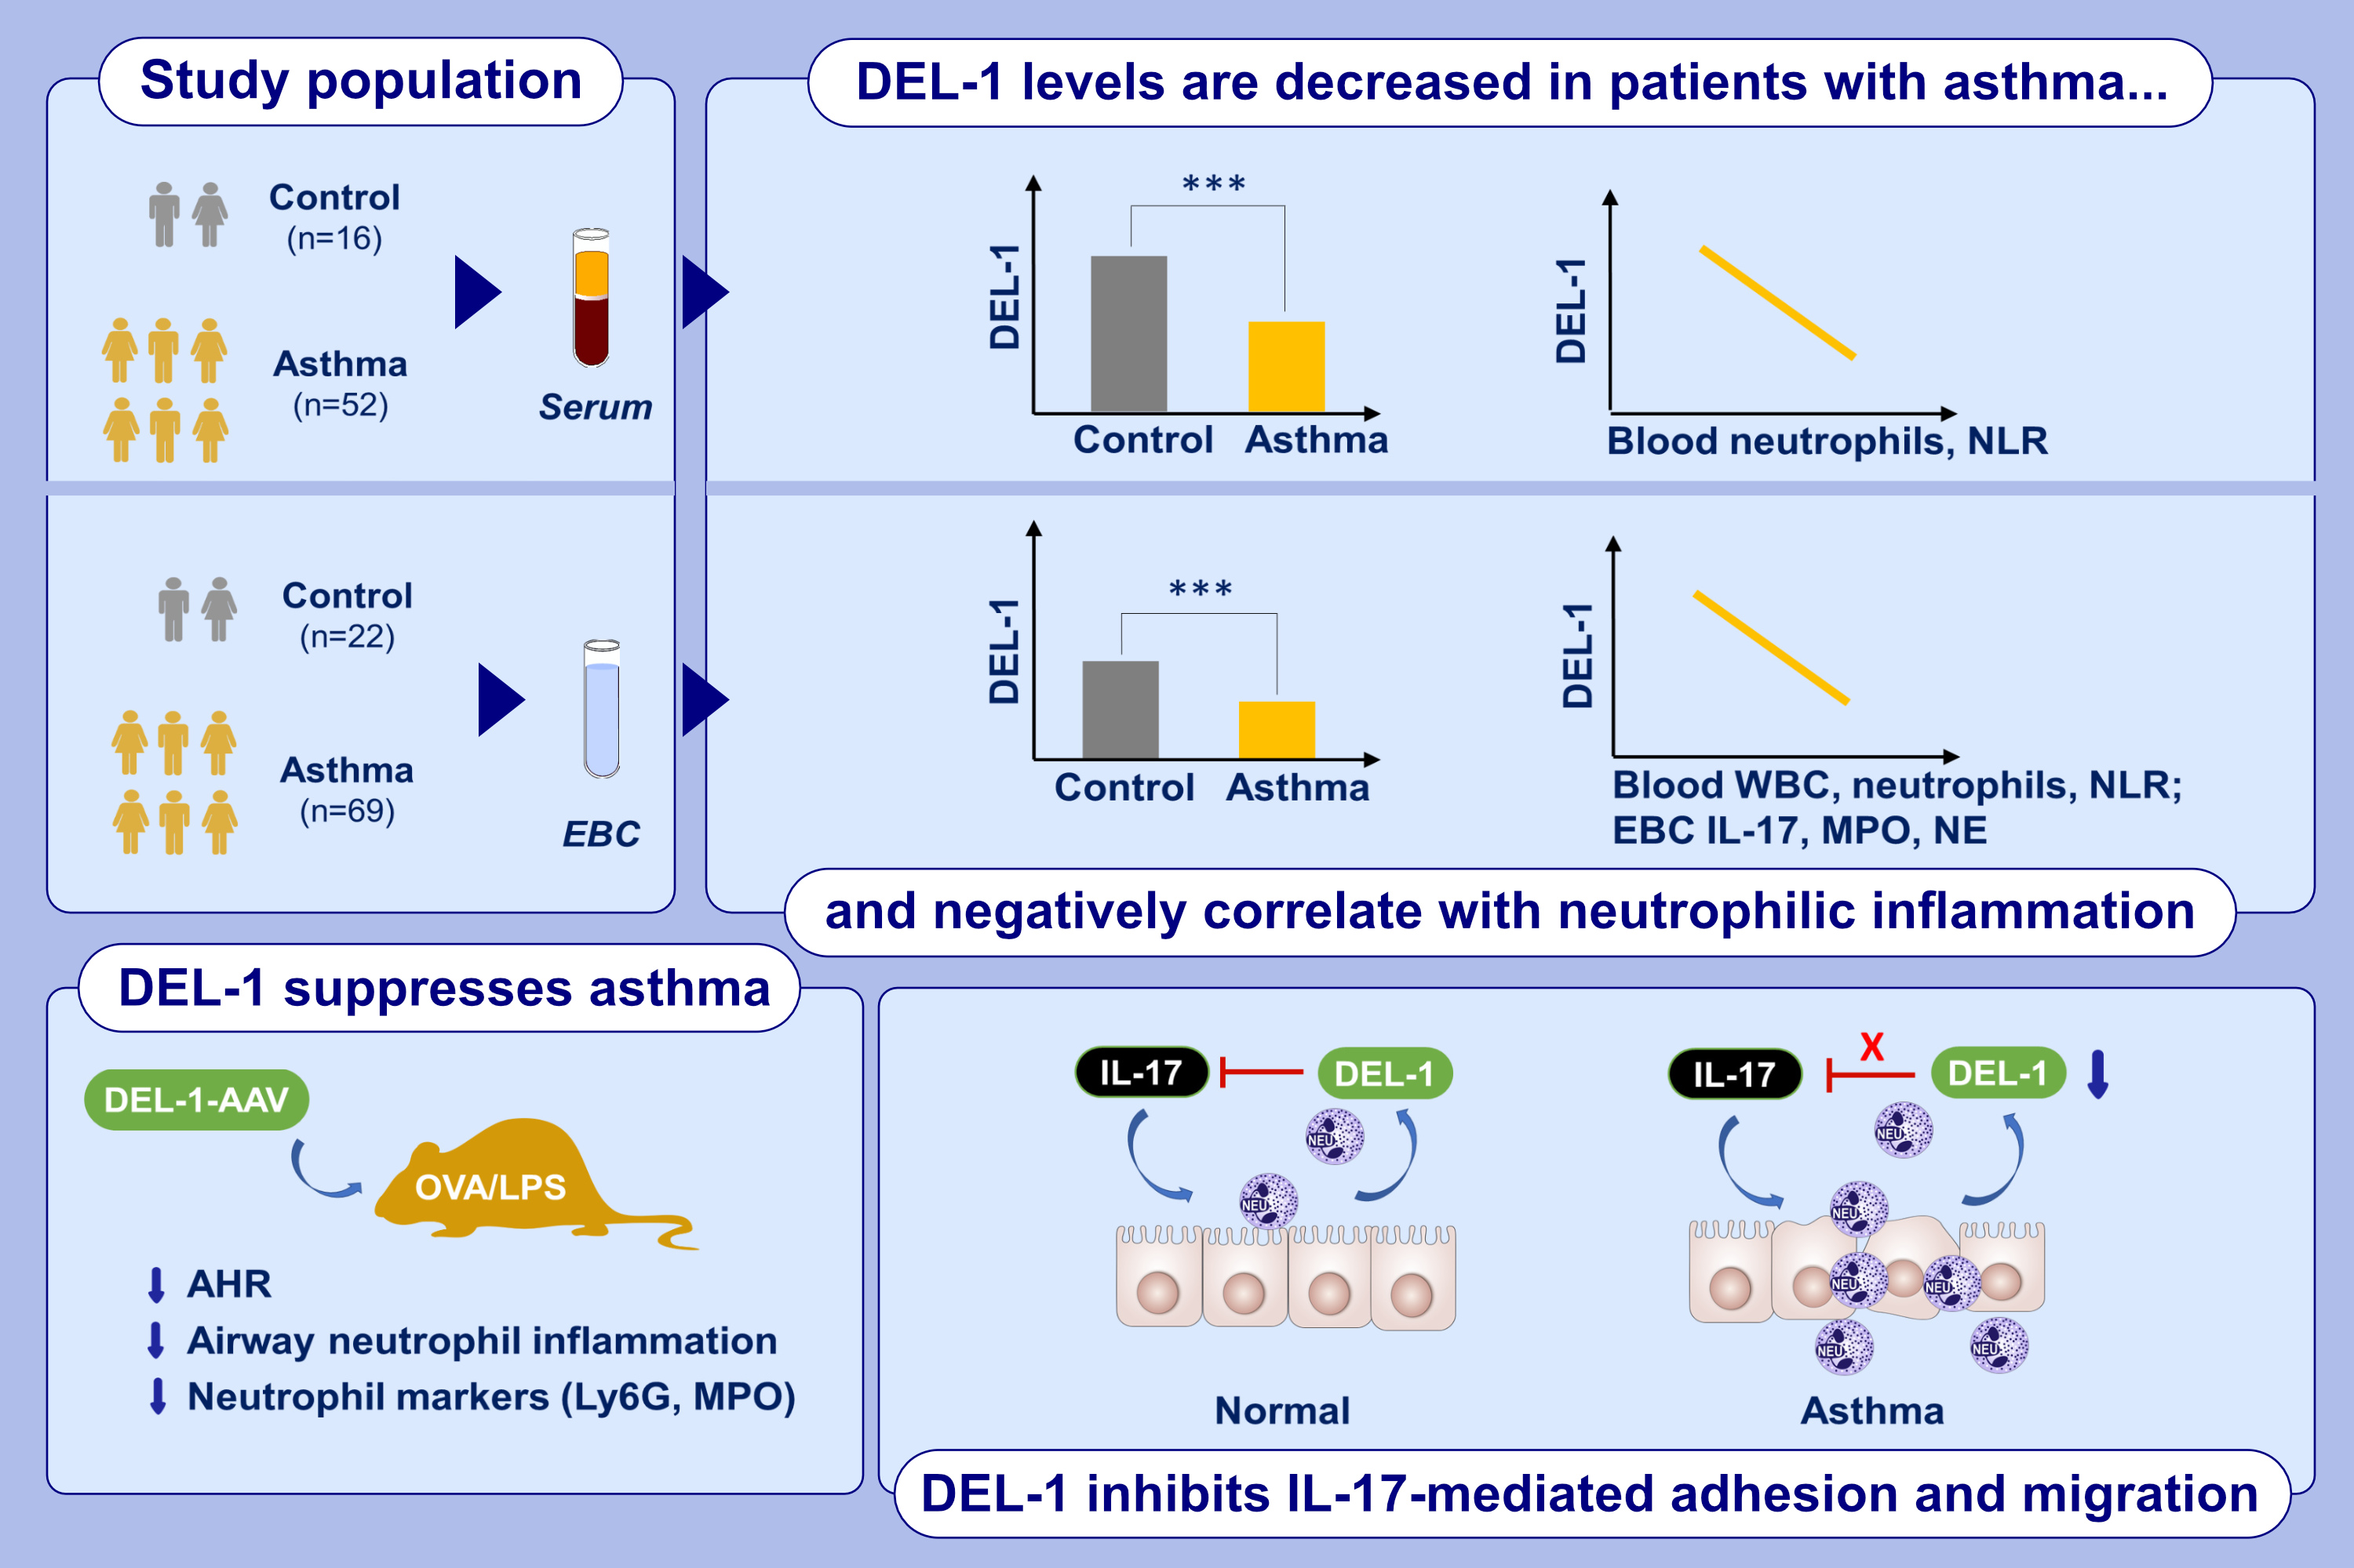
DEL-1, as an anti-neutrophil transepithelial migration molecule, inhibits airway neutrophilic inflammation in asthma
Man Jia, Heng Fu, Xinyu Jiang, Lina Wang, Jiayan Xu, et al.
Allergy. Pages: 1180-1194
https://doi.org/10.1111/all.15882
© 2019 EAACI and John Wiley and Sons A/S. Published by John Wiley and Sons Ltd.
Notes:
HIGHLIGHTS
• EBC and serum DEL-1 levels are decreased in asthma and are correlated with neutrophil related markers.
• IL-17 induces downregulation of DEL-1 in 16HBE, whereas exogenous DEL-1 significantly suppresses IL-17-induced neutrophil adhesion and transepithelial migration in asthma.
• DEL-1 overexpression attenuates airway neutrophil infiltration in neutrophilic asthmatic mice. .

