Slide 1
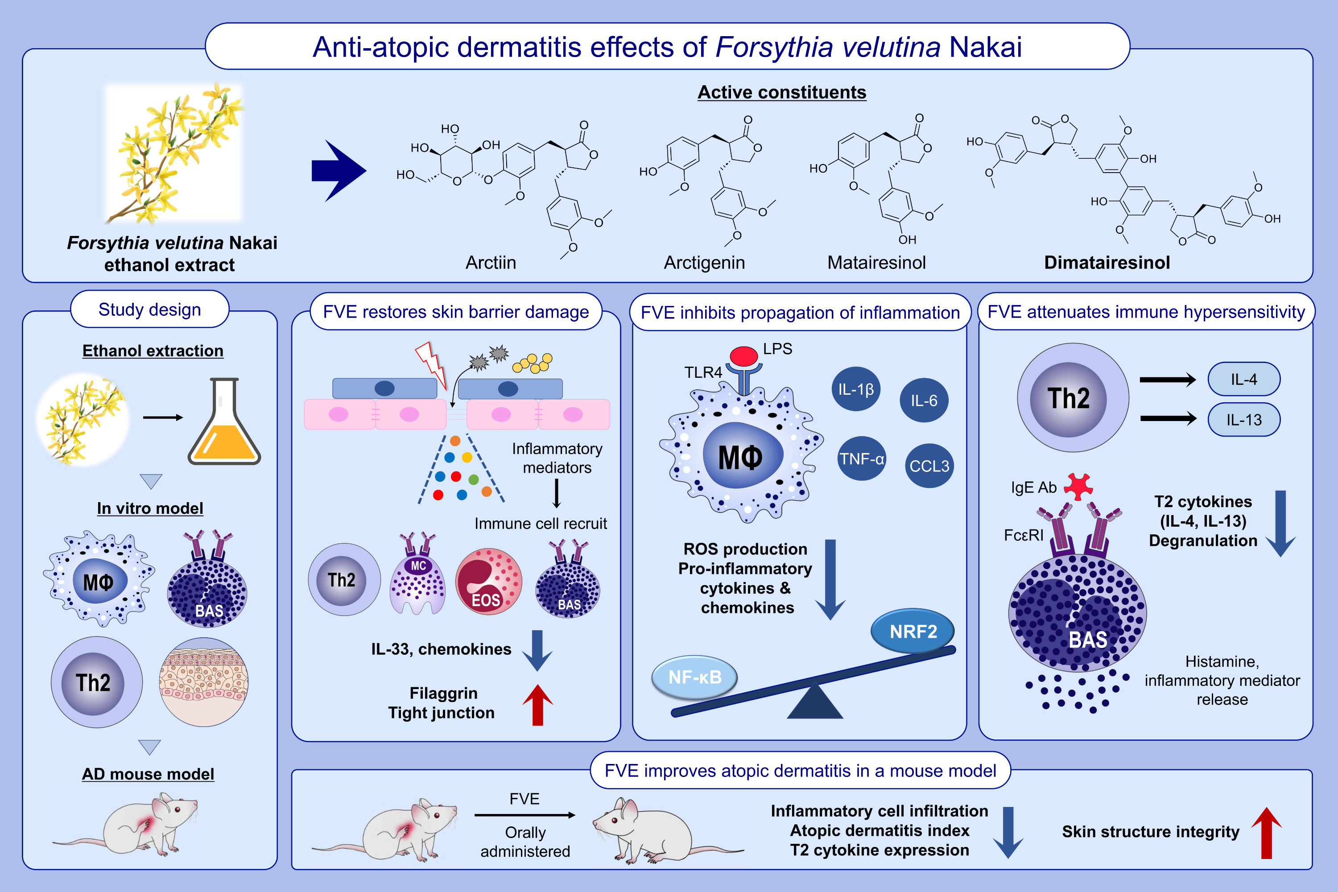
Forsythia velutina Nakai extract: A promising therapeutic option for atopic dermatitis through multiple cell type modulation
Yujin Kwon, Yoon Jin Kang, Jaeyoung Kwon, Su-Yeon Cho, Jiyoon Kim, et al.
Allergy. Pages: 1242-1257
https://doi.org/10.1111/all.15967
© 2019 EAACI and John Wiley and Sons A/S. Published by John Wiley and Sons Ltd.
Notes:
HIGHLIGHTS
• Forsythia velutina Nakai extract (FVE) was investigated for atopic dermatitis (AD) treatment.
• FVE inhibits TLR4-mediated inflammatory MAPK and NF-κB signaling in macrophages, activates the NRF2-mediated ROS scavenging pathway, downregulates T2 cytokine expression in activated basophils and T cells, and restores skin barrier function in keratinocytes.
• The potent anti-AD effects of FVE were validated in a mouse model.
• The active constituents of FVE were identified as lignan compounds and their rarely reported dimers. .

