Slide 1
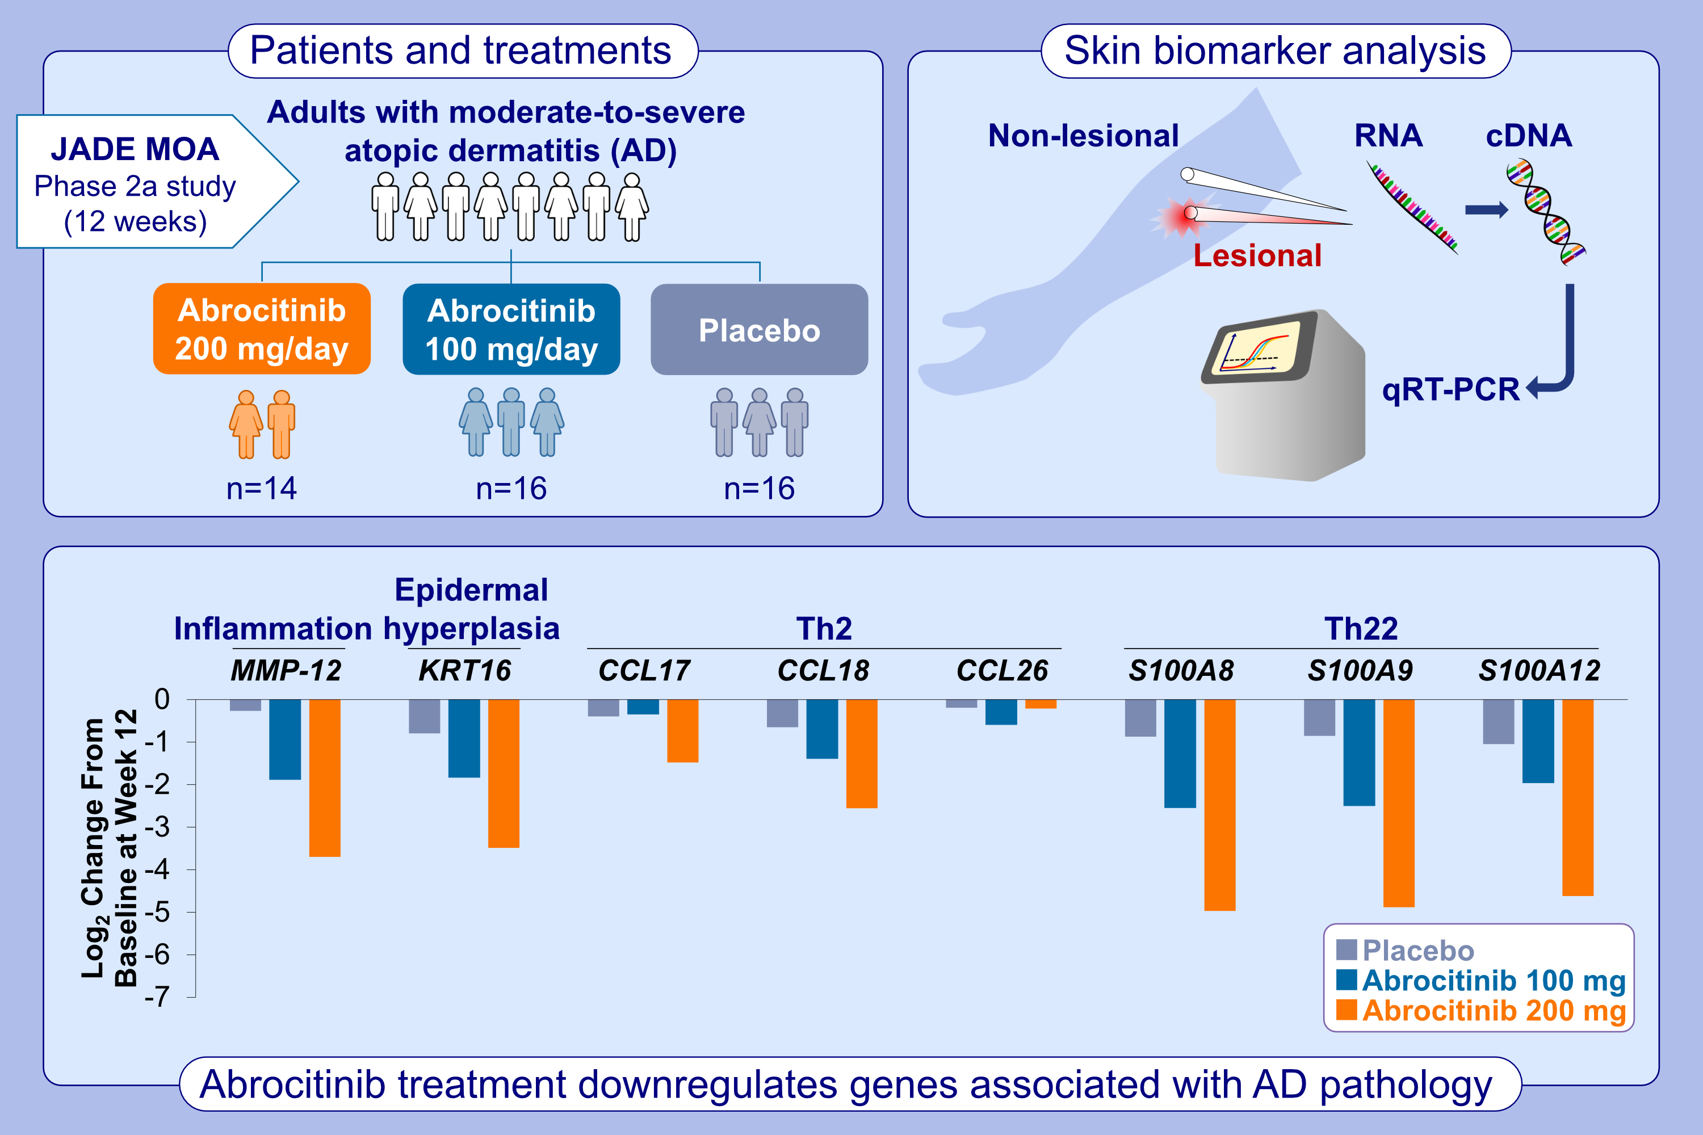
Effect of abrocitinib on skin biomarkers in patients with moderate-to-severe atopic dermatitis
Emma Guttman-Yassky, Paola Facheris, Pedro Jesus Gomez-Arias, Ester Del Duca, Joel Correa Da Rosa, et al.
Allergy. Pages: 1258-1270
https://doi.org/10.1111/all.15969
© 2019 EAACI and John Wiley and Sons A/S. Published by John Wiley and Sons Ltd.
Notes:
HIGHLIGHTS
• AD is characterized by skin barrier and immune abnormalities.
• We assessed treatment response biomarkers of disease activity in the skin of patients with moderate-to-severe AD who received 12 weeks of treatment with abrocitinib, a JAK1-selective inhibitor, or placebo.
• Markers of inflammation, epidermal hyperplasia, and Th2- and Th22-related immune responses, in skin lesions were significantly modulated with abrocitinib.

