Slide 1
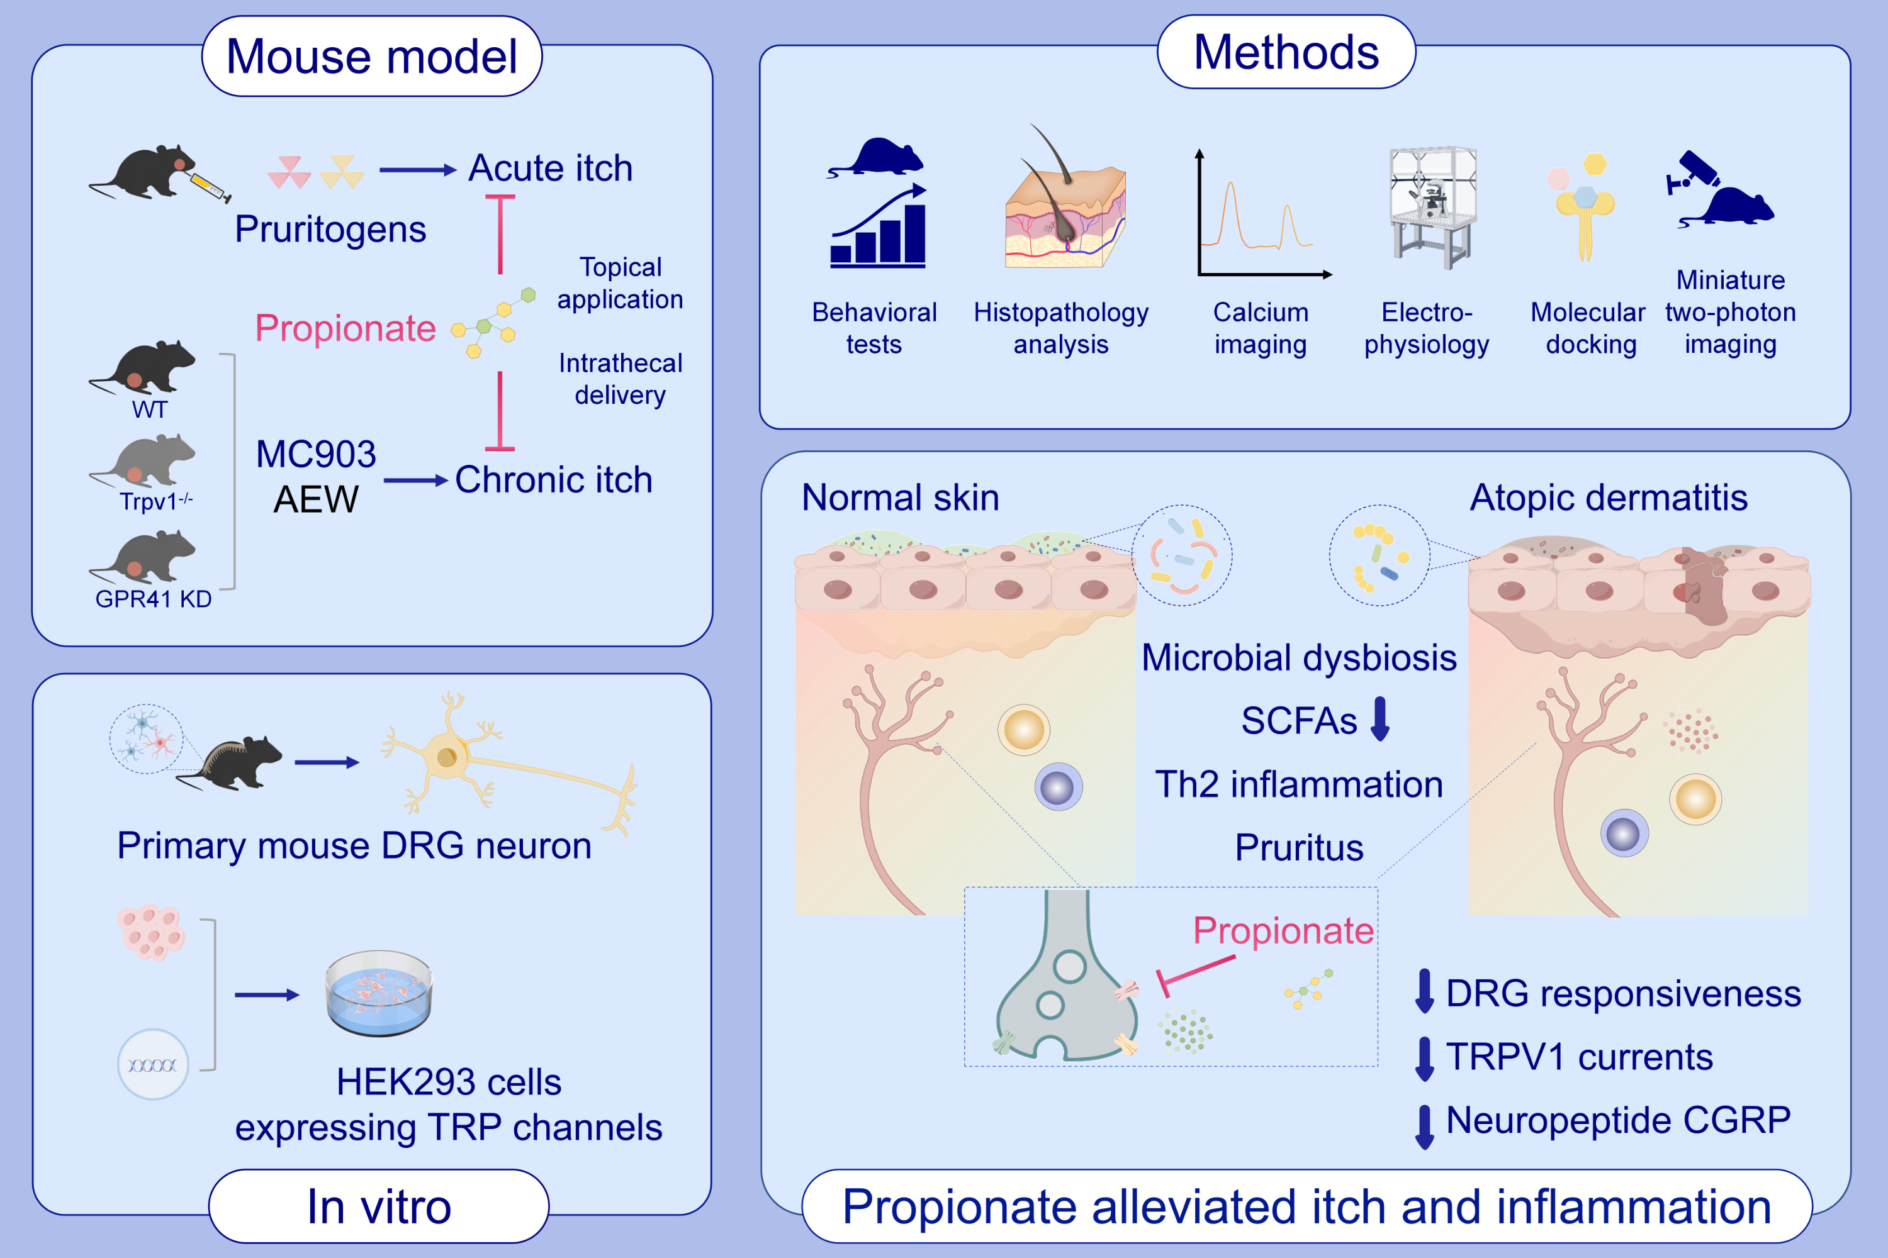
Propionate alleviates itch in murine models of atopic dermatitis by modulating sensory TRP channels of dorsal root ganglion
Yao Xu, Zhuoqiong Qiu, Chaoying Gu, Su Yu, Shangshang Wang, et al.
Allergy. Pages: 1271-1290
https://doi.org/10.1111/all.15998
© 2019 EAACI and John Wiley and Sons A/S. Published by John Wiley and Sons Ltd.
Notes:
HIGHLIGHTS
• Skin microbial metabolite propionate alleviates itch and skin inflammation.
• Propionate reduces the responsiveness of DRG neurons to pruritogens, directly modulates sensory TRP channels and inhibits the secretion of neuropeptide CGRP.
• Regulation of itch via the skin microbiome might be a novel strategy for the treatment of AD. .

