Slide 1
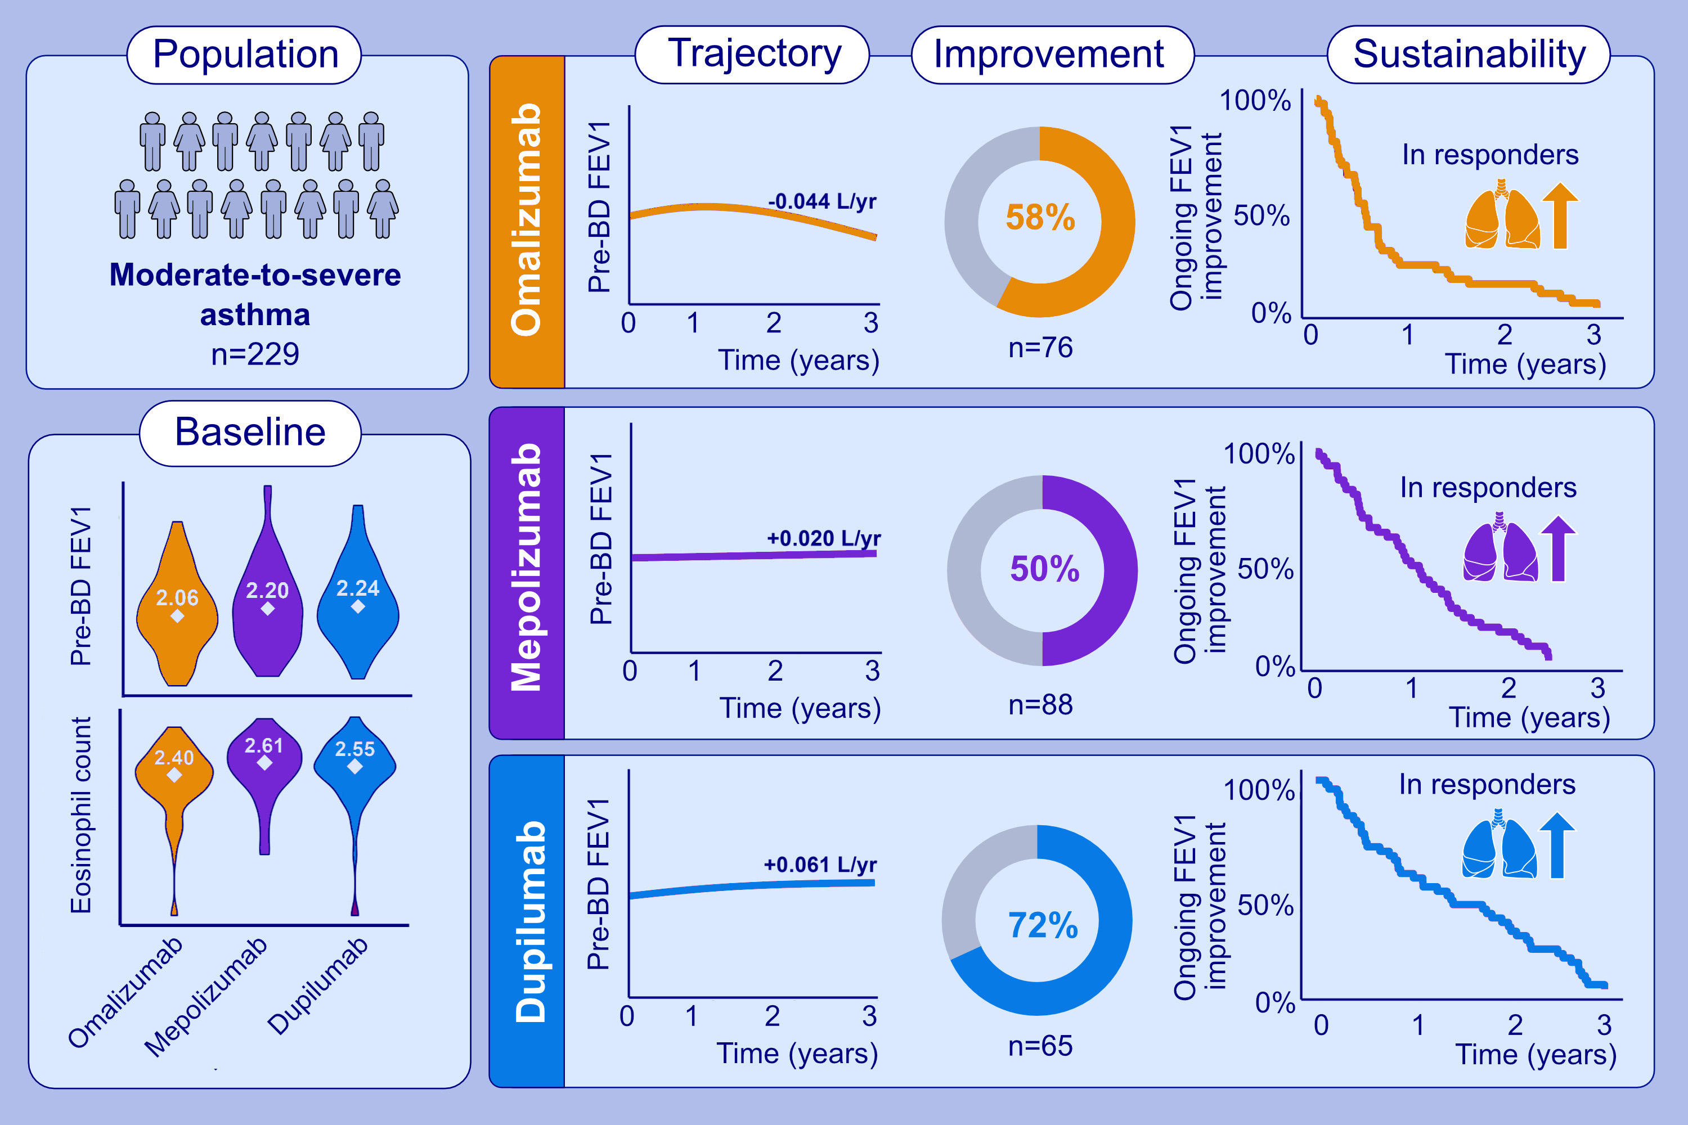
Lung function trajectories in a cohort of patients with moderate-to-severe asthma on mepolizumab, omalizumab, or dupilumab
Tanawin Nopsopon, Nora A. Barrett, Wanda Phipatanakul, Tanya M. Laidlaw, Scott T. Weiss, et al.
Allergy. Pages: 1195-1207
https://doi.org/10.1111/all.16002
© 2019 EAACI and John Wiley and Sons A/S. Published by John Wiley and Sons Ltd.
Notes:
HIGHLIGHTS
• This study evaluates the lung function trajectories of a cohort of patients with asthma receiving biologic therapy.
• Mepolizumab, omalizumab, and dupilumab improved the rate of FEV1 decline in 50-72% of patients with moderate-to-severe persistent asthma over 3 years post-initiation.
• Half of the patients who responded to omalizumab, mepolizumab, and dupilumab continued to experience an ongoing improvement in FEV1 up to and beyond 6-, 12-, and 14-months respectively.
.

