Slide 1
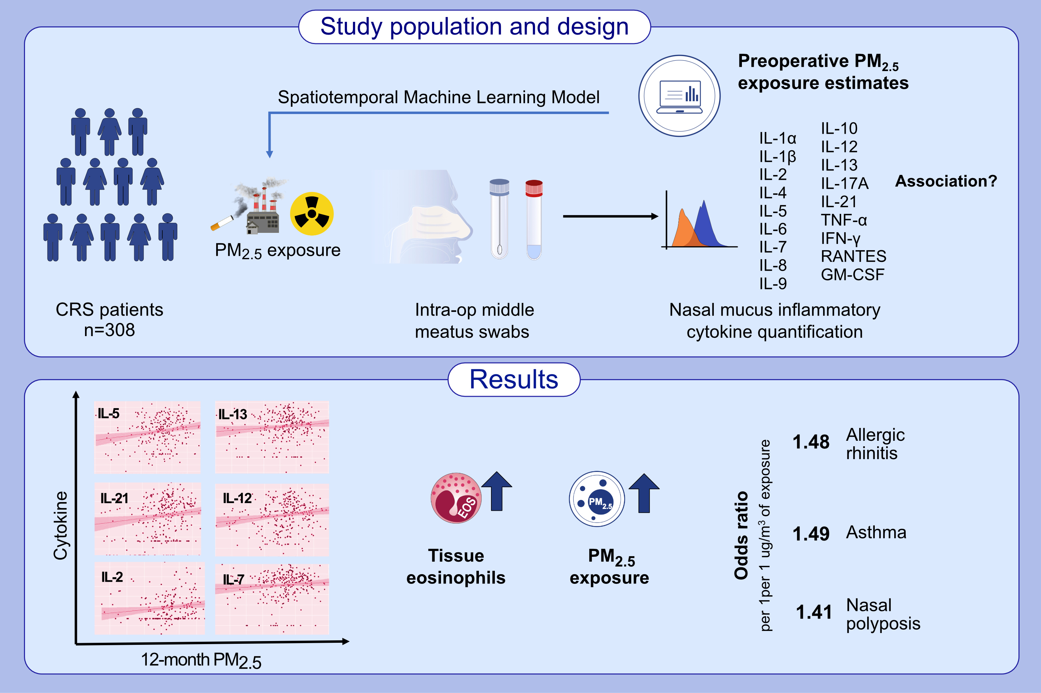
Particulate matter exposure is associated with increased inflammatory cytokines and eosinophils in chronic rhinosinusitis
Rory J. Lubner, Kolin Rubel, Rakesh K. Chandra, Justin H. Turner, Naweed I. Chowdhury et al.
Allergy. Pages: 1219-1229
https://doi.org/10.1111/all.16006
© 2019 EAACI and John Wiley and Sons A/S. Published by John Wiley and Sons Ltd.
Notes:
HIGHLIGHTS
• This study investigates relationships between inflammatory cytokine levels in nasal mucosa of patients with CRS patients and chronic PM2.5 exposures using a novel geospatial machine learning modelling approach.
• Several inflammatory cytokines including IL-2, IL-5/IL-13, IL-12, and 21 were significantly correlated with estimated average 6,9, and 12-month estimated preoperative PM2.5 levels, even after adjusting for age, income, body mass index, rurality, polyps, asthma, and allergic rhinitis.
• Chronic PM2.5 exposure may be an independent risk factor for development of a mixed, type-2 dominant CRS inflammatory response. .

