Slide 1
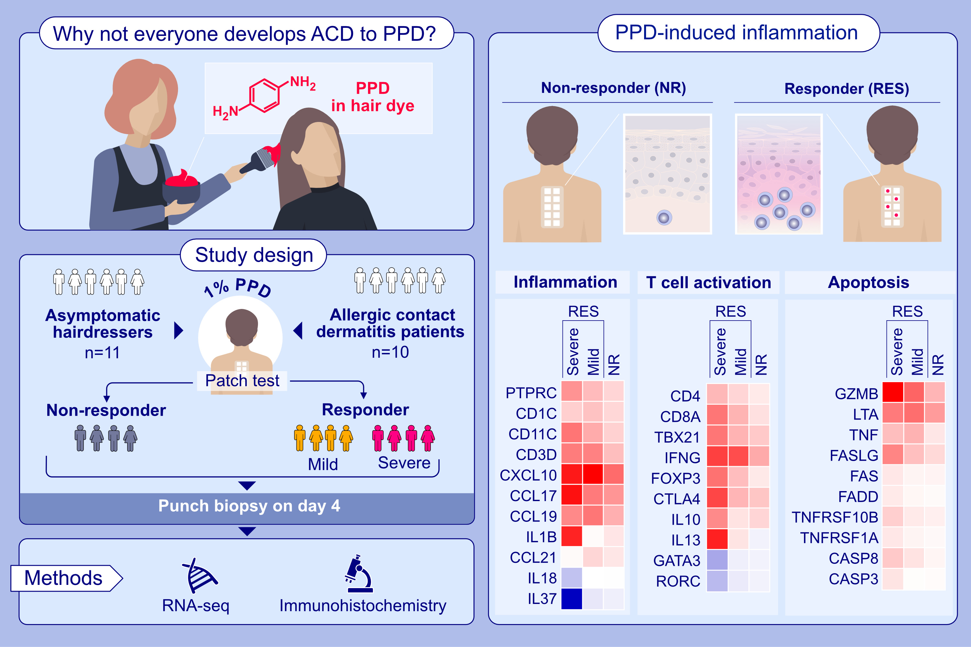
Regulation of immune response genes in the skin of allergic and clinically tolerant individuals exposed to p-phenylenediamine
Sanne S. Meisser, Yasutaka Mitamura, Can Altunbulakli, Josefine Bandier, Morten S. Opstrup, et al.
Allergy. Pages: 1291-1305
https://doi.org/10.1111/all.16031
© 2019 EAACI and John Wiley and Sons A/S. Published by John Wiley and Sons Ltd.
Notes:
HIGHLIGHTS
• T cell activation, inflammation and apoptosis pathways were up-regulated by PPD in both asymptomatic and allergic individuals.
• Individuals with a strong reaction to PPD strongly up-regulated both pro- and anti-inflammatory cytokines genes compared to asymptomatic individuals.
• The balance between inflammatory and anti-inflammatory mechanisms that determines whether a given individual develops allergy or tolerance to PPD.
.

