Slide 1
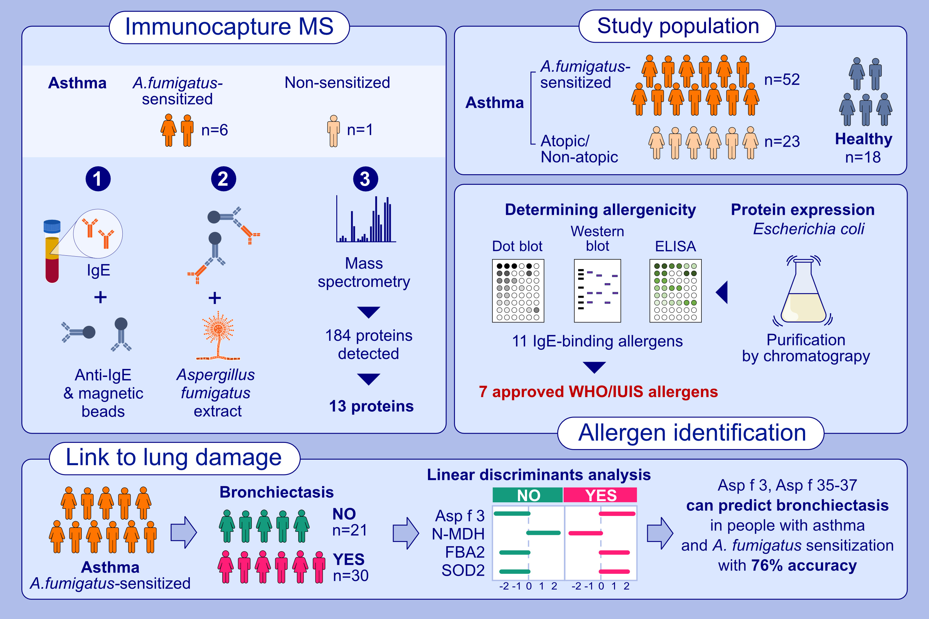
Identification of allergens from Aspergillus fumigatus—Potential association with lung damage in asthma
Eva-Maria Rick, Kerry Woolnough, Matthew Richardson, William Monteiro, Michelle Craner, et al.
Allergy. Pages: 1208-1218
https://doi.org/10.1111/all.16032
© 2019 EAACI and John Wiley and Sons A/S. Published by John Wiley and Sons Ltd.
Notes:
HIGHLIGHTS
• Immunoprecipitation combined with mass spectrometry was used to identify novel allergens from Aspergillus fumigatus.
• From 13 recombinantly expressed proteins, seven were approved by the WHO/IUIS.
• Three of them plus the known Asp f 3 were able to predict bronchiectasis in asthmatics with 76% accuracy in a linear discriminant analysis. .

