Slide 1
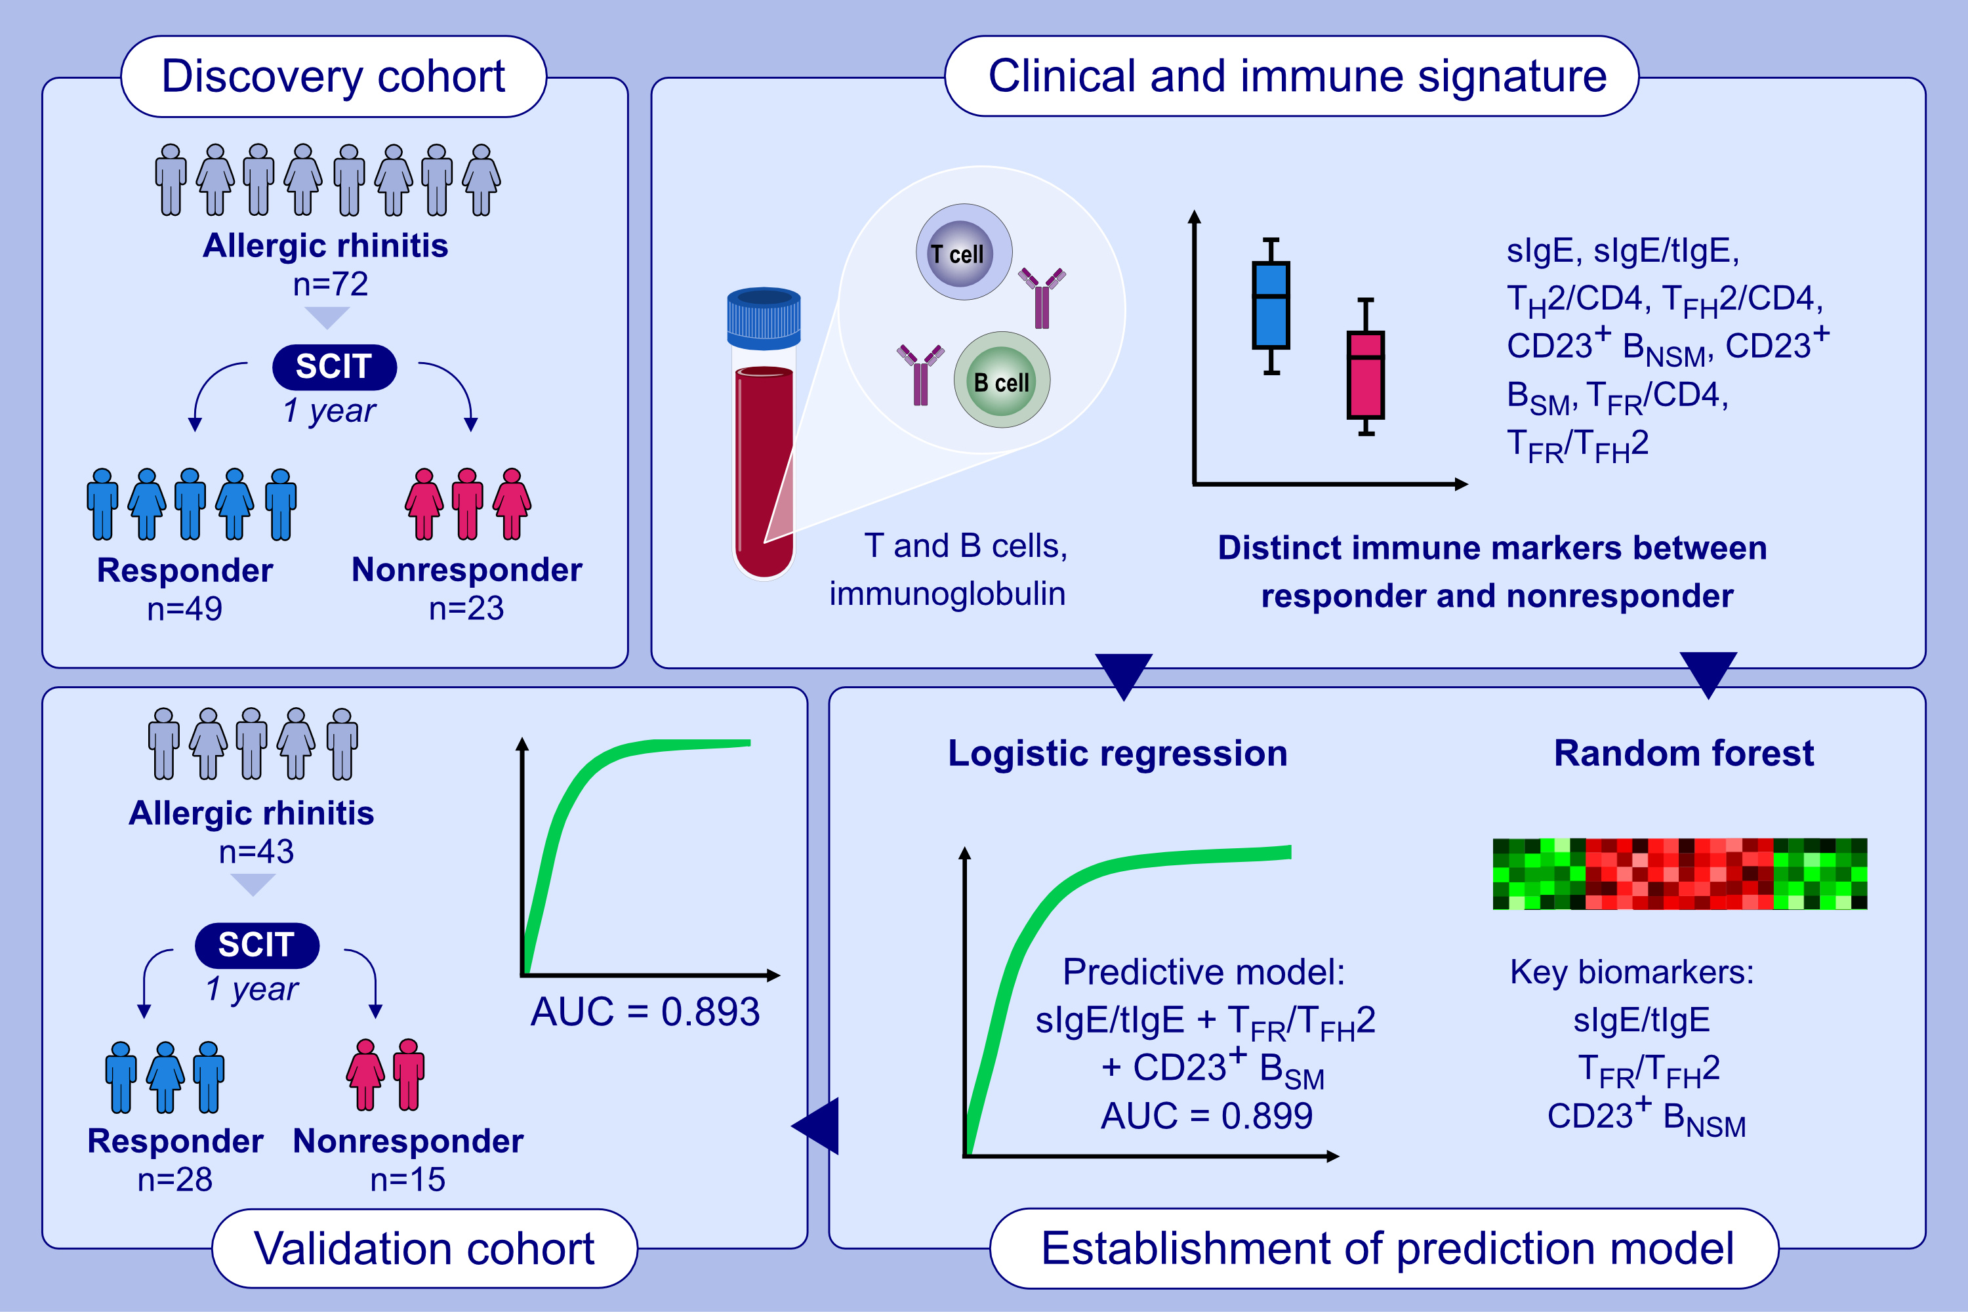
Immune signatures predict response to house dust mite subcutaneous immunotherapy in patients with allergic rhinitis
Nan Wang, Jia Song, Shi-Ran Sun, Ke-Zhang Zhu, Jing-Xian Li, et al.
Allergy. Pages: 1230-1241
https://doi.org/10.1111/all.16068
© 2019 EAACI and John Wiley and Sons A/S. Published by John Wiley and Sons Ltd.
Notes:
HIGHLIGHTS
• In AR patients undergoing HDM SCIT, distinct clinical and immune features are observed between responders and nonresponders prior to treatment.
• A model with combination of baseline sIgE/tIgE ratio, TFR/TFH2 cell ratio, and CD23+ BSM frequency exhibits a strong predictive value for SCIT efficacy, as evidenced by a 12-month post-treatment assessment.
• The efficacy of this model is validated in an independent cohort. .

